Slide 1




ACM-SIAM Symposium on Discrete Algorithms (SODA26)
PageRank Centrality in Directed Graphs
with Bounded In-Degree
Mikkel Thorup, Hanzhi Wang (BARC, University of Copenhagen),
Zhewei Wei, Mingji Yang (Renmin University of China)
13 January 2026
Notes:
Good morning everyone, I am Hanzhi Wang, currently an assistant professor at the University of Melbourne. The paper I am going to present was a collaboration with Prof. Mikkel Thorup when I was a postdoc at BARC, University of Copenhagen. Other collaborators include Prof. Zhewei Wei, who is my PhD advisor, and Mingji Yang, both from Renmin University of China.

Slide 2
Outline
Random-Walk Probability Estimation
1
Problem Formulations
2
Prior Work and Our Results
3
Techniques
4
Conclusions
Notes:
In this paper, we consider the problem of random-walk probability estimation on graphs

Slide 3





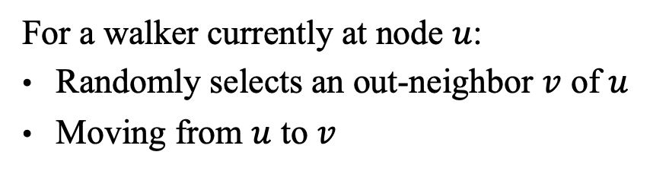


Random Walks on Graphs
10
9
12
2
1
8
3
11
$$1/3$$
$$1/3$$
4
$$1/4$$
$$1/3$$
$$1/4$$
For a walker currently at node $u$:
Randomly selects an out-neighbor $v$ of $u$
Moving from $u$ to $v$
6
5
$$1/4$$
$$1/4$$
7
Notes:
A random-walk on graph is a Markovian process. Intuitively, we can imagine there is a walker (click!) moving on the graph. At each step, the walker uniformly chooses one out-neighbor of its current node and moves to the chosen neighbor in the next step.

Slide 4




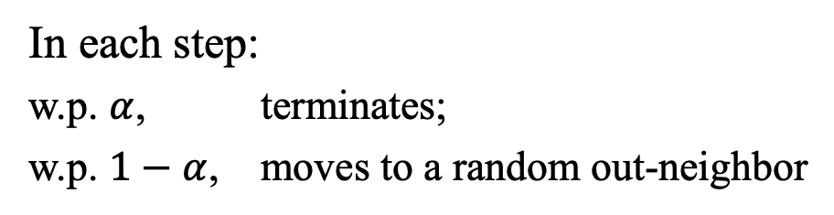
$α$-Discounted Random Walks ($α$-Walks) and PPR
$π\left(s,t\right)=$ Pr{$α$-walk from node $s$ terminates at $t$}
known as Personalized PageRank (PPR) of $t$ to $s$
10
9
12
2
1
8
3
11
$$α$$
4
Damping Factor $α∈(0,1)$
$$1−α$$
6
In each step:
w.p. $α$, terminates;
w.p. $1−α$, moves to a random out-neighbor
5
$$1−α$$
7
Notes:
In our paper, we focus on a special type of random walks, known as \alpha-discounted random walks, or \alpha-walks for short. It introduces a damping factor \alpha, which is a constant in the range of 0 and 1. At each step, (click!) the \alpha-walk terminates with probability \alpha, and with the remaining 1-\alpha probability, it moves to a uniformly random out-neighbor. We use \pi(s,t) to denote the probability of an \alpha-walk from a node s terminating at a node t. (click!) This \pi(s,t) is also known as Personalized PageRank of node t to node s, or for short, the PPR value of node t to node s.

Slide 5
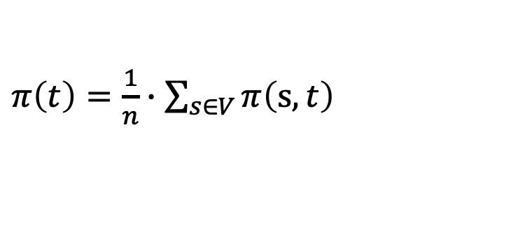


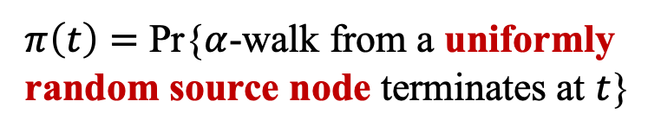


PageRank
Uniformly Sampling a Source Node …
10
10
9
9
12
12
2
2
8
1
8
1
11
3
11
3
$$α$$
4
4
Node $t$’s PageRank centrality
$$1−α$$
$$1−α$$
6
6
5
$π\left(t\right)=$ Pr{$α$-walk from a uniformly random source node terminates at $t$}
5
Sampled!
7
$π\left(t\right)=\frac{1}{n}∙\sum_{s∈V}{π\left(s,t\right)}$
7
Notes:
The reason that this pi(s,t) is called Personalized PageRank, it is because it's a variant of the well-known PageRank centrality. For a node t’s PageRank, it is equal to the probability of an \alpha walk, (click!) starting from a uniformly random source node terminates at t. We use pi(t) here to denote the PageRank of t. By definition, (click!) \pi(t) is the average of \pi(s,t) over all possible s in the graph.

Slide 6
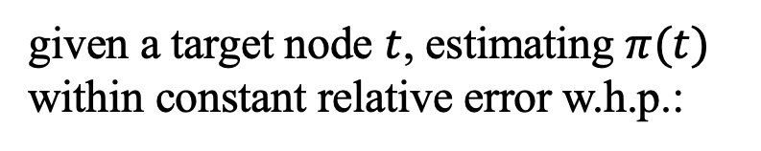


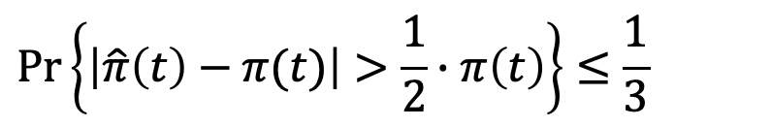
Problem Formulation
Single-Node PageRank Estimation on Directed Graphs
Given a
Target Node
Estimating $π(t)$
$$t$$
goal:
given a target node $t$, estimating $π(t)$ within constant relative error w.h.p.:
Uniformly Sampled Source Node
$$\operatorname{Pr}\left\{\left|\hat{π}\left(t\right)−π(t)\right|>\frac{1}{2}∙π\left(t\right)\right\}≤\frac{1}{3}$$
Notes:
In this paper, we focus on the problem of estimating a single node’s pagerank. Specifically, we are given a target node t in the graph, and aim to estimate the value of \pi(t) within a constant relative error with constant probability.

Slide 7





Graph Access Model
$$u$$
$$v$$
Indeg ($u$): return the in-degree of $u$
Uniformly
Sampled!
Outdeg ($u$): return the out-degree of $u$
InNbr ($u,i$): return the $i_{th}$ in-neighbor of $u$
OutNbr ($u,i$): return the $i_{th}$ out-neighbor of $u$
Jump (): return a uniformly sampled node
Notes:
We consider the canonical graph access model in this paper, which supports five types of graph queries, including the one of returning a node in-degree, the one of returning a node’s out-degree, the one of returning a node’s one in-neighbor, or out-neighbor; and another important query: the jump() query, which returns a uniformly sampled node.

Slide 8
Outline
1
Problem Formulations
2
Prior Work and Our Results
3
Techniques
4
Conclusions
Notes:
For the problem of estimating a single node's pagerank,

Slide 9


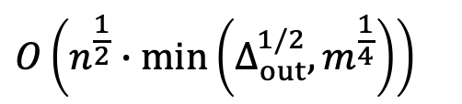
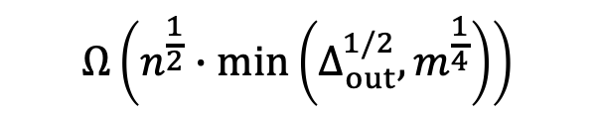
Prior Work
    max out-degree
Optimal Algorithm Parameterized by $n$, $m$, $Δ_{out}$
Prior Work
[Wang, Wei, Wen, Yang, STOC 2024]
Upper Bound
$$O\left(n^{\frac{1}{2}}∙\min\left(Δ_{out}^{1/2},m^{\frac{1}{4}}\right)\right)$$
    match
$$Ω\left(n^{\frac{1}{2}}∙\min\left(Δ_{out}^{1/2}, m^{\frac{1}{4}}\right)\right)$$
Lower Bound
    $n, m$: # of nodes/edges
    ${Δ_{out}}_{ }$: maximum out-degree
Notes:
the previously best bound was given in 2024, which establishes matching upper and lower bounds for this problem. Here, n is the number of nodes in the graph, m is the number of edges, and \Delta_out is the maximum out-degree. So it seems that this problem has been well solved? What are we talking about here?

Slide 10




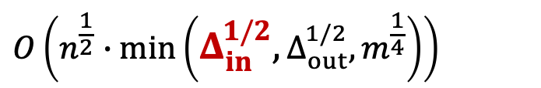

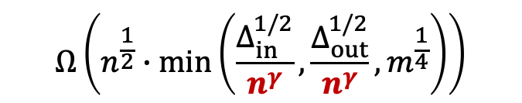


Prior Work
    max in-degree
Theoretical Gaps under Parameterizations by $n$, $m$, $Δ_{out}$, $Δ_{in}$
Prior Work
[Wang, Wei, Wen, Yang, STOC 2024]
Prior Work [Wang, Wei, Wen, Yang, STOC 2024]
Upper Bound
$$O\left(n^{\frac{1}{2}}∙\min\left(Δ_{out}^{1/2},m^{\frac{1}{4}}\right)\right)$$
$$O\left(n^{\frac{1}{2}}∙\min\left(Δ_{in}^{1/2},Δ_{out}^{1/2},m^{\frac{1}{4}}\right)\right)$$
$$Ω\left(n^{\frac{1}{2}}∙\min\left(Δ_{out}^{1/2}, m^{\frac{1}{4}}\right)\right)$$
    theoretical gap when $Δ_{in}=o(n)$
when $α=1/2, ∆_{in}=2$, $O\left(n^{1/2}\right)$ v.s. $Ω\left(1\right)$
$$Ω\left(n^{\frac{1}{2}}∙\min\left(\frac{Δ_{in}^{1/2}}{n^{γ}},\frac{Δ_{out}^{1/2}}{n^{γ}}, m^{\frac{1}{4}}\right)\right)$$
$\frac{\log{(1/(1−α))}}{4\log{∆_{in}}−2\log{(1/(1−α))}}$, if $∆_{in}>1/(1−α)$
Lower Bound
$$γ=$$
$1/2$, if $∆_{in}≤1/(1−α)$
    $n, m$: # of nodes/edges
    ${Δ_{in}, Δ_{out}}_{ }$: maximum in-/out-degree
    $α_{ }$: damping factor of PageRank
Notes:
The interesting thing is that, in the same paper, they point out that when we parameterize the problem by n, m, Deltaout and Deltain, where Deltain is the maximum in-degree, the lower bound would be smaller. There will be a n^\gamma factor in the denominator. The value of \gamma is determined by \Deltain, the maximum of indegree and the damping factor \alpha. When Deltain is asymptotically smaller than n, there is a theoretical gap between the upper and lower bound. An extreme case is when \Deltain is only 2, and the damping factor \alpha is ½, then the lower bound becomes a trivial bound \Omega(1), while the upper bound remains O(\sqrt{n}). Could you guess that which bound is correct? Should the beautiful, elegant, clean upper bound is the correct bound and we need to improve the lower bound? Or actually the ugly, complicated bound is the truth.

Slide 11
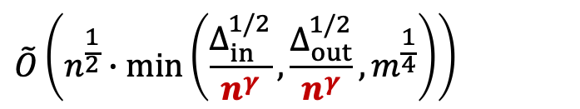
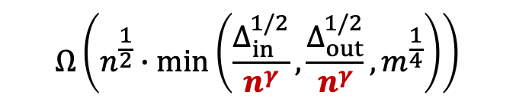
Our Contributions
    max in-degree
Optimal Bounds under Parameterizations by $n$, $m$, $Δ_{out}$, $Δ_{in}$
Prior Work
[Wang, Wei, Wen, Yang, STOC 2024]
Our Results
Upper Bound
$$O\left(n^{\frac{1}{2}}∙\min\left(Δ_{out}^{1/2},m^{\frac{1}{4}}\right)\right)$$
$$Ω\left(n^{\frac{1}{2}}∙\min\left(Δ_{out}^{1/2}, m^{\frac{1}{4}}\right)\right)$$
$$\tilde{O}\left(n^{\frac{1}{2}}∙\min\left(\frac{Δ_{in}^{1/2}}{n^{γ}},\frac{Δ_{out}^{1/2}}{n^{γ}}, m^{\frac{1}{4}}\right)\right)$$
    match
$$Ω\left(n^{\frac{1}{2}}∙\min\left(\frac{Δ_{in}^{1/2}}{n^{γ}},\frac{Δ_{out}^{1/2}}{n^{γ}}, m^{\frac{1}{4}}\right)\right)$$
$\frac{\log{(1/(1−α))}}{4\log{∆_{in}}−2\log{(1/(1−α))}}$, if $∆_{in}>1/(1−α)$
Lower Bound
$$γ=$$
$1/2$, if $∆_{in}≤1/(1−α)$
    $n, m$: # of nodes/edges
    ${Δ_{in}, Δ_{out}}_{ }$: maximum in-/out-degree
    $α_{ }$: damping factor of PageRank
Notes:
In our paper, we prove that the lower bound is the correct one if we know Deltain in advance. We prove this by improving the upper bound to match the lower bound. So the world is indeed a mess.

Slide 12
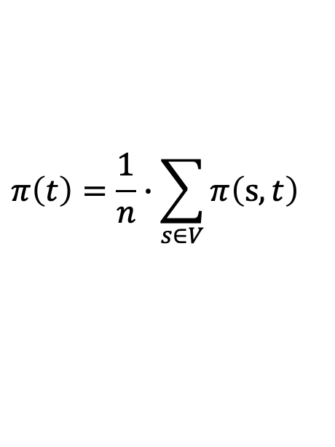


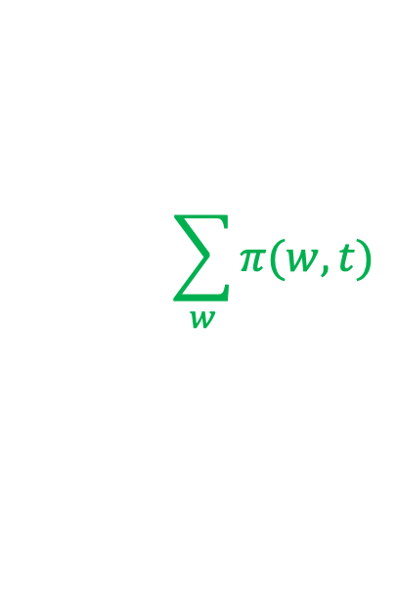






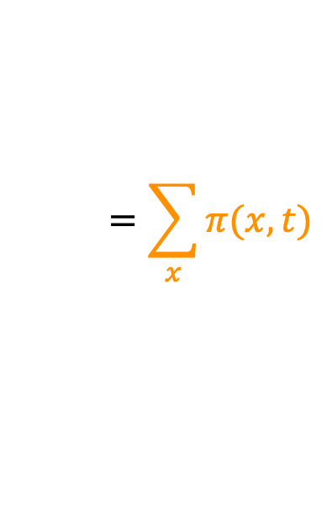

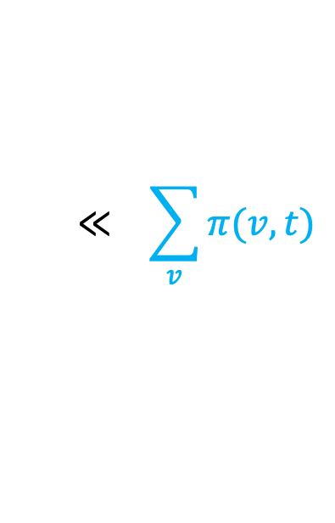

Constructing lower bound of $Ω\left(n^{\frac{1}{2}}∙min⁡\{∆_{out}^{1/2}, m^{\frac{1}{4}}\}\right)$
$$π\left(t\right)=\frac{1}{n}∙\sum_{s∈V}{π\left(s,t\right)}$$
$$\sum_{w}{π(w,t)}$$
$$≪ \sum_{v}{π(v,t)}$$
$$=\sum_{x}{π(x,t)}$$
$=\#$ of $v$ nodes
$=\#$ of $x$ nodes
using the Jump() query
$$x_{1}$$
$$x_{2}$$
$$w_{1}$$
$$w_{2}$$
$$u$$
$$v_{1}$$
$$v_{2}$$
$$t$$
    $n, m$: # of nodes/edges
    ${Δ_{in}, Δ_{out}}_{ }$: maximum in-/out-degree
    $α_{ }$: damping factor of PageRank
Notes:
We can understand the difference between the lower bounds with and without a promise on Deltain by considering the hard instance construction for the lower bounds. This is the hard instance we construct for proving the lower bound when we don’t have a promise on Deltain. Recall that the pagerank of t is the average over all pi(s,t). In this graph, \pi(t) is dominated by the summation of all \pi(v,t) for these blue node v, and the summation of all \pi(x,t) for these yellow node x, since these green nodes their out-degree is very large, so the probability of an alpha-walk moving from these green node to t is much smaller than the probability of random-walks moving from these blud nodes or these yellow nodes to t. In particular, in this graph, the summation of \pi(v,t) is asymptotically equal to the summation of \pi(x,t).
So an algorithm which can accurately estimate \pi(t) must identify the existence of these blue nodes and these yellow nodes. Identifying the existence of these blud nodes is easy, since they are the neighbors of the given target node t, but realizing there exist these yellow nodes is hard. By using the queries allowed by the graph access model, the algorithm either scan all these blue edges to touch the node u, then by checking the degree of u it can check if there is this yellow structure on u, or the algorithm can use the jump query to jump to one of these yellow nodes. Then it can also detect the existence of this yellow structure. The lower bound corresponds to the setting when the time of scaning all blue edges to find u and the expected time of jumping to one yellow node identical to each other. This gives the lower bound on the time complexity in the worst-case.

Slide 13












Constructing lower bound of $Ω\left(n^{\frac{1}{2}}∙\min\left(\frac{Δ_{in}^{1/2}}{n^{γ}},\frac{Δ_{out}^{1/2}}{n^{γ}}, m^{\frac{1}{4}}\right)\right)$
$$\sum_{v}{π(v,t)}$$
$$= \sum_{x}{π(x,t)}$$
$$=\#v∙{(1−α)}^{ℓ_{v}}$$
$$=\#x∙{(1−α)}^{ℓ_{v}+ℓ_{x}}$$
$$x_{1}$$
$$x_{2}$$
$$ℓ_{x}$$
$$v_{1}$$
$$v_{2}$$
$$u$$
$$ℓ_{v}$$
$$t$$
    $n, m$: # of nodes/edges
    ${Δ_{in}, Δ_{out}}_{ }$: maximum in-/out-degree
    $α_{ }$: damping factor of PageRank
Notes:
But when we have a bound on maximum in-degree. We can not construct a node with a large in-degree. We can only put a multi-level structure on node t and node u to increase the number of blud nodes and yellow nodes.

Slide 14
Outline
1
Problem Formulations
2
Prior Work and Our Results
3
Techniques
4
Conclusions

Slide 15
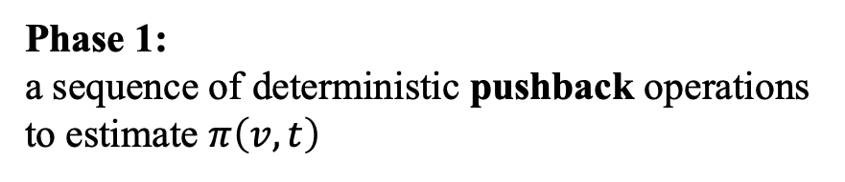

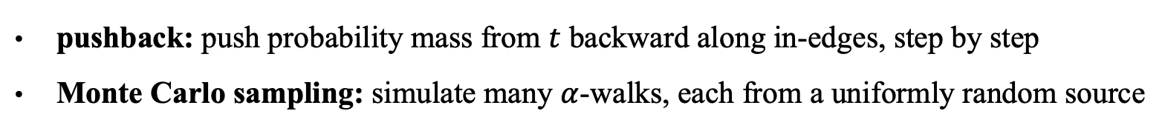












Challenges in Prior Work
pushback: push probability mass from $t$ backward along in-edges, step by step
Monte Carlo sampling: simulate many $α$-walks, each from a uniformly random source
$$x_{1}$$
$$x_{2}$$
Challenge: $α$-walks terminate in mid way
$$ℓ_{x}$$
Phase 2:
Monte Carlo simulation to estimate
$≈$
$$π\left(u\right)$$
# of $α$-walks terminates at $u$
# of $α$-walks generated in total
$$v_{1}$$
$$v_{2}$$
$$u$$
Challenge:
pushback process takes too much time
$$ℓ_{v}$$
Phase 1:
a sequence of deterministic pushback operations to estimate $π\left(v,t\right)$
$$t$$

Slide 16


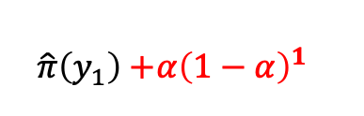





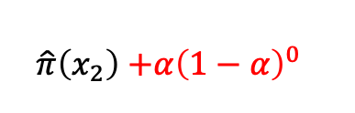



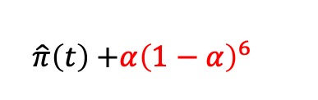





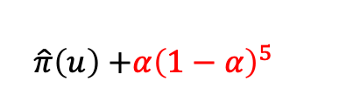





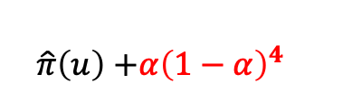

Our Algorithm
Phase 1: non-terminating Monte Carlo
finds all $u$ with $\hat{π}(u)≥ε$.
Phase 2: pushback from $t$: stop pushback if $\hat{π}(u)≥ε$
randomized rounding if $r(v,t)<r_{max}$
$\hat{π}\left(x_{2}\right)$ $+{α\left(1−α\right)}^{0}$
$$x_{1}$$
$$x_{2}$$
$\hat{π}\left(y_{1}\right)$ $+{α\left(1−α\right)}^{1}$
$$y_{1}$$
$\hat{π}\left(y_{2}\right)$ $+{α\left(1−α\right)}^{2}$
$$y_{2}$$
$\hat{π}\left(y_{3}\right)$ $+{α\left(1−α\right)}^{3}$
$$y_{3}$$
Monte Carlo finds all $\hat{π}(u)≥ε$.
$\hat{π}\left(u\right)$ $+{α\left(1−α\right)}^{4}$
STOP pushback on all these large $u$
Sample!
$$v_{1}$$
$$v_{2}$$
$$u$$
$\hat{π}\left(u\right)$ $+{α\left(1−α\right)}^{5}$
$r_{max}$,
w.p. $r(v,t)/r_{max}$
$$ℓ_{v}$$
$$y_{5}$$
$$r(v,t)=$$
$\hat{π}\left(t\right)$ $+{α\left(1−α\right)}^{6}$
$$t$$
$0$,
w.p. $1−r(v,t)/r_{max}$

Slide 17
Outline
1
Problem Formulations
2
Prior Work and Our Results
3
Techniques
4
Conclusions

Slide 18
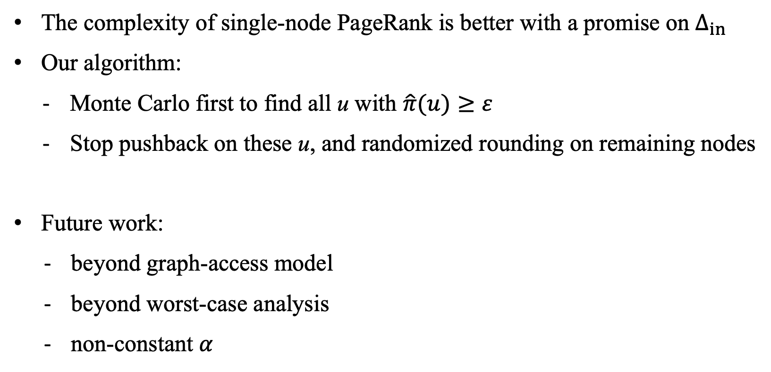
Conclusions
The complexity of single-node PageRank is better with a promise on $∆_{in}$
Our algorithm:
  Monte Carlo first to find all u with $\hat{π}(u)≥ε$
  Stop pushback on these u, and randomized rounding on remaining nodes
Future work:
  beyond graph-access model
  beyond worst-case analysis
  non-constant $α$

Slide 19
Thanks and QA!

