Slide 1


Optimal Dynamic Subset Sampling:
Theory and Applications
Lu Yi, Hanzhi Wang, Zhewei Wei
Renmin University of China
Contact: zhewei@ruc.edu.cn
Notes:
Hello, everyone. I’m Lu Yi, and today I'll be presenting my work, "Optimal Dynamic 'Subset Sampling: Theory and Applications.”This work is collaborated with Hanzhi Wang and my supervisor, zhewei Wei from Renmin University of China. @@

Slide 2








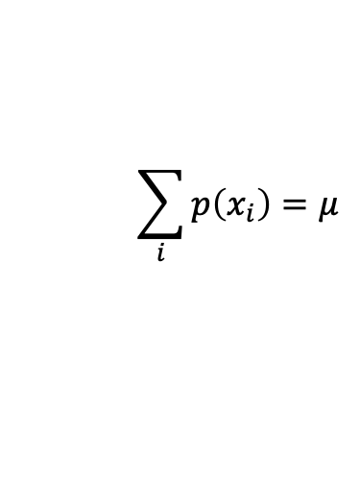




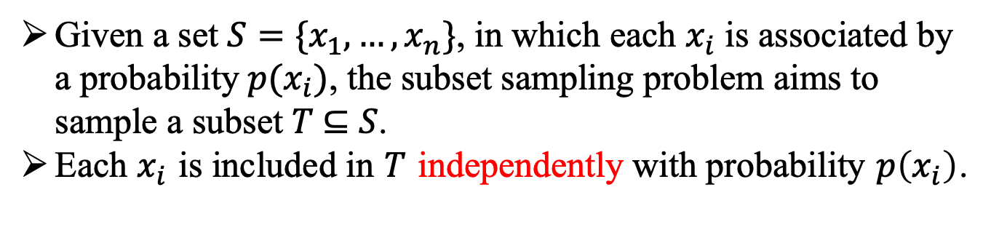


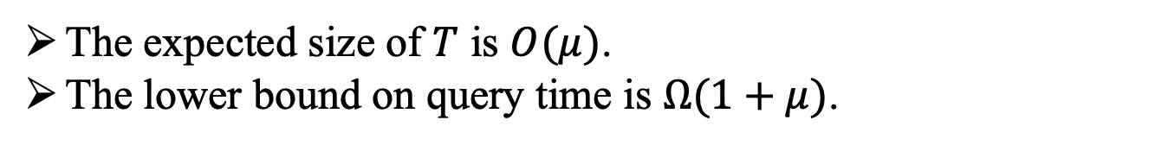
Subset Sampling
Given a set $S=\{x_{1},…,x_{n}\}$, in which each $x_{i}$ is associated by a probability $p(x_{i})$, the subset sampling problem aims to sample a subset 𝑇 ⊆ 𝑆.
Each $x_{i}$ is included in $T$ independently with probability $p\left(x_{i}\right)$.
domain set S
sample result $T⊆S$
$${ x}_{1}$$
$${ x}_{2}$$
$${ x}_{3}$$
$${ x}_{4}$$
$$…$$
$${ x}_{n}$$
query
$${ x}_{1}$$
$$p(x_{1})$$
$$p(x_{2})$$
$$p(x_{3})$$
$$p(x_{4})$$
$$p(x_{n})$$
$$x_{4}$$
$$\sum_{i}{p\left(x_{i}\right)=μ}$$
The expected size of $T$ is $O(μ)$.
The lower bound on query time is $Ω(1+μ)$.
Notes:
Subset sampling is such a problem: given a domain set S@@, which includes n distinct events from x one to x n, the subset sampling problem return@@ a subset of S, denoted as T. Each event x i@@ is included in T independently with probability p(x i). We denote the sum@@ of probabilities as \mu. SO the expected@@ size of T is O(\mu) and thus the lower bound of the query time is @@\Omega one plus \mu since any algorithm needs Omega \mu time to output the result T. @@

Slide 3















Dynamic Subset Sampling
The events and the probabilities change over time
  Insert an event
  Delete an event
  Modify the probability of an event
$${ x}_{n+1}$$
$$p(x_{n+1})$$
domain set S
$${ x}_{1}$$
$${ x}_{2}$$
$${ x}_{3}$$
$${ x}_{4}$$
$$…$$
$${ x}_{n}$$
$$p(x_{1})$$
$$p(x_{2})$$
$$p(x_{3})$$
$$p(x_{4})$$
$$p(x_{n})$$
$$p(x_{n+1})$$
$$p′(x_{2})$$
Notes:
In a dynamic subset sampling problem, the events@@ in the domain set and the probabilities of the events will change. There are three kinds of update operations: insert@@ an events, delete@@ an event, and modify the probability of an event.

Slide 4


















Applications of Dynamic Subset Sampling
Dynamic Influence Maximization
Approximate Graph Propagation
Computational Epidemiology
Fractional (bipartite) matching
$0.4$
$0.3$
$0.1$
$0.4$
$0.1$
$0.1$
$0.6$
$0.1$
$0.1$
$0.4$
$0.3$
$0.5$
$0.1$
$0.1$
$0.3$
$0.1$
Dynamic Influence Maximization
Notes:
Various applications are in dire need of efficient ‘subset sampling techniques, especially of .the implementations in a dynamic setting. For example, in a dynamic influence maximization problem, we use subset sampling to sample the neighbors of an active node. Other applications includes approximate graph propagation, computational epidemiology, and fractional matching.

Slide 5


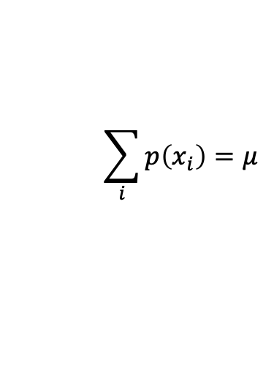



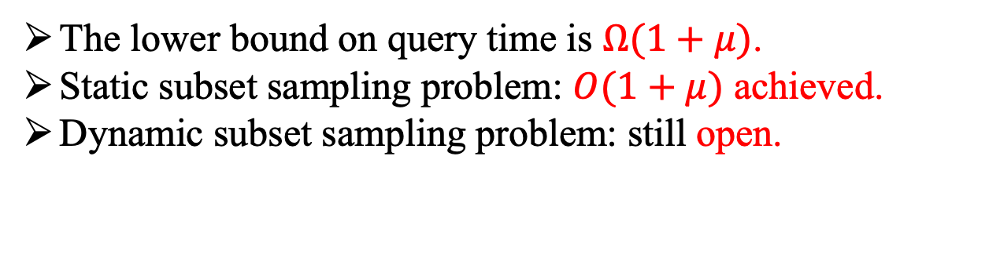
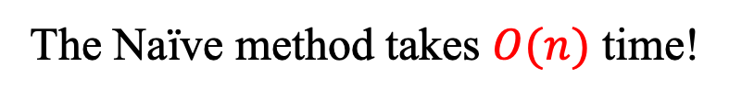
Naïve Method for Subset Sampling
The Naïve method takes $O(n)$ time!
$rand(0,1)<p\left(x_{2}\right)?$
$rand(0,1)<p\left(x_{1}\right)?$
YES!
NO!
domain set S
sample result T
$${ x}_{1}$$
$${ x}_{2}$$
$${ x}_{3}$$
$${ x}_{4}$$
$$…$$
$${ x}_{n}$$
subset sampling
$${ x}_{1}$$
$$p(x_{1})$$
$$p(x_{2})$$
$$p(x_{3})$$
$$p(x_{4})$$
$$p(x_{n})$$
$$x_{4}$$
$$\sum_{i}{p\left(x_{i}\right)=μ}$$
The lower bound on query time is $Ω(1+μ)$.
Static subset sampling problem: $O(1+μ)$ achieved.
Dynamic subset sampling problem: still open.
Notes:
How can we solve the subset sampling problem? The naive way is to generate@@ a uniform random number for each x_i, and check whether the number is less than p(x_i). If yes,@@ sample the event@@, else@@, do not sample it. It takes O(n) time@@.
.The existing work has achieved@@ O(one plus \mu) time in the static ‘subset sampling problem. However, when it comes to a dynamic setting, the problem is still open.

Slide 6


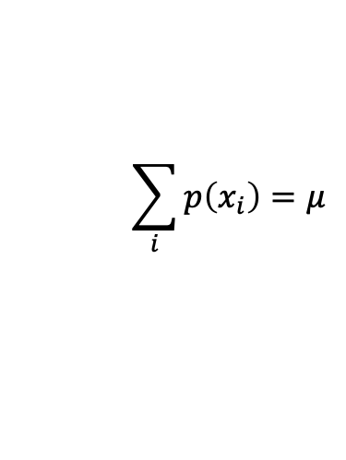




Optimal Dynamic Subset Sampling(ODSS)
domain set S
sample result $T⊆S$
$${ x}_{1}$$
$${ x}_{2}$$
$${ x}_{3}$$
$${ x}_{4}$$
$$…$$
$${ x}_{n}$$
$${ x}_{1}$$
$$p(x_{1})$$
$$p(x_{2})$$
$$p(x_{3})$$
$$p(x_{4})$$
$$p(x_{n})$$
$O\left(1+μ\right)$ per query
$$x_{4}$$
$$\sum_{i}{p\left(x_{i}\right)=μ}$$
Insert an element
Delete an element
Modify the probability of an element
$O\left(1\right)$ per update
Our contribution: achieve both optimality in query and update.
Notes:
In our work, we propose an optimal dynamic subset sampling algorithm, called ODSS, achieving@@ O(one plus \mu) query time and@@ O one update time. That is, we achieve@@ both optimality in query and update. In the following, we will present the details of our proposed algorithm ODSS.

Slide 7












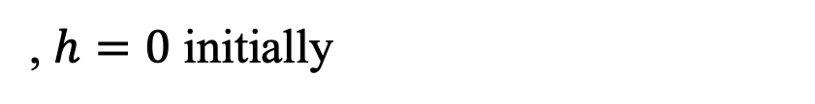


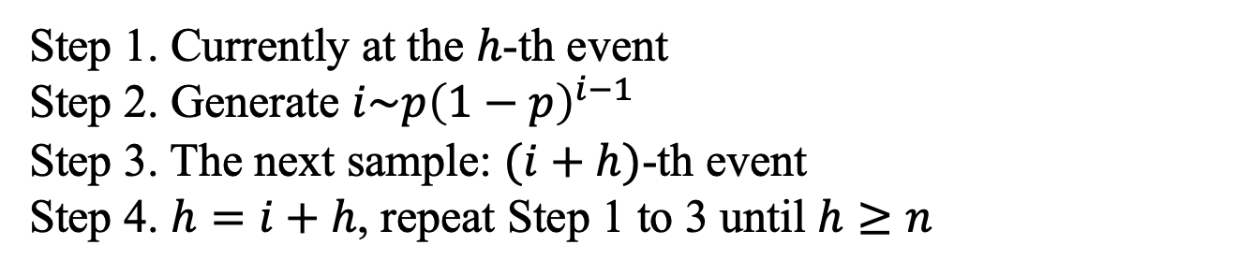
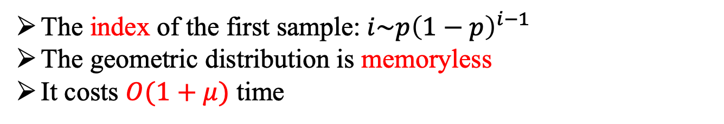

A Simple Case
domain set S
$$p$$
$$p$$
$$p$$
$$p$$
$$p$$
$$p$$
$$p$$
$${ x}_{1}$$
$${ x}_{2}$$
$${ x}_{3}$$
$${ x}_{4}$$
$${ x}_{5}$$
$${ x}_{6}$$
$${ x}_{7}$$
$$h=2$$
$$i=3$$
Sample $h+i=5$
$$h=5$$
The index of the first sample: $i\sim p{\left(1−p\right)}^{i−1}$
The geometric distribution is memoryless
It costs $O(1+μ)$ time
Step 1. Currently at the $h$-th event
Step 2. Generate $i\sim p{\left(1−p\right)}^{i−1}$
Step 3. The next sample: $(i+h)$-th event
Step 4. $h=i+h$, repeat Step 1 to 3 until $h≥n$
, $h=0$ initially
Notes:
Let’s start with a simple case. Each event has the same@@ probability. How can we get the first sampled event?
To get the first one, we fail to sample the events before the first one and successfully sample it. Therefore, the index of the first sample@@ follows the geometric distribution with parameter p. Since the geometric@@ distribution is memoryless, we can obtain the index of the second sample by generating geometric random number in the remainder of the group. Suppose that we are at@@ .the h-th element currently, h equals two, we generate a @@geometric random number i with parameter p, and obtain i as three, Thus, the index of the next@@ sample is I plus h, that is，@@ x five. And we set h as i plus h@@, that is, h equals five, and repeat .the above process until h is greater than n. Initially,@@ we set h equals 0. This finishes the sample. The algorithm costs@@ O one plus \mu time.

Slide 8


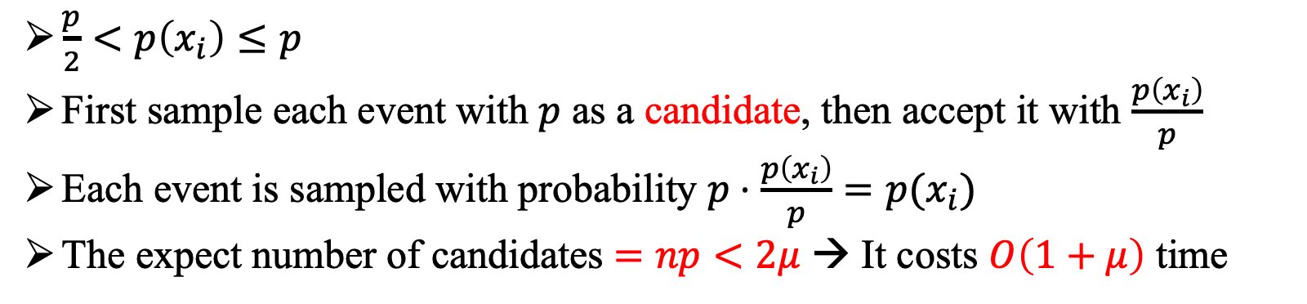



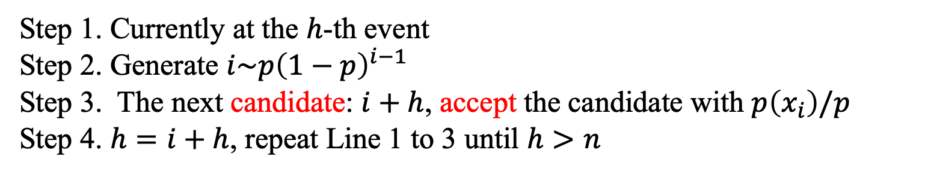






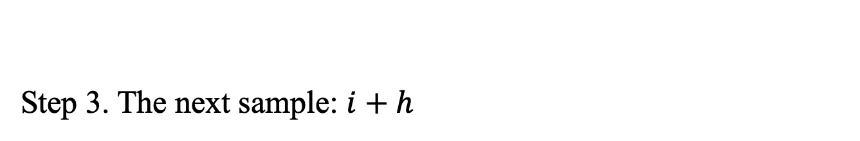



A More Complicated Case
domain set S
$$p(x_{1})$$
$$p(x_{2})$$
$$p(x_{3})$$
$$p(x_{4})$$
$$p(x_{5})$$
$$p(x_{6})$$
$$p(x_{7})$$
$${ x}_{1}$$
$${ x}_{2}$$
$${ x}_{3}$$
$${ x}_{4}$$
$${ x}_{5}$$
$${ x}_{6}$$
$${ x}_{7}$$
GeoSS
$\frac{p}{2}<p\left(x_{i}\right)≤p$
First sample each event with $p$ as a candidate, then accept it with $\frac{p\left(x_{i}\right)}{p}$
Each event is sampled with probability $p⋅\frac{p\left(x_{i}\right)}{p}=p(x_{i})$
The expect number of candidates $=np<2μ$ → It costs $O\left(1+μ\right)$ time
Step 1. Currently at the $h$-th event
Step 2. Generate $i\sim p{\left(1−p\right)}^{i−1}$
Step 3. The next candidate: $i+h$, accept the candidate with $p\left(x_{i}\right)/p$
Step 4. $h=i+h$, repeat Line 1 to 3 until $h>n$
Step 3. The next sample: $i+h$
Notes:
Next, we consider a more complicated case. In this case, all probabilities @@are greater than p divided by two and no greater than p. We first sample each element@@ with probability p as a candidate, then accept the candidate with probability p x i divided by p. Thus, each element is correctly sampled with probability p x i. Note that the expected number of candidates equals np, which is less than twice \mu@@ since each p x I is less than p, thus it only costs one plus \mu time to obtain a sample. Only Step 3@@ of the algorithm need to be revised. We call the method as geometric subset sampling@@. This inspires us that we can partition the elements into some groups according to their probabilities and then sample within the groups.

Slide 9


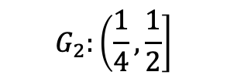


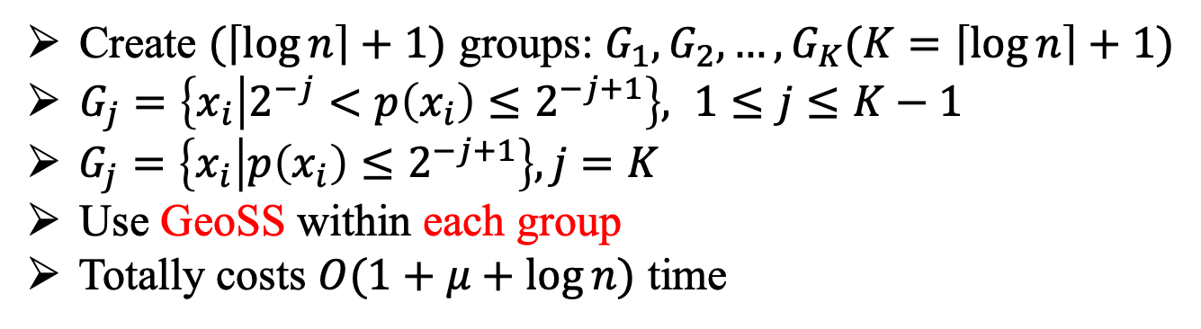
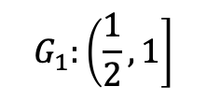




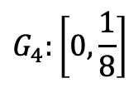




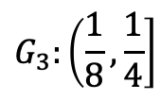
Group Partition
domain set S
$$p(x_{1})$$
$$p(x_{2})$$
$$p(x_{3})$$
$$p(x_{4})$$
$$p(x_{5})$$
$$p(x_{6})$$
$$p(x_{7})$$
$${ x}_{1}$$
$${ x}_{2}$$
$${ x}_{3}$$
$${ x}_{4}$$
$${ x}_{5}$$
$${ x}_{6}$$
$${ x}_{7}$$
$${ x}_{1}$$
$${ x}_{4}$$
$${ x}_{6}$$
$${ x}_{7}$$
$${ x}_{2}$$
$${ x}_{3}$$
$${ x}_{5}$$
$$G_{1}:\left(\frac{1}{2},1\right]$$
$$G_{2}:\left(\frac{1}{4},\frac{1}{2}\right]$$
$$G_{3}:\left(\frac{1}{8},\frac{1}{4}\right]$$
$$G_{4}:\left[0,\frac{1}{8}\right]$$
Create $(\left\lceil \log{n}\right\rceil +1)$ groups: $G_{1}, G_{2},…,G_{K}(K=\left\lceil \log{n}\right\rceil +1)$
$G_{j}=\left\{x_{i} | 2^{−j}<p\left(x_{i}\right)≤2^{−j+1}\right\}, 1≤j≤K−1$
$G_{j}=\left\{x_{i} | p\left(x_{i}\right)≤2^{−j+1}\right\}, j=K$
Use GeoSS within each group
Totally costs $O(1+μ+\log{n})$ time
Notes:
Now it is time to consider the general case. In our algorithm, we will first partition the n events into@@ the ceiling of log n plus one groups, from group one to group K. For the first@@ K minus one groups, the j-th group contains the elements with probability greater than two to the power of negative j and less than two to the power of negative j plus one. And the last group@@ G K contains the elements with probability less than two to the power of negative K plus one.In the example here, there are seven events in the domain set S. Thus, we@@ create four groups, and put the elements into the groups@@ according to their probabilities. In doing so, we can use the geometric@@ subset sampling method within each group. It costs@@ one plus \mu plus log n time since there are log n groups. The time complexity is not optimal due to the log n term. How to get rid of it?
??

Slide 10













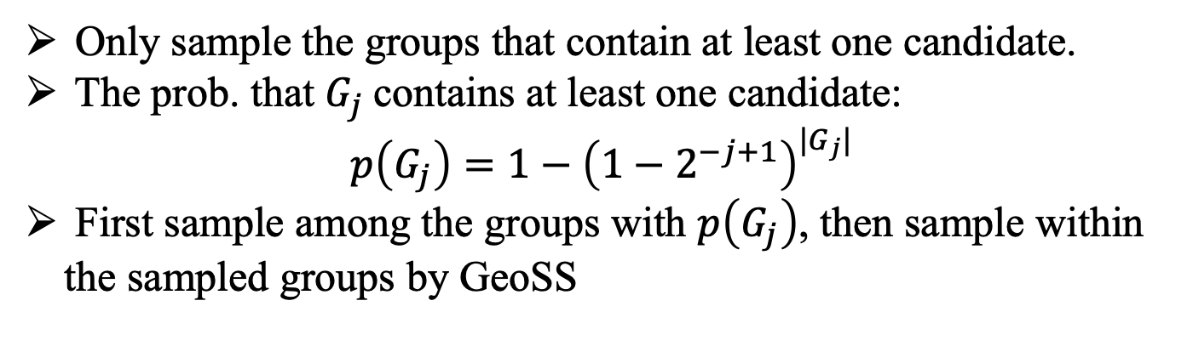





















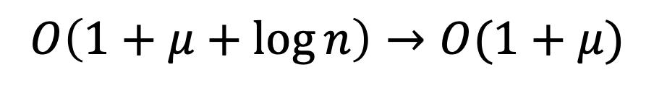
$$O\left(1+μ+\log{n}\right)→O(1+μ)$$
domain set S
$$p(x_{1})$$
$$p(x_{2})$$
$$p(x_{3})$$
$$p(x_{4})$$
$$p(x_{5})$$
$$p(x_{6})$$
$$p(x_{7})$$
$${ x}_{1}$$
$${ x}_{2}$$
$${ x}_{3}$$
$${ x}_{4}$$
$${ x}_{5}$$
$${ x}_{6}$$
$${ x}_{7}$$
$${ x}_{1}$$
$${ x}_{4}$$
$${ x}_{6}$$
$${ x}_{7}$$
$${ x}_{2}$$
$${ x}_{3}$$
$${ x}_{5}$$
$$G_{1}$$
$$G_{2}$$
$$G_{3}$$
$$G_{4}$$
$${ G}_{1}$$
$${ G}_{2}$$
$${ G}_{3}$$
$${ G}_{4}$$
$$p(G_{1})$$
$$p(G_{2})$$
$$p(G_{3})$$
$$p(G_{4})$$
Only sample the groups that contain at least one candidate.
The prob. that $G_{j}$contains at least one candidate:
$p\left(G_{j}\right)=1−{\left(1−2^{−j+1}\right)}^{|G_{j}|}$
First sample among the groups with $p\left(G_{j}\right)$, then sample within the sampled groups by GeoSS
Notes:
To get rid of the log n term, we must not sample within each group. Instead, we only@@ sample the group when the group has at least one candidate. The probability that the group G j contains at least one candidate can be calculated as p G j. We@@ first sample among the groups with p G j, then only sample within the sampled groups by geometric subset sampling. In our example, we get four @@new group events, G one to G four. After we sample these four groups according to their probabilities p G j, we get the sample result containing @@G one and G three. Then we sample within G one and G three, and we obtain @@x one and x six in G one and obtain @@x two in G three.

Slide 11








































Sample Among the Groups
domain set S
$$p(x_{1})$$
$$p(x_{2})$$
$$p(x_{3})$$
$$p(x_{4})$$
$$p(x_{5})$$
$$p(x_{6})$$
$$p(x_{7})$$
$$p(x_{1}^{\left(0\right)})$$
$$p(x_{2}^{\left(0\right)})$$
$$p(x_{3}^{\left(0\right)})$$
$$p(x_{4}^{\left(0\right)})$$
$$p(x_{5}^{\left(0\right)})$$
$$p(x_{6}^{\left(0\right)})$$
$$p(x_{7}^{\left(0\right)})$$
$${ x}_{1}$$
$${ x}_{2}$$
$${ x}_{3}$$
$${ x}_{4}$$
$${ x}_{5}$$
$${ x}_{6}$$
$${ x}_{7}$$
$$x_{1}^{\left(0\right)}$$
$$x_{2}^{\left(0\right)}$$
$$x_{3}^{\left(0\right)}$$
$$x_{4}^{\left(0\right)}$$
$$x_{5}^{\left(0\right)}$$
$$x_{6}^{\left(0\right)}$$
$$x_{7}^{\left(0\right)}$$
Level 0
$${ x}_{2}$$
$${ x}_{5}$$
$${ x}_{1}$$
$${ x}_{4}$$
$${ x}_{6}$$
$${ x}_{7}$$
$$x_{2}^{\left(0\right)}$$
$${ x}_{3}$$
$$x_{5}^{\left(0\right)}$$
$$x_{1}^{\left(0\right)}$$
$$x_{4}^{\left(0\right)}$$
$$x_{6}^{\left(0\right)}$$
$$x_{7}^{\left(0\right)}$$
$$x_{3}^{\left(0\right)}$$
$$G_{1}$$
$$G_{2}$$
$$G_{3}$$
$$G_{4}$$
$$G_{1}^{\left(0\right)}$$
$$G_{2}^{\left(0\right)}$$
$$G_{3}^{\left(0\right)}$$
$$G_{4}^{\left(0\right)}$$
$$x_{1}^{\left(1\right)}$$
$$x_{2}^{\left(1\right)}$$
$$x_{3}^{\left(1\right)}$$
$$x_{4}^{\left(1\right)}$$
$${ G}_{1}$$
$${ G}_{2}$$
$${ G}_{3}$$
$${ G}_{4}$$
$$p(x_{1}^{\left(1\right)})$$
$$p(x_{2}^{\left(1\right)})$$
$$p(x_{3}^{\left(1\right)})$$
$$p(x_{4}^{\left(1\right)})$$
$$p(G_{1})$$
$$p(G_{2})$$
$$p(G_{3})$$
$$p(G_{4})$$
Level 1
$$x_{3}^{\left(1\right)}$$
$$x_{4}^{\left(1\right)}$$
$$x_{1}^{\left(1\right)}$$
$$x_{2}^{\left(1\right)}$$
$$G_{3}^{\left(1\right)}$$
$$G_{1}^{\left(1\right)}$$
$$G_{2}^{\left(1\right)}$$
Still a subset sampling problem.
Partition again.
How can we sample the groups at level 1?
Notes:
Now we are left with the problem that how to sample among the groups. We note that it is a subset sampling problem too. Our choice is to @@partition the groups again and thus breaking down the problem into a new but smaller subset sampling problem. To distinguish various subset sampling problems, we denote the subset sampling problem with level index. Level zero@@ is the original subset sampling problem with n elements@@. At level one@@, the elements are the groups from level zero@@. After partitioning again, we obtain three@@ groups at level one. So @@how can we sample among the groups at level one? @@

Slide 12



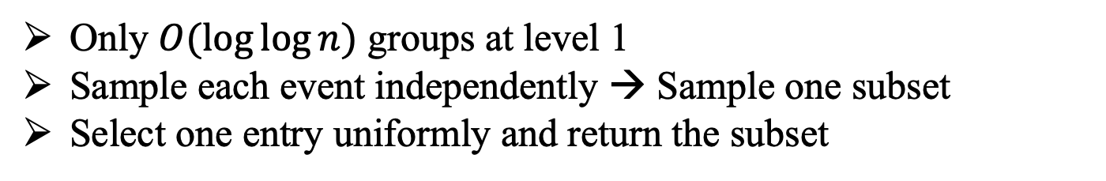
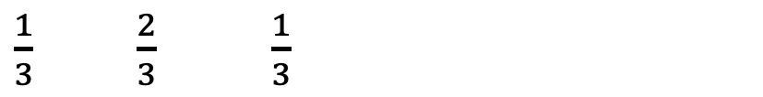













Table Lookup Method
Only $O(\log{\log{n}})$ groups at level 1
Sample each event independently → Sample one subset
Select one entry uniformly and return the subset
$${ x}_{1}$$
$${ x}_{2}$$
$${ x}_{3}$$
$\frac{1}{3}$ $\frac{2}{3}$ $\frac{1}{3}$
$${ x}_{1}$$
$${ x}_{2}$$
$${ x}_{3}$$
$\frac{1}{3}⋅\frac{2}{3}⋅\frac{1}{3}=\frac{2}{27}$
111
111
110
110
110
110
…
…
…
…
$${ x}_{1}$$
$${ x}_{2}$$
$${ x}_{3}$$
$\frac{1}{3}⋅\frac{2}{3}⋅\frac{2}{3}=\frac{4}{27}$
$$=1$$
27 entries
……
$${ x}_{1}$$
$${ x}_{2}$$
$${ x}_{3}$$
$\frac{2}{3}⋅\frac{1}{3}⋅\frac{2}{3}=\frac{4}{27}$
Notes:
Note that there are @@only O log log n groups at level one. To deal with the subset sampling problem with so few events, we introduce a table lookup method. The main idea is that sampling each element independently is equal to sampling one subset with the corresponding probability. Suppose that we have @@three elements. We can calculate the probability that each subset is selected as the sample result, for example, the subset containing all the three elements@@ is selected as the result with probability two over twenty-seven. All the probabilities sum up to one. Thus, we can sample one subset from all the subsets according to the probability distribution of subsets. We create a row@@ to help with sample. There are twenty-seven entries. For the first subset@@ that contains all the events, since its probability is two over twenty-seven, we fill two entries@@ with the subset, denoted as 111 in binary. The second subset@@, with probability four over twenty-seven, is thus filled in four entries@@. After we’ve done with all subsets@@, the row is full-filled. To get a sample, we simply @@select one entry uniformly from the row and return the subset indicated by the entry.

Slide 13
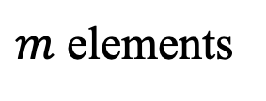
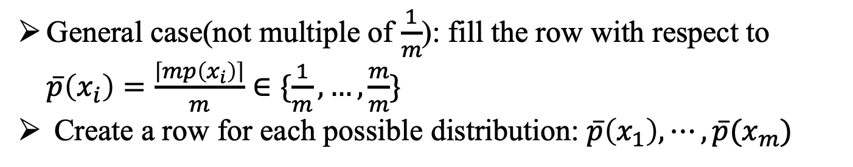
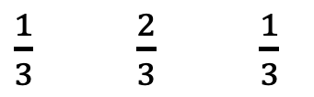


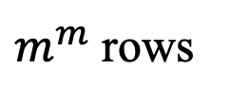



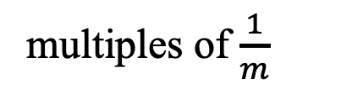
Table Lookup Method
General case(not multiple of $\frac{1}{m}$): fill the row with respect to $\overline{p}\left(x_{i}\right)=\frac{\left\lceil mp\left(x_{i}\right)\right\rceil }{m}∈\{\frac{1}{m},…,\frac{m}{m}\}$
Create a row for each possible distribution: $\overline{p}\left(x_{1}\right),⋯,\overline{p}(x_{m})$
$${ x}_{1}$$
$${ x}_{2}$$
$${ x}_{3}$$
$m$ elements
$\frac{1}{3}$ $\frac{2}{3}$ $\frac{1}{3}$
multiples of $\frac{1}{m}$
111
111
110
110
110
110
…
$m^{m}$ rows
$m^{m}$ entries
…
$m^{m}$ entries
Notes:
In a word, when there are@@ m events@@, and all the probabilities@@ are the multiples@@ of one over m, we can create a row with m to the power of m entries to sample.
To deal with the general case, in which the probabilities are not the multiple of one over m, we @@fill the row with respect to bar p x i instead of p x i.
Note that the probabilities of the events will change over time. To accommodate the modification, we @@create a row for each possible distribution so we can just change to the another row if any probabilities are changed. Thus, a table@@ with m@@ to the power@@ of m rows and m@@ to the power of m columns is obtained@@.

Slide 14



















The Structure Overview
domain set S
$$x_{1}^{\left(0\right)}$$
$$x_{4}^{\left(0\right)}$$
$$x_{6}^{\left(0\right)}$$
$$x_{7}^{\left(0\right)}$$
$$x_{2}^{\left(0\right)}$$
$$x_{3}^{\left(0\right)}$$
$$x_{5}^{\left(0\right)}$$
Level 0
$$G_{1}^{\left(0\right)}$$
$$G_{2}^{\left(0\right)}$$
$$G_{3}^{\left(0\right)}$$
$$G_{4}^{\left(0\right)}$$
$$x_{3}^{\left(1\right)}$$
$$x_{4}^{\left(1\right)}$$
$$x_{1}^{\left(1\right)}$$
$$x_{2}^{\left(1\right)}$$
Level 1
$$G_{3}^{\left(1\right)}$$
$$G_{1}^{\left(1\right)}$$
$$G_{2}^{\left(1\right)}$$
$$p\left(G_{1}^{\left(1\right)}\right),p\left(G_{2}^{\left(1\right)}\right),p\left(G_{3}^{\left(1\right)}\right)$$
101
Level 2
…
Return $\{x_{2},x_{4}\}$ as the sample result.
Notes:
Now, it is time to look at the whole algorithm. After preprocessing, we have three levels: level zero has the original events, which have been put@@ in the corresponding groups. The groups at level zero becomes the events at level one@@, which have also been put@@ in the corresponding groups. Level two is a lookup table, which is used to sample the groups at level one. According to the probabilities of the groups at level one, that is, p G one, p G two, and p G three@@, we have indexed into a row that corresponds to the current distribution. When sampling, we first uniformly choose@@ an entry in the row. In the example, we suppose that it turns out@@ to be one zero one, that is, sampling the g one@@ and g three@@. Then, We sample within g one and g three at level one. In G three, we successfully sample @@x 3 and reject x 4. In G one, we successfully sample @@x 1. Then we comes to level zero. We sample within g three and g one, and finally it comes out that @@x four and @@x two is sampled@@. This finishes the sampling@@.

Slide 15
Update Operations
Insert an element
Delete an element
Modify the probability of an element
Notes:
Next, we consider the update operations, including insertions@@, deletions@@ and modifications@@.

Slide 16

























Update Operations
$$x_{8}^{\left(0\right)}$$
$$p\left(x_{8}^{\left(0\right)}\right)=0.3$$
Insert an element
$$x_{1}^{\left(0\right)}$$
$$x_{4}^{\left(0\right)}$$
$$x_{6}^{\left(0\right)}$$
$$x_{7}^{\left(0\right)}$$
$$x_{7}^{\left(0\right)}$$
$$x_{8}^{\left(0\right)}$$
$$x_{2}^{\left(0\right)}$$
$$x_{3}^{\left(0\right)}$$
$$x_{5}^{\left(0\right)}$$
Level 0
$$G_{1}^{\left(0\right)}$$
$$G_{2}^{\left(0\right)}$$
$$G_{3}^{\left(0\right)}$$
$$G_{4}^{\left(0\right)}$$
$$x_{3}^{\left(1\right)}$$
$$x_{4}^{\left(1\right)}$$
$$x_{1}^{\left(1\right)}$$
$$x_{1}^{\left(1\right)}$$
$$x_{2}^{\left(1\right)}$$
$$x_{2}^{\left(1\right)}$$
Level 1
$$G_{3}^{\left(1\right)}$$
$$G_{1}^{\left(1\right)}$$
$$G_{2}^{\left(1\right)}$$
$$p\left(G_{1}^{\left(1\right)}\right),p\left(G_{2}^{\left(1\right)}\right),p\left(G_{3}^{\left(1\right)}\right)$$
Level 2
…
Notes:
Suppose that x eight@@ is to insert. According to p x eight, it is assigned to G two@@ at level zero@@. Since the size of G two is enlarged to two elements, p G 2@@ becomes smaller, that is, the probability of x two at level one is modified and needs to be moved@@ from G two@@ to G one@@. Thus, G two becomes empty and G one contains two elements. Since G one and G two is modified, the probabilities of them is modified accordingly. Thus, the current row index@@ needs to be revised@@@@ based on the new probabilities. Deletions and probability modifications can be done in a similar way.

Slide 17
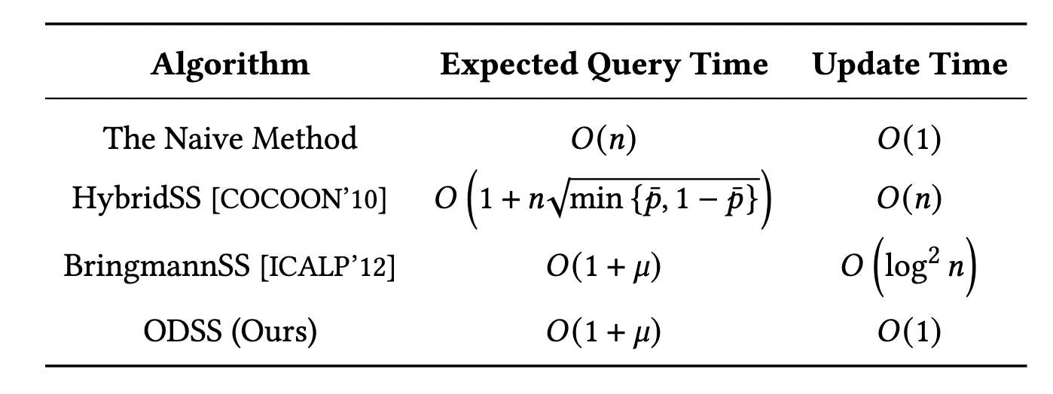
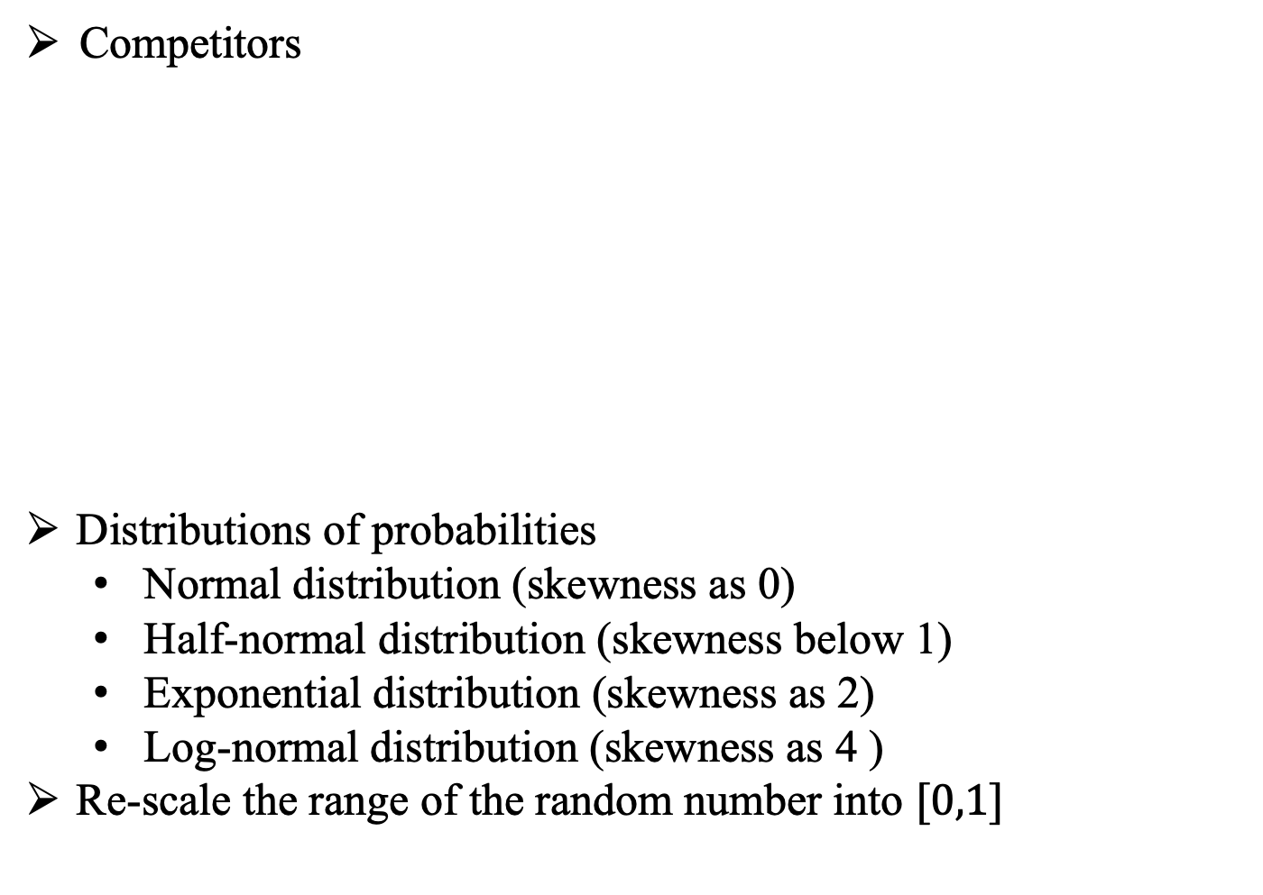
Experiments
Competitors
Distributions of probabilities
  Normal distribution (skewness as 0)
  Half-normal distribution (skewness below 1)
  Exponential distribution (skewness as 2)
  Log-normal distribution (skewness as 4 )
Re-scale the range of the random number into $[0,1]$
Notes:
We evaluate the performance of our algorithm ODSS @@against the existing works, including the naïve method, the hybrid subset sampling method, the bringmann subset sampling method. We carefully set the probabilities of elements distributed with various skewnesses. We choose the normal distribution, the half-normal distribution, exponential distribution and log-normal distribution. After generating random numbers, we @@rescale the range of them into the closed interval from zero to one.

Slide 18
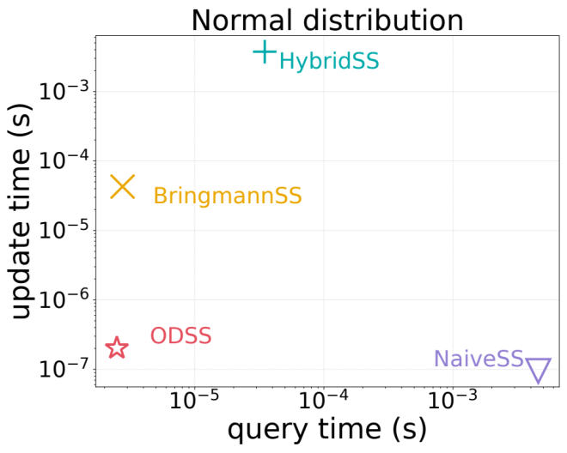
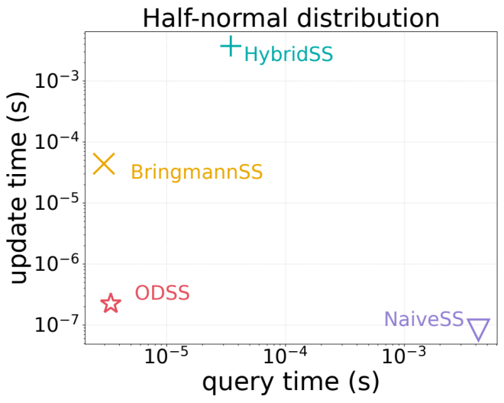
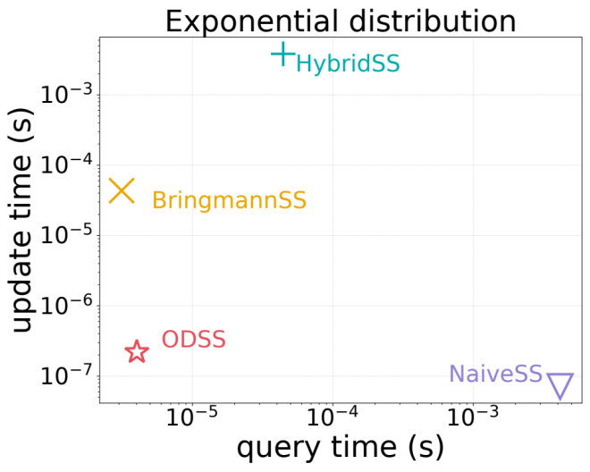
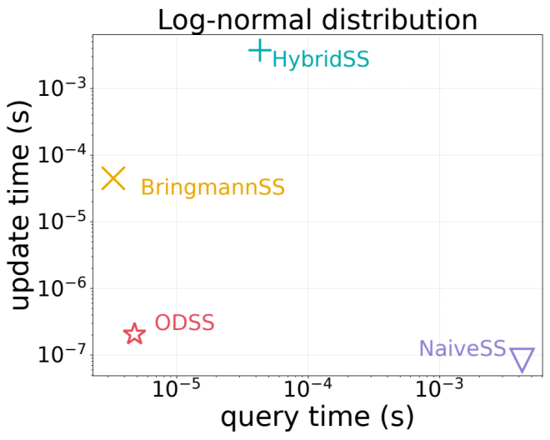
Experiments
Trade-off between query time and update time. ($n={10}^{5},μ=1$)
Notes:
We first draw the trade-off plots between query time and update time of each method. Here we set the number of events as one hundred thousand and the sum of probabilities as one. We observe that our ODSS, which is at bottom left, outperforms other methods in terms of both query and update time. The Naive method performs efficient updates, but it requires a large query time. The query time of the Bringmann subset sampling method and the Hybrid subset sampling method is much smaller than that of the Naive method, while the update time is much larger.

Slide 19
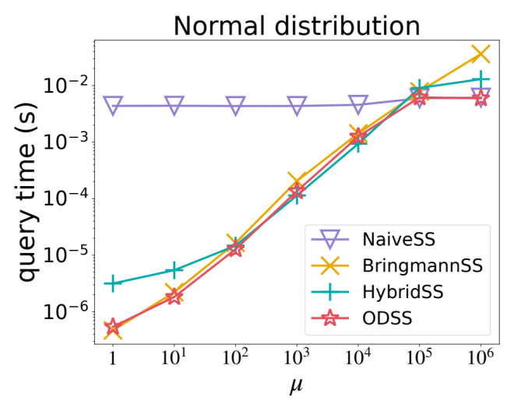
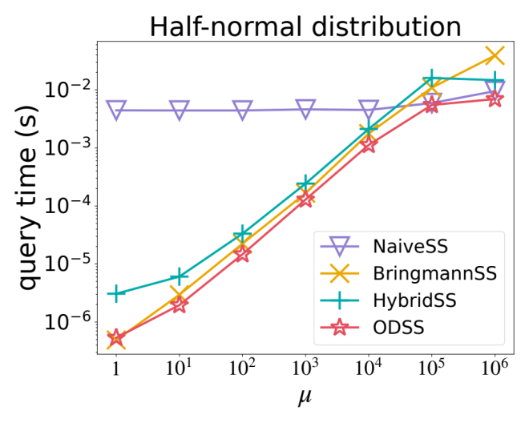
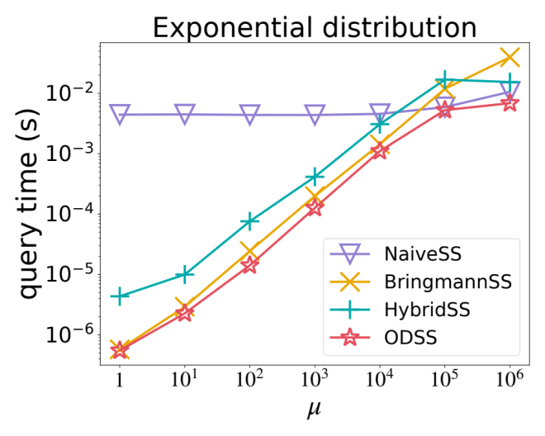
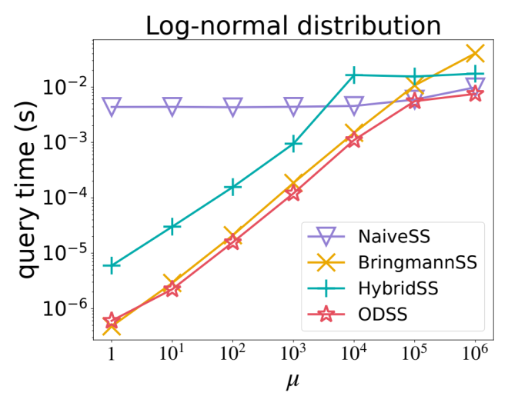
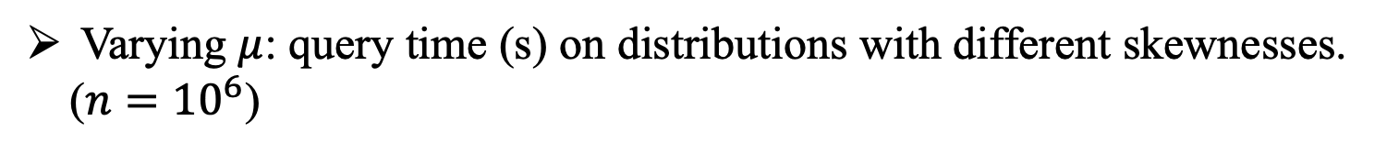
Experiments
Varying $μ$: query time (s) on distributions with different skewnesses. ($n={10}^{6}$)
Notes:
To further examine the query time of these algorithms, we vary 𝜇, the sum of the probabilities of elements, and show the query time. As shown in the figures, for the Bringmanss, hybrids, and odss, the query time increase linearly with \mu. These results concur with the theoretical time complexity of the query time of all algorithms.

Slide 20
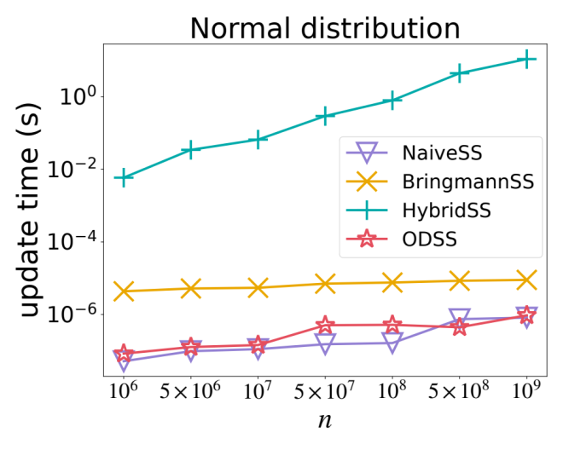
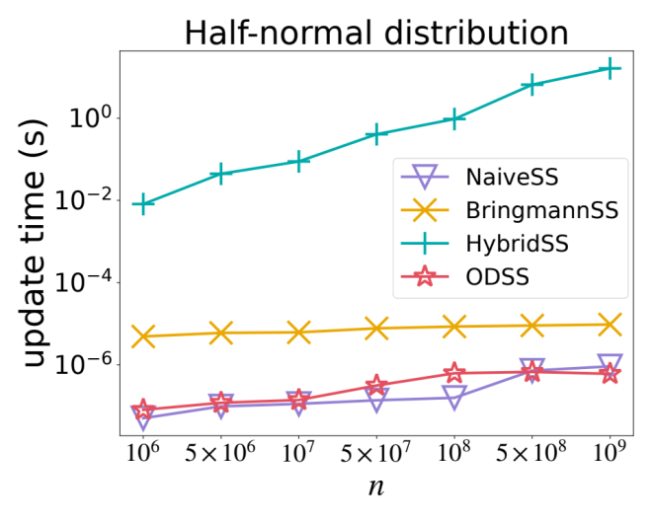
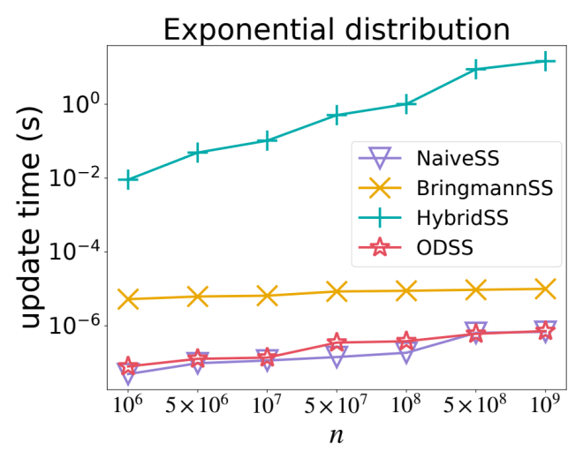

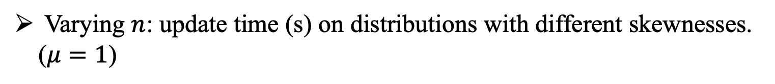
Experiments
Varying $n$: update time (s) on distributions with different skewnesses. ($μ=1$)
Notes:
To further examine the update time, we set \mu as one and vary n from one million to one billion. The results shows that the naïve method and ODSS consistently outperform other algorithms on all distributions.

Slide 21
Thank you!
Notes:
That’all. Thank you for your listening and welcome any questions.

