Slide 1


Exact Single-Source SimRank Computation on Large Graphs
SIGMOD 2020
Hanzhi Wang, Zhewei Wei*, Ye Yuan, Xiaoyong Du, and Ji-Rong Wen
Contact: zhewei@ruc.edu.cn
Code: https://github.com/wanghzccls/ExactSim
Notes:
Hello everyone, I’m Hanzhi Wang and I’m going to talk about our work: “Exact Single-source SimRank Computation on Large Graphs.”. This work is cooperated with Zhewei Wei, Xiaoyong Du, Ji-Rong Wen at Renmin University of China, and Ye Yuan from Beijing institute of technology.

Slide 2
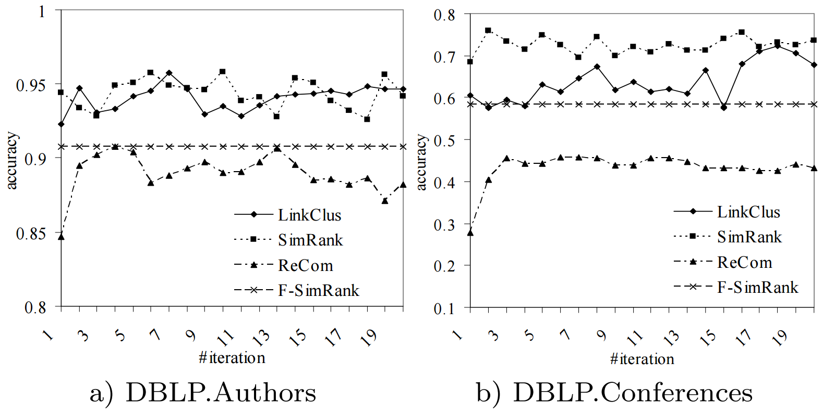
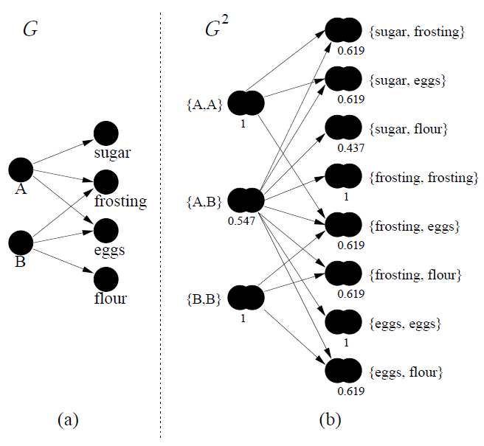

SimRank Applications
  SPAM detection [KDD12]
  Recommendation system [WWW15]
  Clustering via semantic links [VLDB06]
Notes:
Well, SimRank is a popular measurement of node-to-node similarities. It has been adopted in various applications, such as spam detection, recommendation system, clustering and so on.

Slide 3



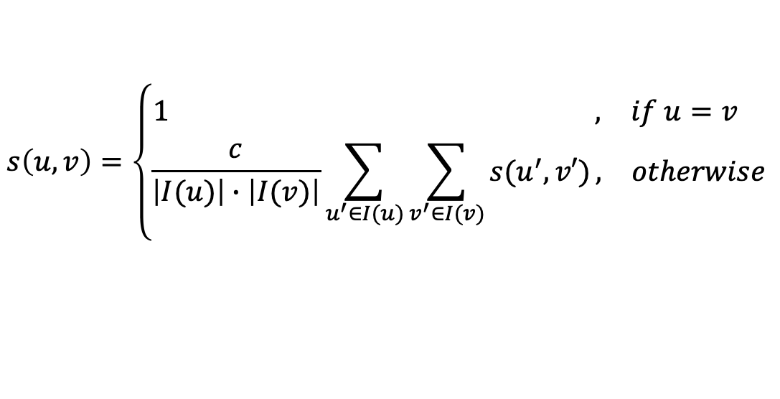


SimRank [Jeh and Widom, KDD 02]
Professor A
Student A
University
Similarity=1
High
Relatively high
Professor B
Student B
$$s\left(u,v\right)=\left\{\begin{aligned}\begin{matrix}1 , & if u=v \end{matrix} \\ \begin{matrix}\frac{c}{\left|I(u)\right|∙\left|I(v)\right|}\sum_{u^{′}∈I(u)}{\sum_{v^{′}∈I(v)}{s(u^{′},v′)}}, & otherwise\end{matrix}\end{aligned}\right.$$
$$c∈(0,1)$$
$T\left(n\right)=Ο\left(n^{3}\right), S\left(n\right)=Ο\left(n^{2}\right)$
512 GB $≈O\left({12000}^{2}\right)$ float values
Notes:
The definition of SimRank is based on the intuition that: “two nodes are similar if they are pointed by similar nodes”. For example, in the given graph, the node “university” owns the maximum similarity with itself as value 1. Student A and B are relatively similar because their in-neighbors are similar too.
The definition equation is given below.
（Click!） It is given in an iterative format and this largely limits SimRank’s scalability.
Because of the iterative format, we have to store all of the square of n pairs of nodes on the graph and update them in each iteration.
(Click!)This makes the space complexity comes to the square of n.
Suppose we have five hundred and twelve gigabyte memory space which is quite large for most of computers,
(Click!) it only support the graph with less than 12 thousand nodes. Not to mention the cube of n computational complexity is also infeasible for large graphs.

Slide 4
Taxonomy
Linearization
Monte Caro Sampling
Local Push
SimMat
Fujiwara, ICDE13
Monte Carlo
Fogaras, WWW05
TopSim
Jeffery Yu, ICDE12
TSF
Bin Cui, VLDB15
ParSim
W. Yu, VLDB15
SLING
B. Tian, SIGMOD16
CloudWalker
Z. Li, VLDB15
Linearization
Kusumoto, SIGMOD14
KDD14, ICDE15
ProbeSim
Y. Liu, VLDB18
Uniwalk,
J. Song, TKDE17
READS
W. Yu, VLDB17
PRSim
Z. Wei, SIGMOD19
How to evaluate these approximate algorithms when lack of ground truths ?
Notes:
Because the power method given by SimRank’s definition is infeasible for large graphs, many methods have emerged to propose approximate algorithms to extend the scalability of SimRank.
However, we don’t have the ground truths derived by power method based on definition,
(Click!) How should we evaluate the performance of these approximate methods without ground truths on large graphs?

Slide 5
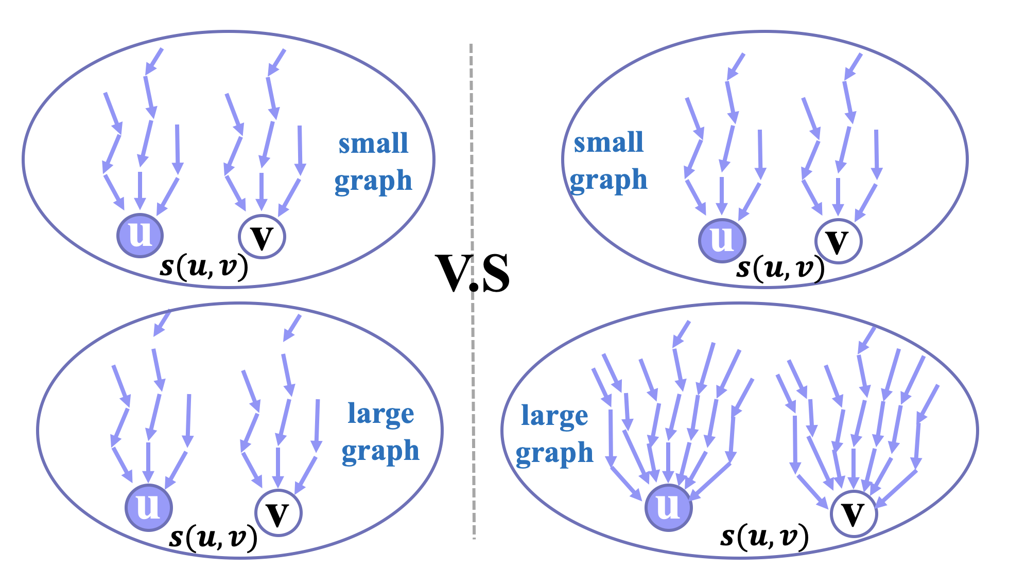
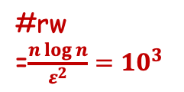
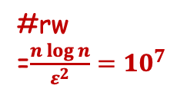
Motivation
Lack of ground truths on large graphs
  Evaluate the accuracy on small graphs.
  Report the efficiency/scalability results on large graphs
  with consistent parameters.
Method 1
Method 2
Better?
#rw
=$\frac{n\log{n}}{ε^{2}}={10}^{3}$
#rw=1000
consistent
parameters
consistent
parameters
#rw
=$\frac{n\log{n}}{ε^{2}}={10}^{7}$
#rw=1000
faster
slower
Notes:
Many methods take the following measurement: they evaluate the accuracy on small graphs and report the efficiency or scalability on large graphs with consistent parameters.
But such measurement can lead to quite unfair conclusion.
For example, we have two methods method 1 and method 2(Click!) given in the left side and right side. They are all Monte-Carlo based methods that they generate pairs of random walks to check whether the two walk meet at the same step. And they use the percentage of walks that meet in the process to estimate SimRank scores between the two nodes. Method 1 decides to fix the number of random walks as 1000 on both small and large graphs.(Click!) And method 2 tries to fix the error parameter \e and generate 1000 walks on small graphs and ten million walks on large graphs.(Click!) Suppose the two methods achieve the same accuracy on small graphs. .(Click!) The query time of method 1 is definitely smaller than that of method 2 on large graphs. So can we come to the conclusion that method 1 has the better efficiency than method 2 on large graphs(Click!)? Of course not. Because 1000 walks on large graphs are quite insufficient to achieve the same accuracy as that on small graphs. Only comparing the speed of two methods on large graphs is unreasonable. This absurd conclusion is mainly caused by lack of ground truths.

Slide 6
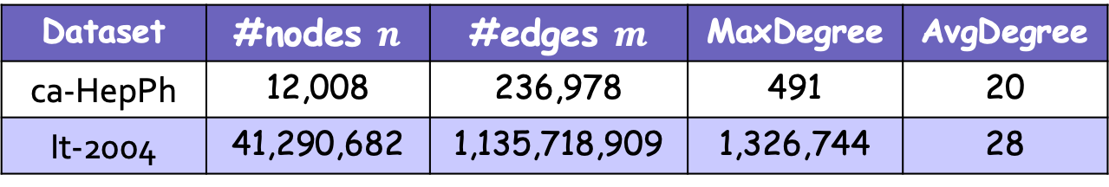
Motivation
Lack of ground truths on large graphs
  Evaluate the accuracy on small graphs.
  Report the efficiency/scalability results on large graphs.
But the structure of small and large graphs are quite different.
Dataset | #nodes $n$ | #edges $m$ | MaxDegree | AvgDegree
ca-HepPh | 12,008 | 236,978 | 491 | 20
It-2004 | 41,290,682 | 1,135,718,909 | 1,326,744 | 28
Quite different
Similar
Notes:
Furthermore, the structure of small and large graphs can be quite different. So the accuracy results on small graphs can only serve as a rough guideline as we mentioned before. Designing algorithms without ground truths is just like shooting in the dark.
So ground truths on large graphs are quite important for fair evaluation.

Slide 7
Our Contributions
Notes:
Based on these problems,

Slide 8

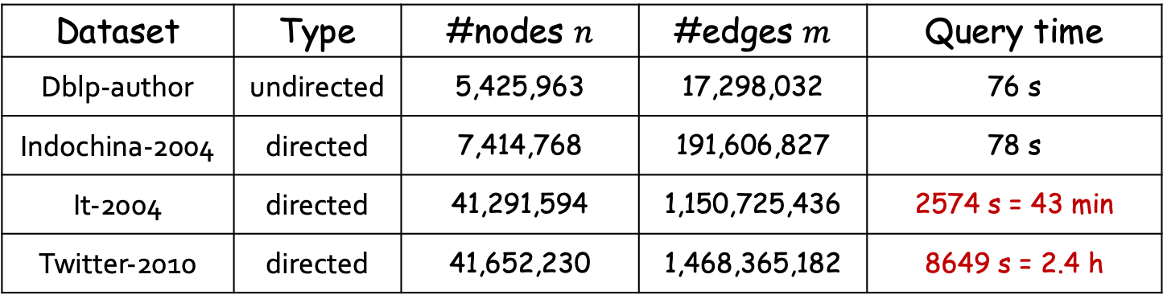

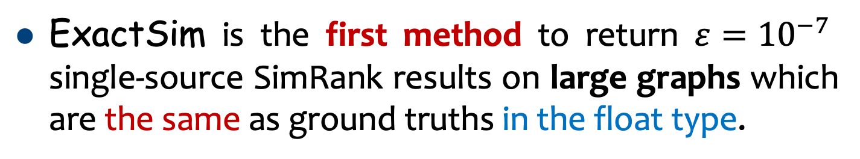
Provide ground truths on large graphs
ExactSim is the first method to return $ε={10}^{−7}$ single-source SimRank results on large graphs which are the same as ground truths in the float type.
e.g. ExactSim result: $\hat{s}\left(u,v\right)=0.1452345$
Ground truth: $s\left(u,v\right)=0.1452349$
the same in float precision
ExactSim‘s performance when $ε={10}^{−7}$:
Dataset | Type | #nodes $n$ | #edges $m$ | Query time
Dblp-author | undirected | 5,425,963 | 17,298,032 | 76 s
Indochina-2004 | directed | 7,414,768 | 191,606,827 | 78 s
It-2004 | directed | 41,291,594 | 1,150,725,436 | 2574 s = 43 min
Twitter-2010 | directed | 41,652,230 | 1,468,365,182 | 8649 s = 2.4 h
one billion
Power method only support the graph with $≤12000$ nodes
Notes:
we propose the first method, ExactSim, which is able to return the single-source SimRank results with 10 to the minus 7th power additive error，
(Click!)which are the same as ground truths in the float type.
Here, single-source SimRank means we the SimRank values between each node and a given source node.
(Click!)On graphs with billions of edges, ExactSim can return ground truths within a few hours.
(Click!)Recall that the power method can only support graphs with less than 12 thousand nodes. But we can derive the same results as power method on one billion edges graphs.

Slide 9
Existing methods CANNOT achieve exactness
Linearization
Monte Caro Sampling
Local Push
SimMat
Fujiwara, ICDE13
Monte Carlo
Fogaras, WWW05
TopSim
Jeffery Yu, ICDE12
TSF
Bin Cui, VLDB15
ParSim
W. Yu, VLDB15
SLING
B. Tian, SIGMOD16
CloudWalker
Z. Li, VLDB15
Linearization
Kusumoto, SIGMOD14
KDD14, ICDE15
ProbeSim
Y. Liu, VLDB18
Uniwalk,
J. Song, TKDE17
READS
W. Yu, VLDB17
PRSim
Z. Wei, SIGMOD19
Notes:
So we first analyze why existing single-source methods cannot achieve exactness.
Then we show why ExactSim can solve this problem.
As mentioned before, there are many approximate methods aiming to compute SimRank results on large graphs.
We can classify them into three categories: Linearization methods, Monte-Carlo based methods and local push methods.

Slide 10
Existing methods CANNOT achieve exactness
Linearization
Monte Caro Sampling
Local Push
SimMat
Fujiwara, ICDE13
Monte Carlo
Fogaras, WWW05
TopSim
Jeffery Yu, ICDE12
Modify SimRank equation which incurs large error.
TSF
Bin Cui, VLDB15
ParSim
W. Yu, VLDB15
SLING
B. Tian, SIGMOD16
CloudWalker
Z. Li, VLDB15
Linearization
Kusumoto, SIGMOD14
KDD14, ICDE15
ProbeSim
Y. Liu, VLDB18
Uniwalk,
J. Song, TKDE17
READS
W. Yu, VLDB17
PRSim
Z. Wei, SIGMOD19
Notes:
For the two linearization methods SimMat and ParSim, they modify linearized equation to compute SimRank results, which incurs large error.

Slide 11

Existing methods CANNOT achieve $ε={10}^{−7}$
Linearization
Monte Caro Sampling
Local Push
Too much time to achieve exactness
SimMat
Fujiwara, ICDE13
Monte Carlo
Fogaras, WWW05
TopSim
Jeffery Yu, ICDE12
TSF
Bin Cui, VLDB15
ParSim
W. Yu, VLDB15
SLING
B. Tian, SIGMOD16
CloudWalker
Z. Li, VLDB15
Linearization
Kusumoto, SIGMOD14
KDD14, ICDE15
ProbeSim
Y. Liu, VLDB18
Uniwalk,
J. Song, TKDE17
READS
W. Yu, VLDB17
PRSim
Z. Wei, SIGMOD19
Notes:
And for the other methods, they all encounter too long query time with small $ε$, which incurs them to achieve exactness.

Slide 12


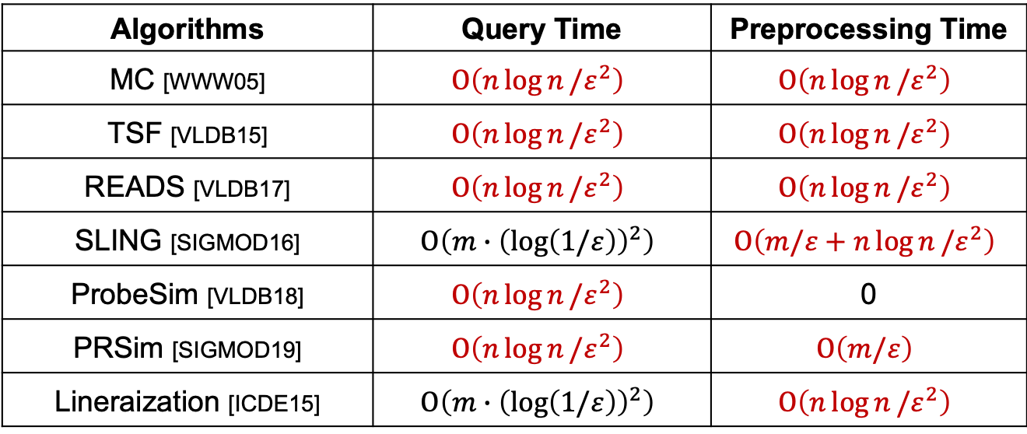

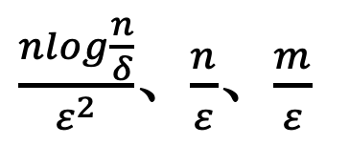
Too much time to achieve exactness
Twitter dataset: ${n=4×10}^{7}, ε={10}^{−7}, \frac{nlogn}{ε^{2}}≈{10}^{23}$
Algorithms | Query Time | Preprocessing Time
MC [WWW05] | $$Ο\left(n\log{n}/ε^{2}\right)$$ | $$Ο\left(n\log{n}/ε^{2}\right)$$
TSF [VLDB15] | $$Ο\left(n\log{n}/ε^{2}\right)$$ | $$Ο\left(n\log{n}/ε^{2}\right)$$
READS [VLDB17] | $$Ο\left(n\log{n}/ε^{2}\right)$$ | $$Ο\left(n\log{n}/ε^{2}\right)$$
SLING [SIGMOD16] | $$Ο\left(m∙{\left(\log\left(1/ε\right)\right)}^{2}\right)$$ | $$Ο\left(m/ε+n\log{n}/ε^{2}\right)$$
ProbeSim [VLDB18] | $$Ο\left(n\log{n}/ε^{2}\right)$$ | 0
PRSim [SIGMOD19] | $$Ο\left(n\log{n}/ε^{2}\right)$$ | $$O\left(m/ε\right)$$
Lineraization [ICDE15] | $$Ο\left(m∙{\left(\log\left(1/ε\right)\right)}^{2}\right)$$ | $$Ο\left(n\log{n}/ε^{2}\right)$$
large $n,m$
$\frac{nlog\frac{n}{δ}}{ε^{2}}$、$\frac{n}{ε}$、$\frac{m}{ε}$
small $ε,ε^{2}$
Notes:
We have listed the complexity of most of these methods. And we find there is a common term shown in these. That is nlogn over square of $ε$. This term combines two expensive part n and 1 over the square of $ε$, and will be super large with large n and small $ε$.
For example,(Click!) as for the twitter dataset with forty million nodes, if we want to achieve 10 to the minus 7th power additive error. The nlogn over square of $ε$ becomes 10 to the 23th power. This may take years to complete the computation. Hence, these complexity are all infeasible for large graphs to achieve small error.

Slide 13
How?
Notes:
But how can our method achieve exactness?

Slide 14

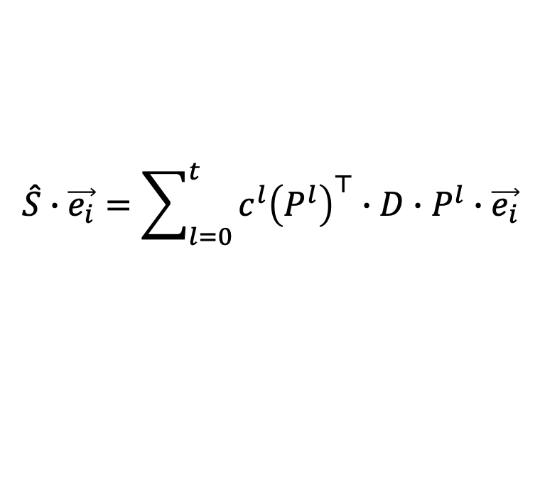
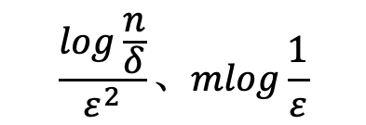
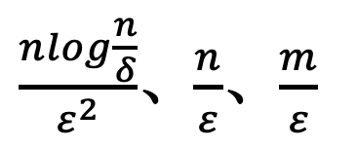
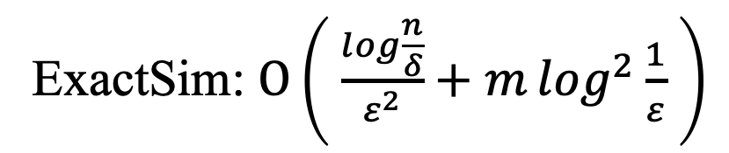
ExactSim: computation complexity
P: transition matrix (known)
single-source queries:
D: diagonal correction matrix (unknown)
$$\hat{S}∙\vec{e_{i}}=\sum_{l=0}^{t}{c^{l}{\left(P^{l}\right)}^{⊤}∙D∙P^{l}∙\vec{e_{i}}}$$
ExactSim: $Ο\left( \frac{log\frac{n}{δ}}{ε^{2}}+m\log^{2}{\frac{1}{ε}} \right)$
$\frac{nlog\frac{n}{δ}}{ε^{2}}$、$\frac{n}{ε}$、$\frac{m}{ε}$
$$\frac{log\frac{n}{δ}}{ε^{2}}、mlog\frac{1}{ε}$$
Notes:
That’s because we avoid to combine the two large terms n and 1 over square of $ε$ simultaneously in our complexity. And this makes ExactSim feasible for large graphs and small $ε$.
In detail,(Click!) we transform the definition equation of SimRank into a linearized equation shown in top.
(Click!) P is the transition matrix which is already known with the given graph.
(Click) D is an unknown diagonal correction matrix. So we use Monte-Carlo sampling to estimate matrix D first and compute SimRank results according to the linearized equation with the obtained D.
Hence, the complexity of our method is composed by two parts,

Slide 15
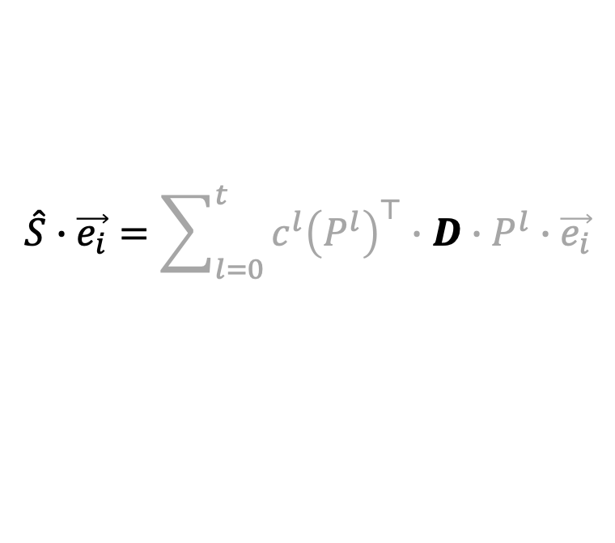
ExactSim: computation complexity
P: transition matrix (known)
single-source queries:
D: diagonal correction matrix (unknown)
$$\hat{S}∙\vec{e_{i}}=\sum_{l=0}^{t}{c^{l}{\left(P^{l}\right)}^{⊤}∙D∙P^{l}∙\vec{e_{i}}}$$
matrix D’s estimation
ExactSim: $Ο\left( \frac{log\frac{n}{δ}}{ε^{2}}+m\log^{2}{\frac{1}{ε}} \right)$
$\frac{nlog\frac{n}{δ}}{ε^{2}}$、$\frac{n}{ε}$、$\frac{m}{ε}$
$$\frac{log\frac{n}{δ}}{ε^{2}}、mlog\frac{1}{ε}$$
Notes:
The first term comes from matrix D’s estimation.

Slide 16
ExactSim: computation complexity
P: transition matrix (known)
single-source queries:
D: diagonal correction matrix (unknown)
$$\hat{S}∙\vec{e_{i}}=\sum_{l=0}^{t}{c^{l}{\left(P^{l}\right)}^{⊤}∙D∙P^{l}∙\vec{e_{i}}}$$
matrix D’s estimation
Multiplication with obtained matrix D
ExactSim: $Ο\left( \frac{log\frac{n}{δ}}{ε^{2}}+m\log^{2}{\frac{1}{ε}} \right)$
$\frac{nlog\frac{n}{δ}}{ε^{2}}$、$\frac{n}{ε}$、$\frac{m}{ε}$
$$\frac{log\frac{n}{δ}}{ε^{2}}、mlog\frac{1}{ε}$$
Notes:
And the second term comes from the linear summation.
In both of the two terms, we avoid to combine n and 1 over square of $ε$ simultaneously. And this makes ExactSim feasible for large graphs and small $ε$.

Slide 17
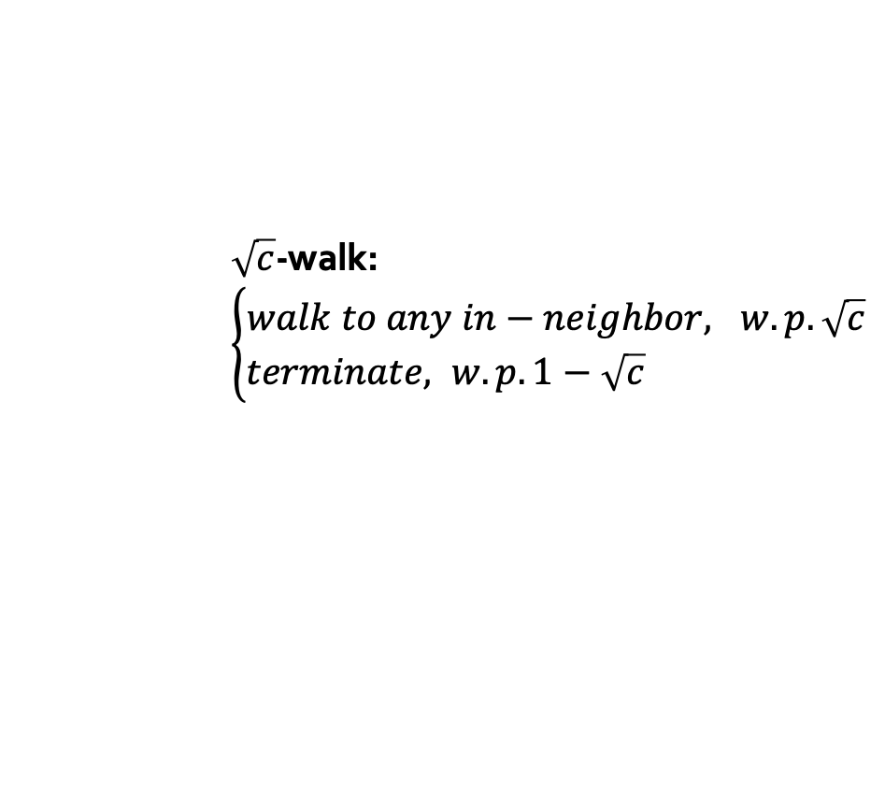
Diagonal Correction Matrix D
10
9
2
12
1
8
3
11
Do not meet!
4
Counter
+1
6
5
$\sqrt{c}$-walk: $\left\{\begin{aligned}walk to any in−neighbor, w.p.\sqrt{c} \\ terminate, w.p. 1−\sqrt{c} \end{aligned}\right.$
7
D(k,k)=Pr{two $\sqrt{c}$-walks from $v_{k}$ do not meet} = $\frac{counter}{total walk nums}$
Notes:
In the process of matrix D’s estimation, we try to understand D from the probability aspect. The kth entry of matrix D D(k,k)equals the probability that two square root of c walks from node $v_{k}$ do not meet in the walking process.
Here, (Click!)the square root of c walk represents the random walk which will move to a random in-neighbor with probability the square root of c, or terminates at each step with the left probability. We generate many pairs of the square root of c walk from $v_{k}$ and use the percentage that the two walks do not meet as the estimation of D(k,k).
For example, in the given graph, we generate two walks from node 4 to see whether they meet. (Click!)
In this time, they do not meet(Click), so we add one to the counter.

Slide 18
Diagonal Correction Matrix D
10
9
2
12
1
8
3
11
Meet!
4
Counter
+0
6
5
$\sqrt{c}$-walk: $\left\{\begin{aligned}walk to any in−neighbor, w.p.\sqrt{c} \\ terminate, w.p. 1−\sqrt{c} \end{aligned}\right.$
7
D(k,k)=Pr{two $\sqrt{c}$-walks from $v_{k}$ do not meet} = $\frac{counter}{total walk nums}$
Notes:
But if they meet in the walking process like this time, we add nothing to the counter.
Then we calculate the percentage of the counter value taken into the total walks’ number to estimated the value of D(k,k).

Slide 19




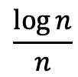

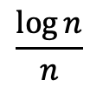
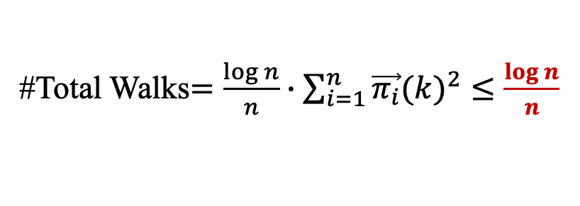
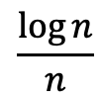

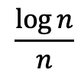

Sample according to ${\vec{π_{i}}(k)}^{2}$ to estimate $D(k,k)$
Linearization[Maehara, ICDE15]
#Total Walks$=n∙\frac{\log{n}}{n}$
1
2
…
k
…
n
$$\frac{\log{n}}{n}$$
$$\frac{\log{n}}{n}$$
$$\frac{\log{n}}{n}$$
$$\frac{\log{n}}{n}$$
Our ExactSim
#Total Walks$=\frac{\log{n}}{n}∙\sum_{i=1}^{n}{{\vec{π_{i}}(k)}^{2}}≤\frac{\log{n}}{n}$
$\vec{π_{i}}(k)$: The PPR of $v_{k}$
1
2
…
k
…
n
$$\frac{\log{n}}{n}∙{\vec{π_{i}}(1)}^{2}$$
$$\frac{\log{n}}{n}∙{\vec{π_{i}}(2)}^{2}$$
$$\frac{\log{n}}{n}∙{\vec{π_{i}}(k)}^{2}$$
$$\frac{\log{n}}{n}∙{\vec{π_{i}}(n)}^{2}$$
Notes:
Beyond that, we arrange the sampling number for each node proportional to the square of the personalized pagerank value.
Compared with the method Linearization, it will sample logn over n walks from each node.
But in our method, we only have to generate logn over n walks in total.
This makes our estimation feasible for large graphs.

Slide 20




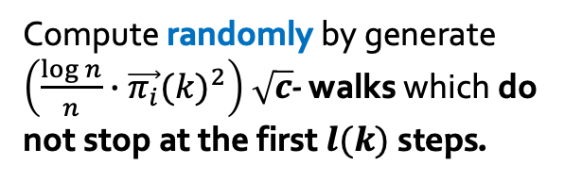


Local deterministic exploitation for $D$
$D\left(k,k\right)=$Pr{two $\sqrt{c}$-walks from $v_{k}$ do not meet}
Pr{do not meet at $≤l(k)$ steps}
$$+$$
Pr{do not meet at $>l(k)$ steps}
deterministically
randomly
Compute randomly by generate $\left(\frac{\log{n}}{n}∙{\vec{π_{i}}(k)}^{2}\right)$ $\sqrt{c}$- walks which do not stop at the first $l(k)$ steps.
$>l(k)$ steps
6
5
8
7
4
2
3
$≤l(k)$ steps
Compute deterministically by enumerating all possible paths.
k
Notes:
Besides, we separate the estimation process into two parts. In the first phase,
(CLICK!)we deterministically compute never meet probability by enumerating all possible paths in the first l(k) levels.
And in the second phase, (CLICK!)we generate square root of c walks to estimate the other probability. By this means, we can increase the accuracy of D’s estimation.

Slide 21


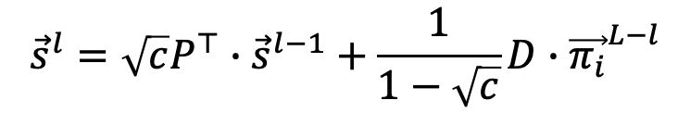

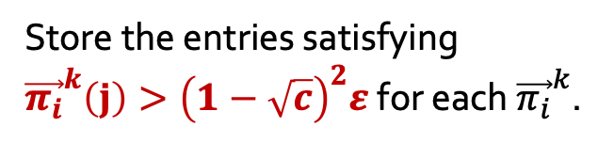

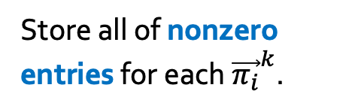

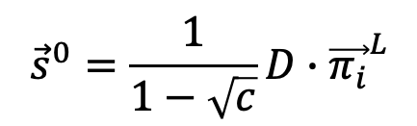



Sparse Linearization
$${\vec{s}}^{l}=\sqrt{c}P^{⊤}∙{\vec{s}}^{l−1}+\frac{1}{1−\sqrt{c}}D∙{\vec{π_{i}}}^{L−l}$$
$${\vec{s}}^{0}=\frac{1}{1−\sqrt{c}}D∙{\vec{π_{i}}}^{L}$$
entries $>0$
entries $>{\left(1−\sqrt{c}\right)}^{2}ε$
0
0.09
…
0.5
0
0.1
0.02
0.01
…
0.2
0.1
0
0.009
0.002
…
0.01
0
0
0
0.09
…
0.5
0
0.1
0.02
0.01
…
0.2
0.1
0
0.009
0.002
…
0.01
0
0
Space Saving
$${\vec{π_{i}}}^{1}$$
$${\vec{π_{i}}}^{2}$$
…
$${\vec{π_{i}}}^{t}$$
$${\vec{π_{i}}}^{1}$$
$${\vec{π_{i}}}^{2}$$
…
$${\vec{π_{i}}}^{t}$$
Store all of nonzero entries for each ${\vec{π_{i}}}^{k}$.
Store the entries satisfying ${\vec{π_{i}}}^{k}\left(j\right)>{\left(1−\sqrt{c}\right)}^{2}ε$ for each ${\vec{π_{i}}}^{k}$.
Notes:
What’s more, we only store the large entries instead of all of nonzero entries to save memory space.
These techniques can further improve ExactSim’s efficiency.

Slide 22
Outline
Problems and Motivations
Contributions
High Level Ideas
Experiments
Conclusion
Notes:
In the experimental part,

Slide 23
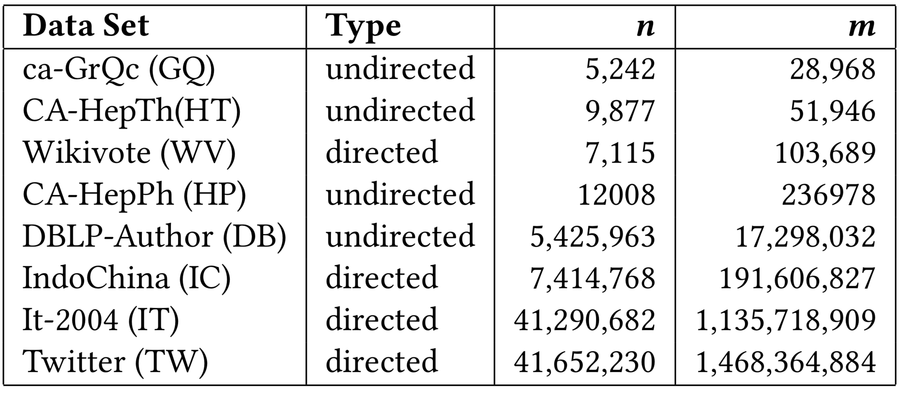
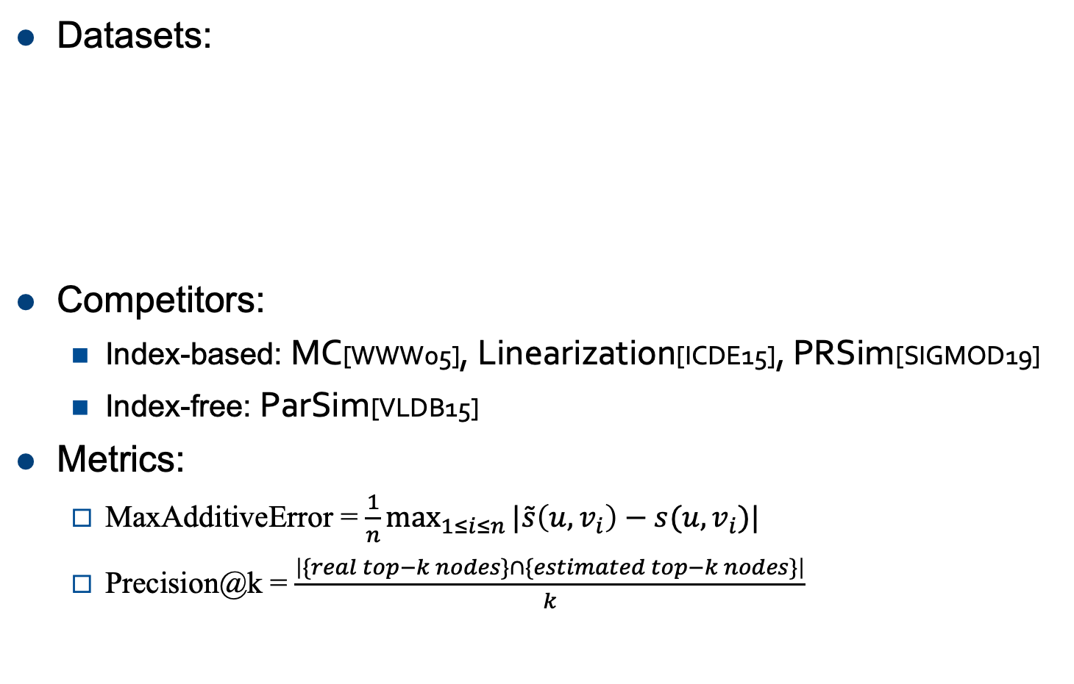
Experiments
Datasets:
Competitors:
  Index-based: MC[WWW05], Linearization[ICDE15], PRSim[SIGMOD19]
  Index-free: ParSim[VLDB15]
Metrics:
  MaxAdditiveError = $\frac{1}{n}\max_{1≤i≤n}{|\tilde{s}\left(u,v_{i}\right)−s(u,v_{i})|}$
  Precision@k = $\frac{\left|\{real top−k nodes\}∩\{estimated top−k nodes\}\right|}{k}$
K=500
Dataset source: http://snap.stanford.edu/data/index.html.
http://law.di.unimi.it/datasets.php.
Notes:
We select four small graphs and four larges to compare the performance of ExactSim with state-of-the-art methods. We use maximum additive error and top k precision as our metrics. Here, we set k equals 500.

Slide 24
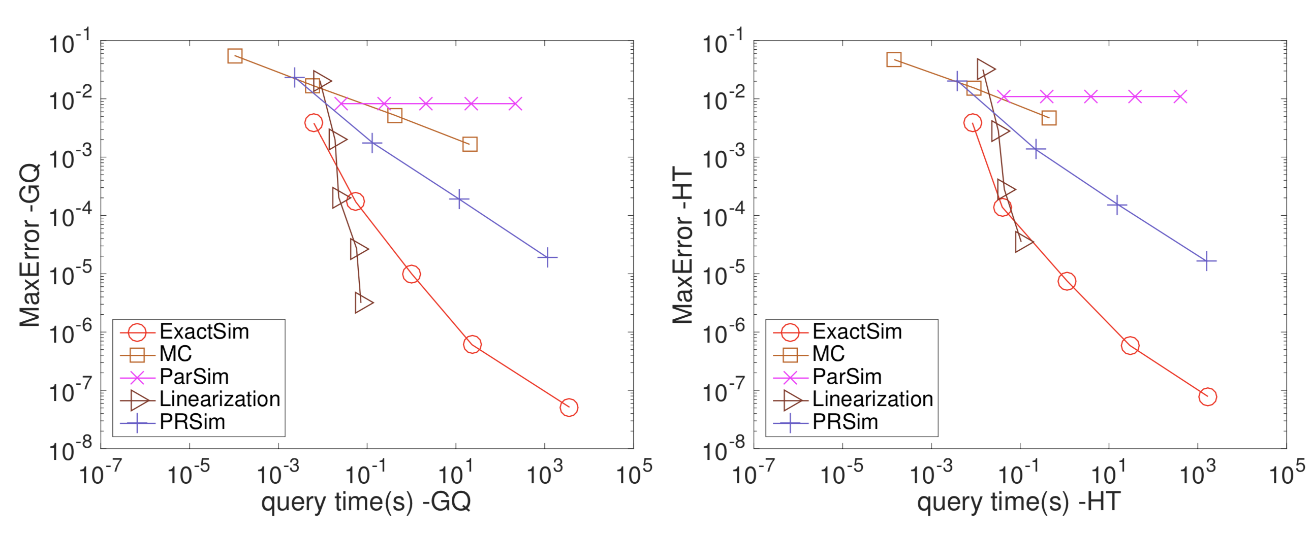
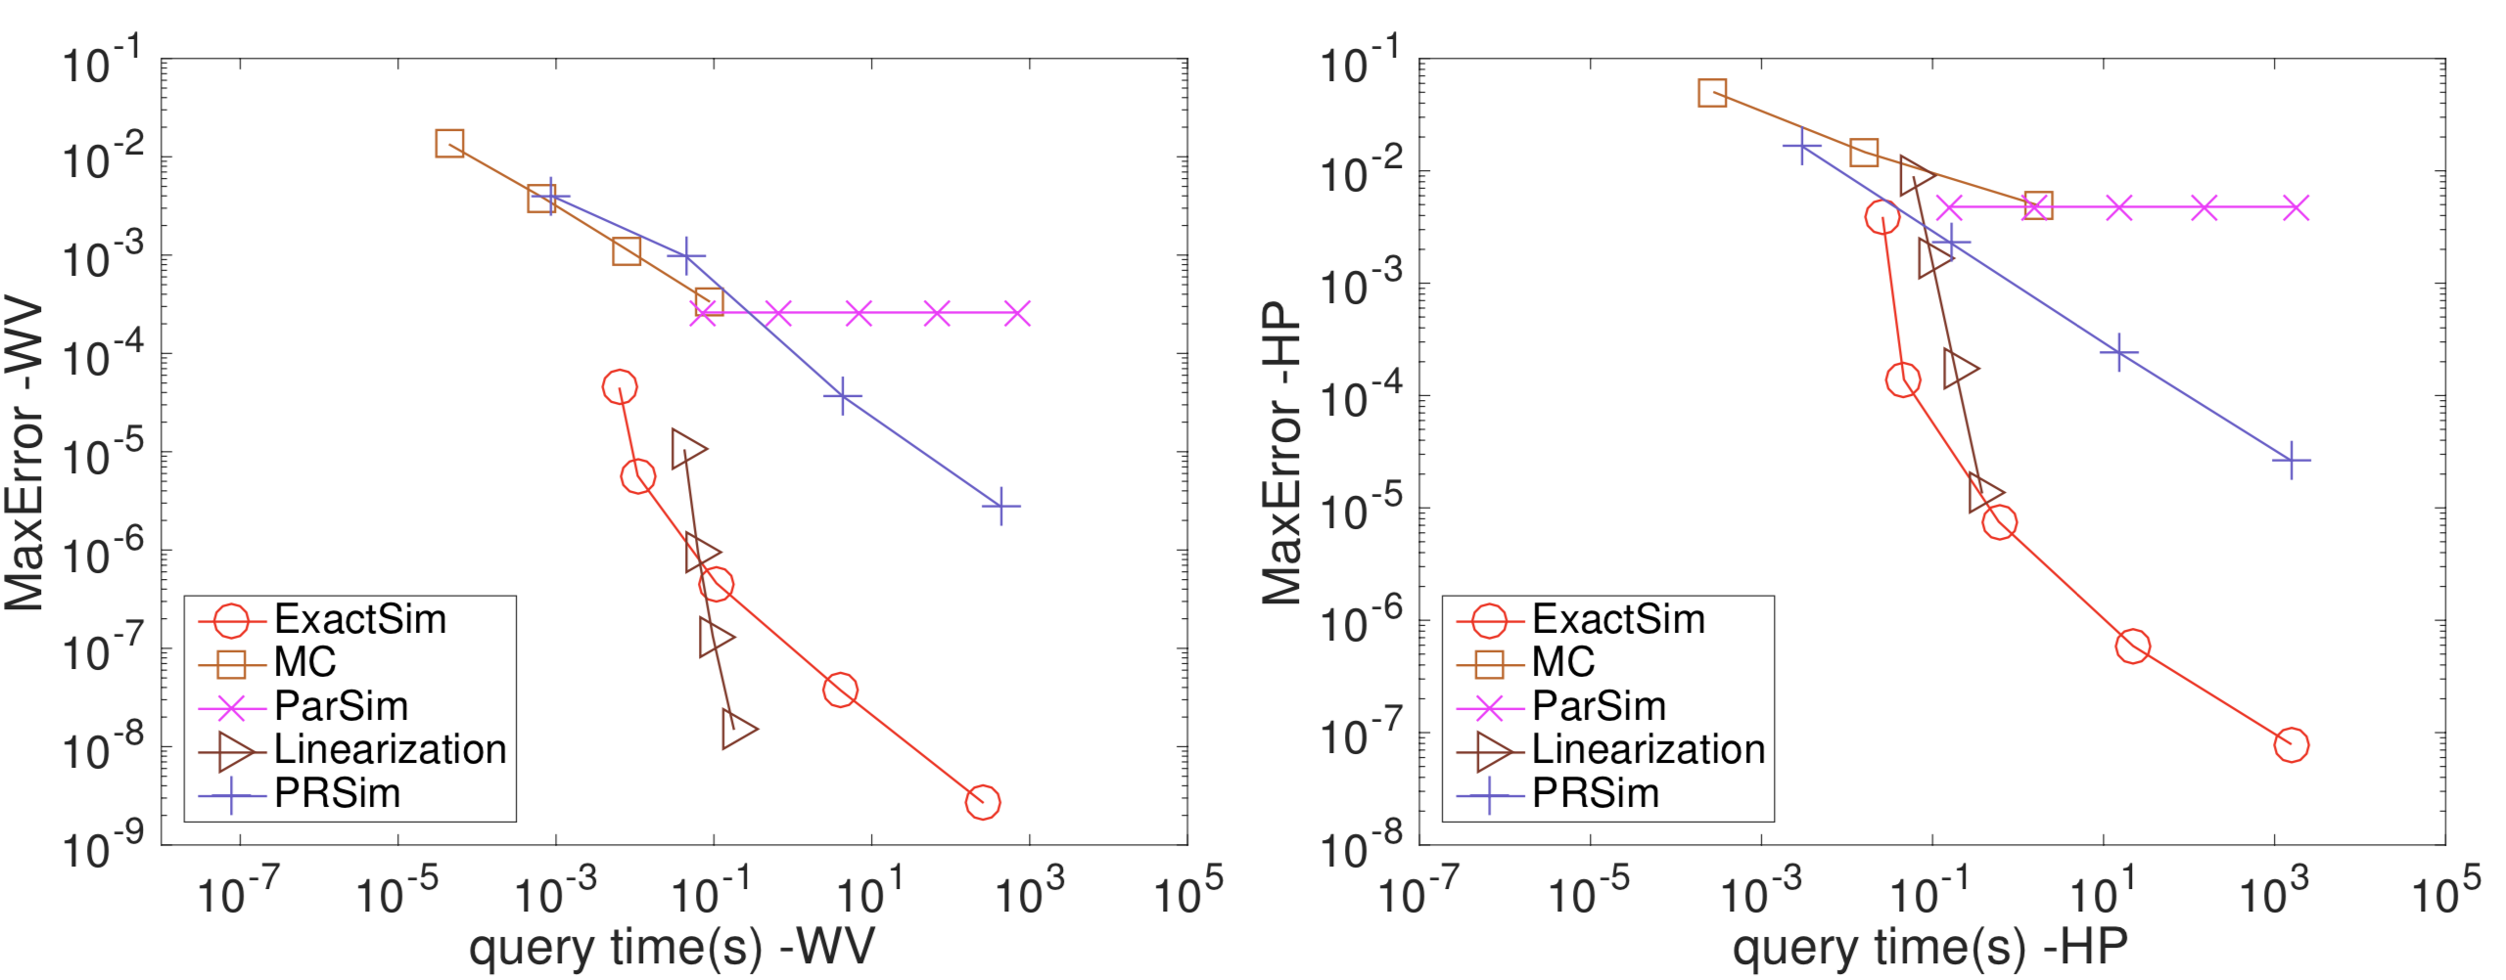
Experiments-small graphs
MaxError v.s. Query time on small graphs
Ground truths: power method results
Notes:
We can observe that on small graphs, ExactSim, plotted in the read line, is the only method which can consistently achieves 10 to the minus 7th power additive error within ten thousand seconds.

Slide 25
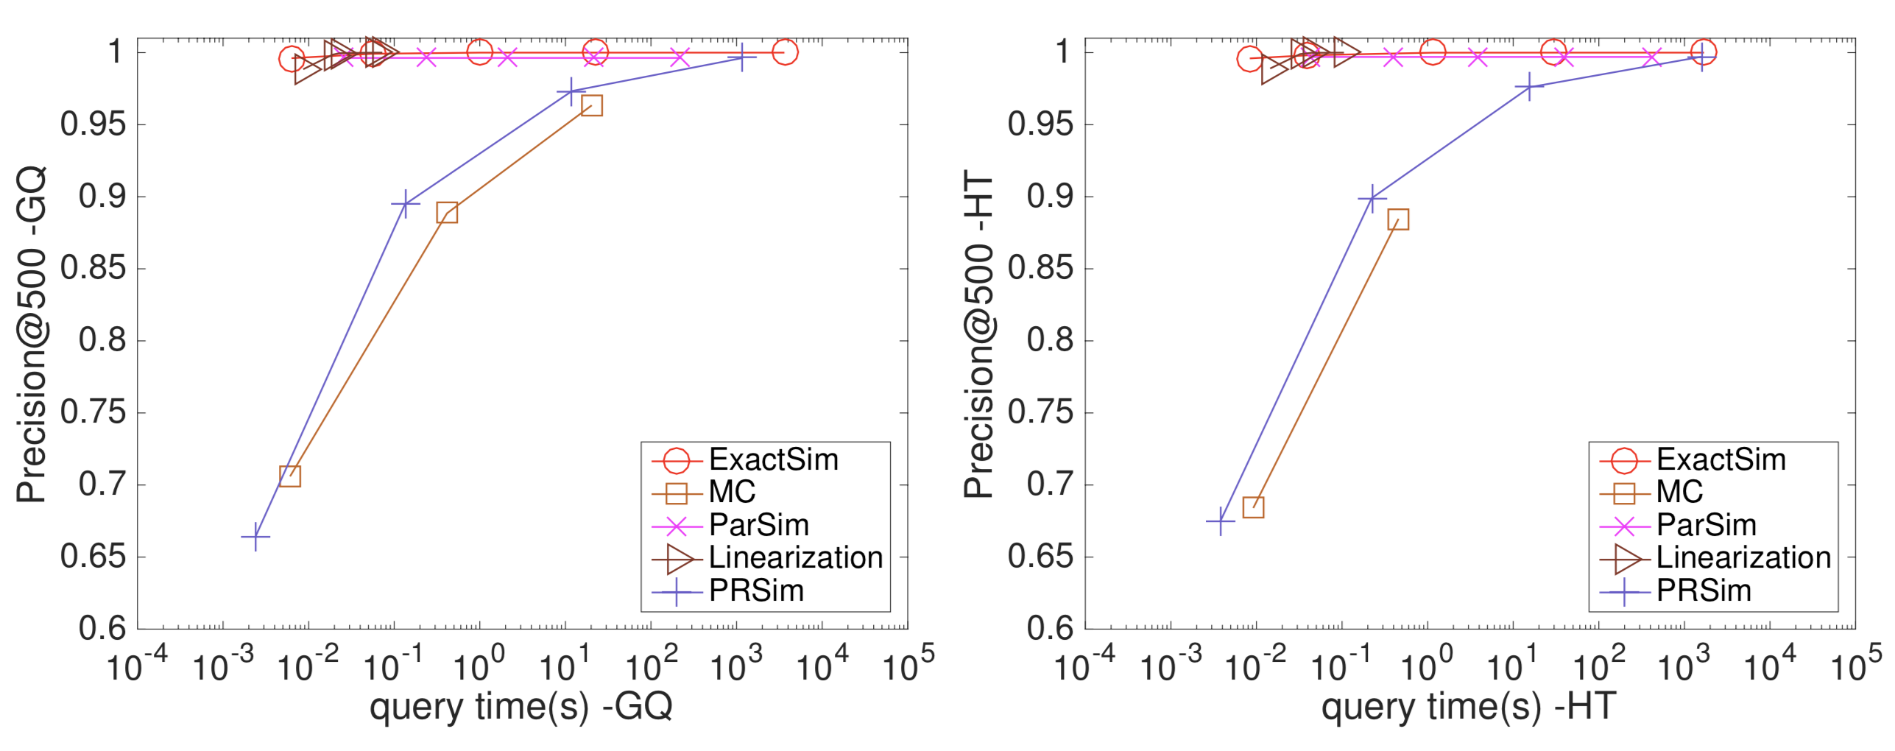
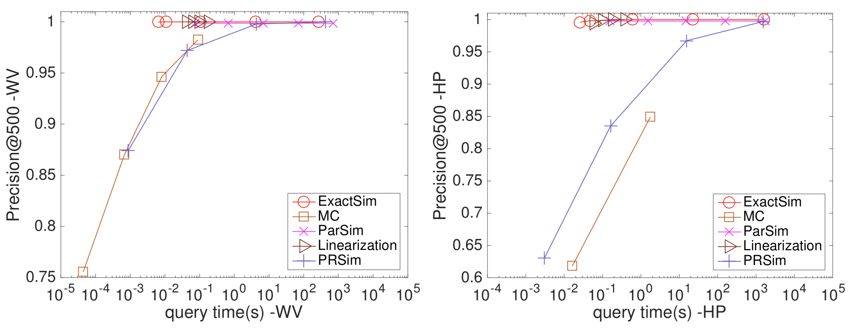
Experiments-small graphs
Precision@500 v.s. Query time on small graphs
Ground truths: power method results
Notes:
And the precision of ExactSim always achieve 1 with small \e.

Slide 26
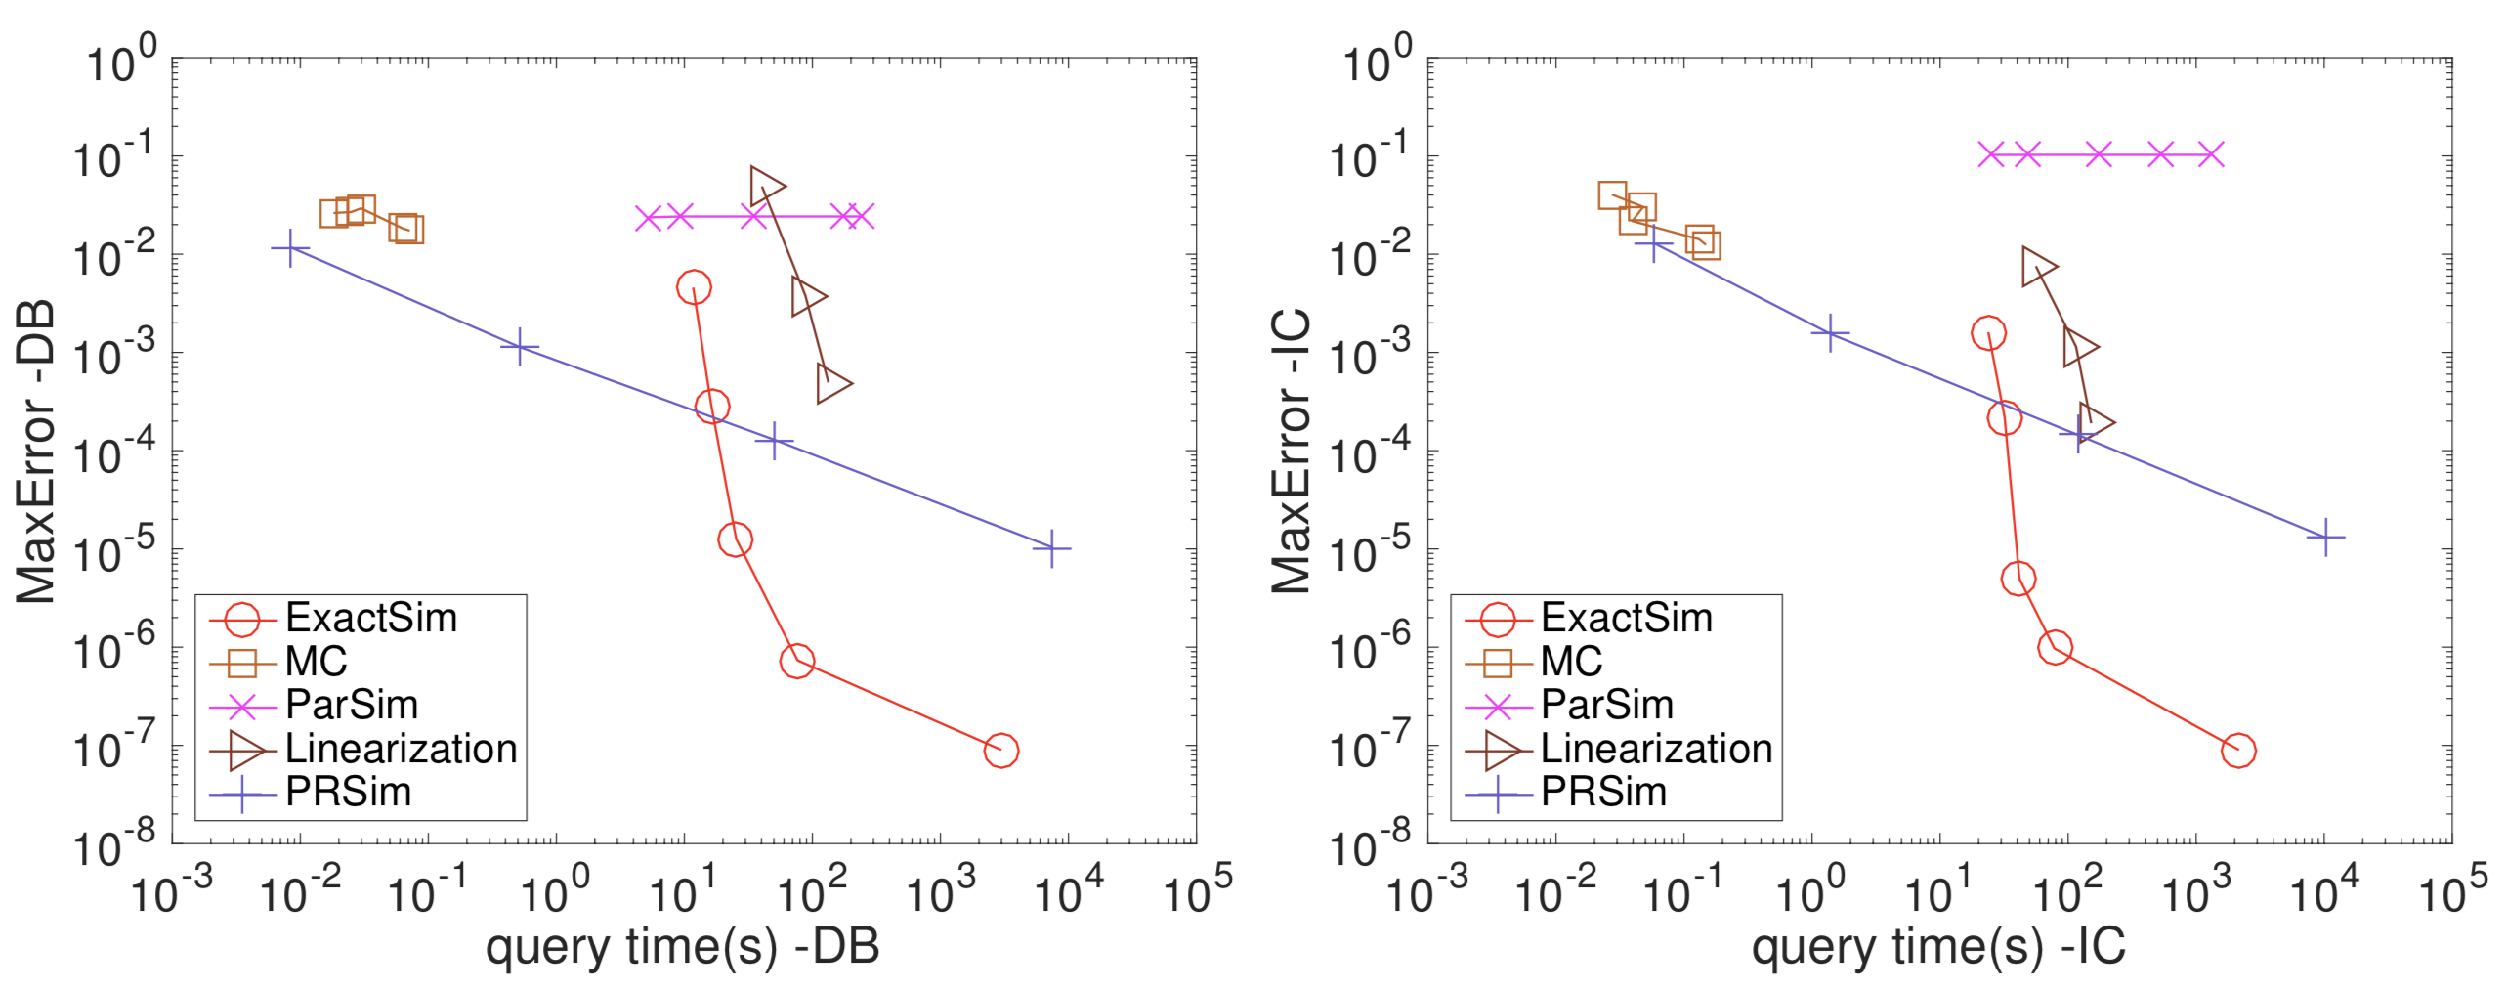
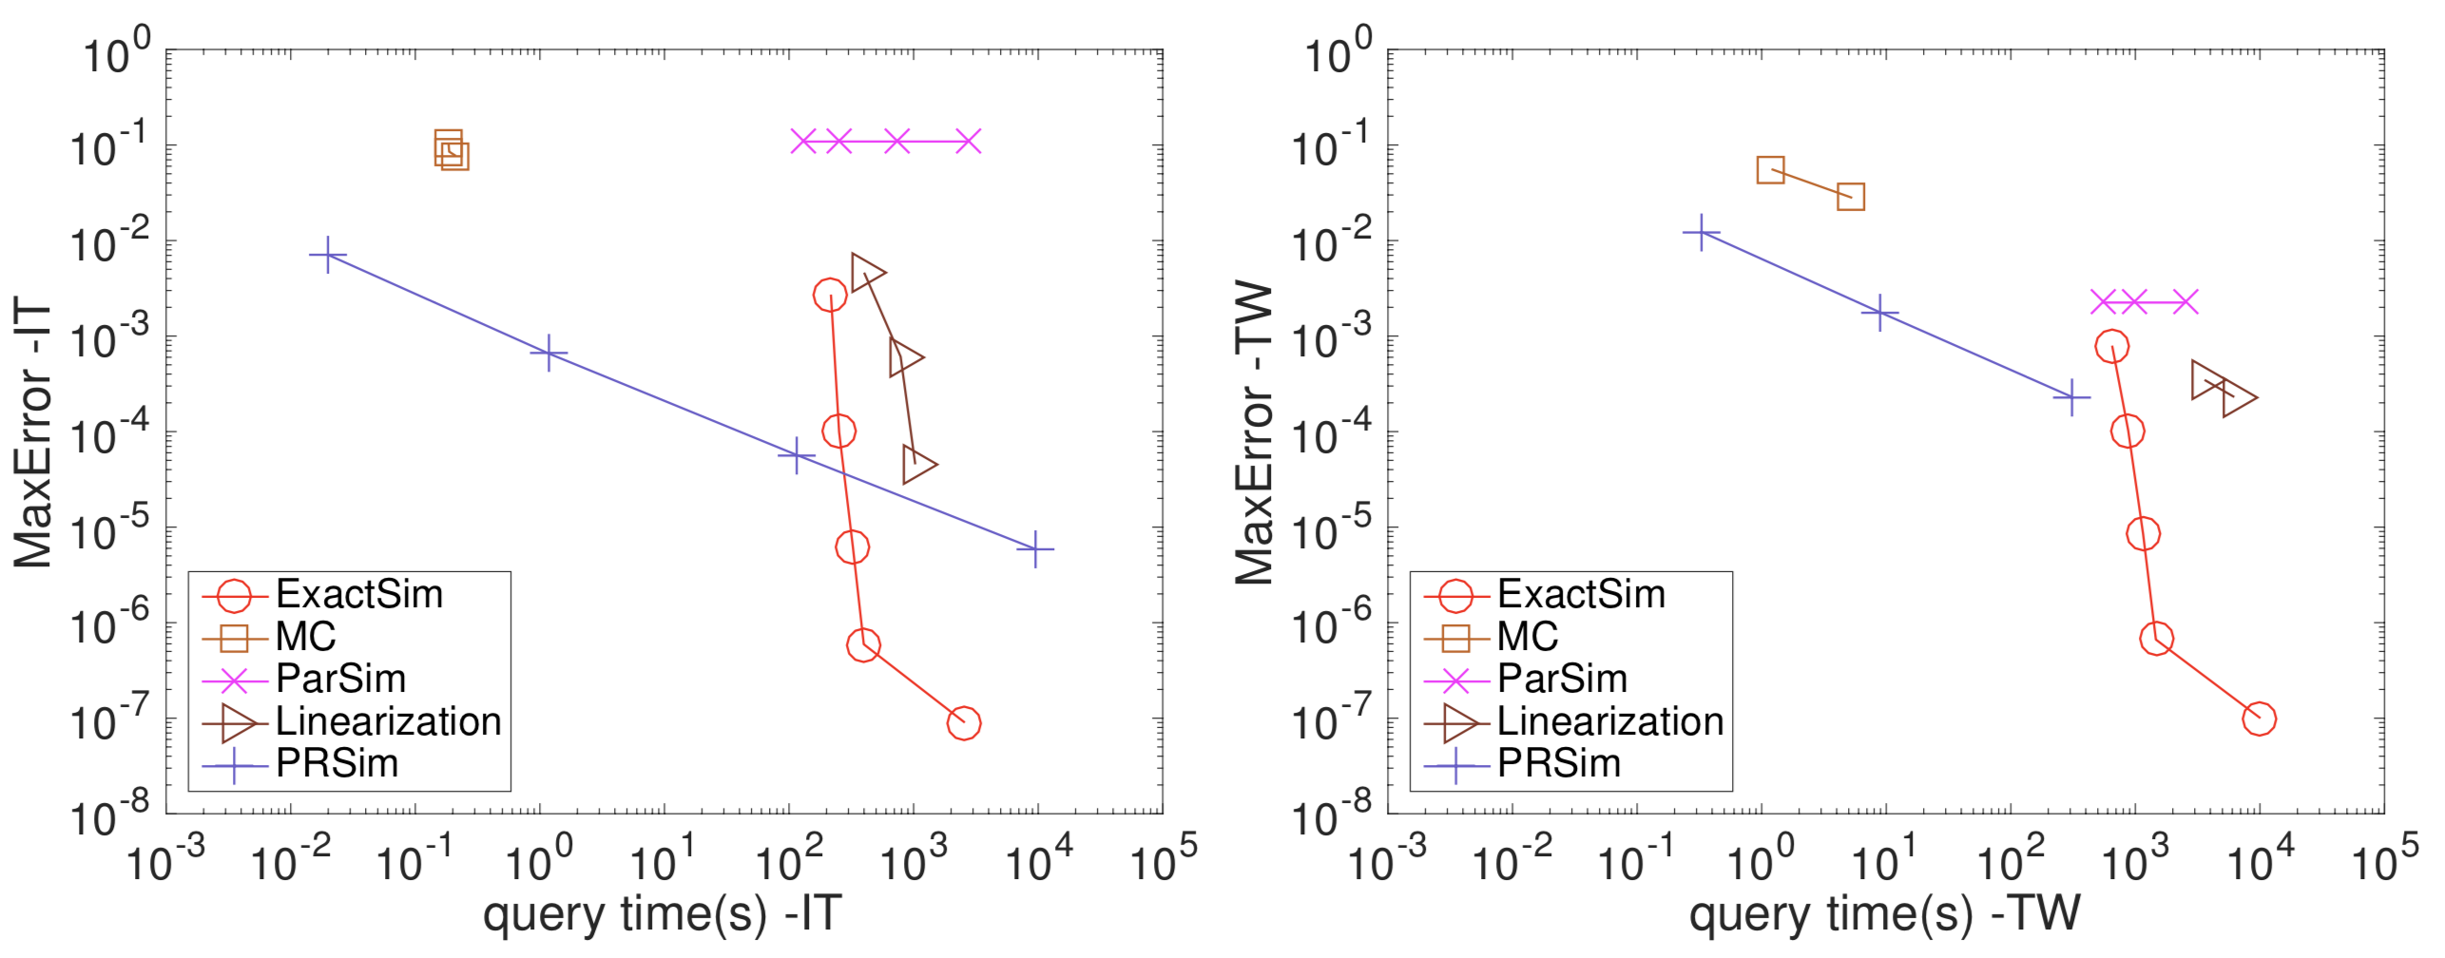
Experiments-large graphs
MaxError v.s. Query time on large graphs
Ground truths: ExactSim results when $ε={10}^{−7}$.
Notes:
On the large graph, we use the ExactSim results with 10 to the minus 7th power additive error as ground truths to compare the performance of ExactSim with larger \e and other methods. Our theoretical analysis guarantees the accuracy of ExactSim.
We observe that ExactSim is the only method which can achieve an error of less than 10 to the minus 6th power.

Slide 27
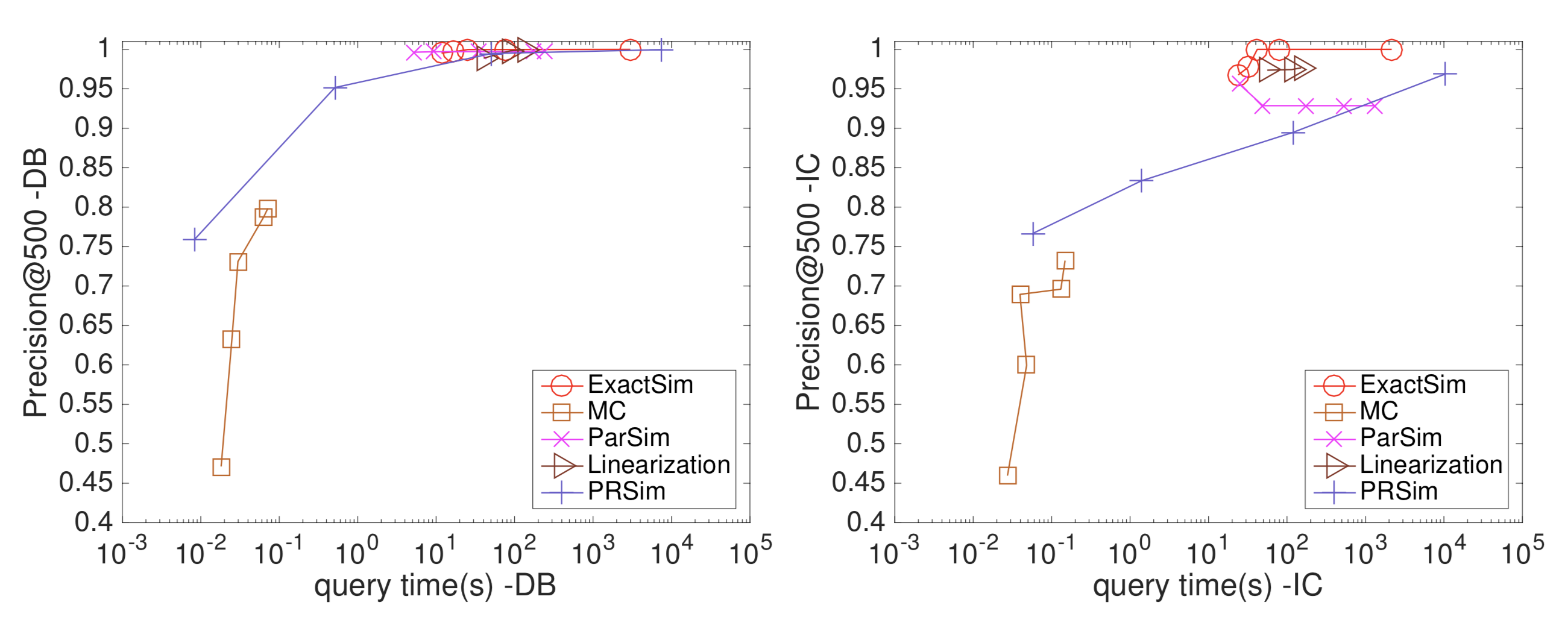
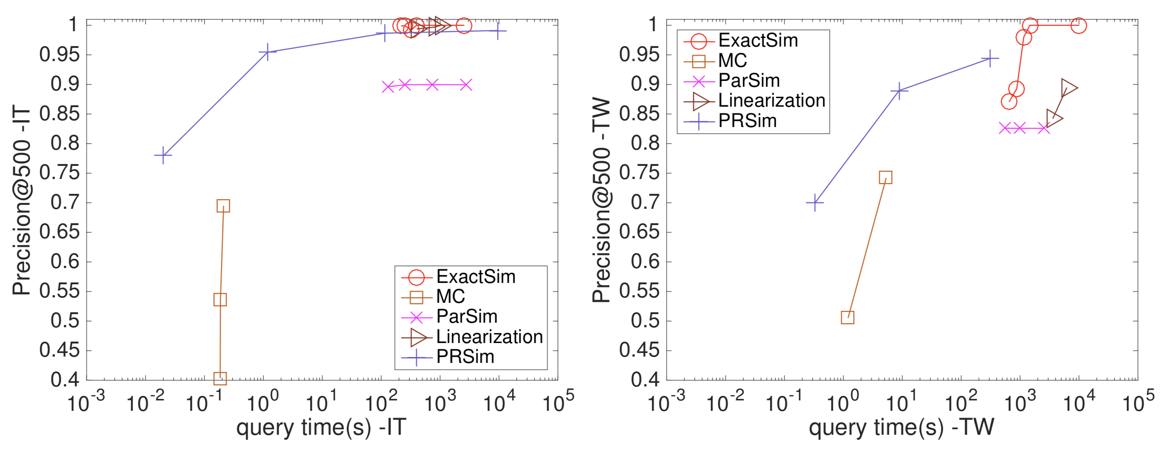
Experiments-large graphs
Precision@500 v.s. Query time on large graphs
Ground truths: ExactSim results when $ε={10}^{−7}$.
Notes:
And the precision of ExactSim with 10 to the minus 6th power $ε$ also achieves precision 1 on all large graphs. This means ExactSim actually converges after 10 to the minus 6th power $ε$.

Slide 28


Conclusion
ExactSim first achieves ${ε=10}^{−7}$ additive error on large graphs.
ExactSim’s results with ${ε=10}^{−7}$ are the same as ground truths in float type.
Outperforms the state-of-the-art methods on both small and large graphs in terms of query time and accuracy.
Notes:
As a conclusion, ExactSim is the first method to produce 10 to the minus 7th power additive error single-source SimRank results within effective query time.
(Click!)These results are the same as ground truths if they are stored in the float type. Hence, we can say ExactSim can return the ground truths on large graphs.
(Click!)Besides, We conduct comprehensive experiments to show ExactSim outperforms other methods both in terms of query time and accuracy.

Slide 29
Thank you!
Exact Single-Source SimRank Computation on Large Graphs
Notes:
That’s all of our presentation. Thank you.

Slide 30



Motivation
Lack of ground truths on large graphs
  Evaluate the accuracy on small graphs.
  Report the efficiency/scalability results on large graphs
  with consistent parameters.
Method 1
Method 2
Better?
small
graph
#rw
=$\frac{n\log{n}}{ε^{2}}={10}^{3}$
#rw=1000
small
graph
u
v
u
v
$$s(u,v)$$
V.S
$$s(u,v)$$
consistent
parameters
consistent
parameters
large
graph
large
graph
#rw
=$\frac{n\log{n}}{ε^{2}}={10}^{7}$
#rw=1000
faster
u
v
u
v
slower
$$s(u,v)$$
$$s(u,v)$$
Notes:
Many methods take the following measurement: they evaluate the accuracy on small graphs and report the efficiency or scalability on large graphs with consistent parameters.
But such measurement can lead to quite unfair conclusion.
For example, we have two methods method 1 and method 2 given in the left side and right side. They are all Monte-Carlo based methods that they generate pairs of random walks to check whether the two walk meet at the same step. And they use the percentage of walks that meet in the process to estimate SimRank scores between the two nodes. Method 1 decides to fix the number of random walks as 1000 on both small and large graphs. And method 2 tries to fix the error parameter \e and generate 1000 walks on small graphs and ten million walks on large graphs. Suppose the two methods achieve the same accuracy on small graphs. The query time is definitely smaller of method 1 than that of method 2. Can we derive the conclusion that method 1 has the better efficiency than method 2 on large graphs(Click!). Of course not. Because 1000 walks on large graphs are quite insufficient to achieve the same accuracy as that on small graphs. So only comparing the speed of two methods on large graphs is unreasonable. This absurd conclusion is mainly caused by lack of ground truths.

Slide 31
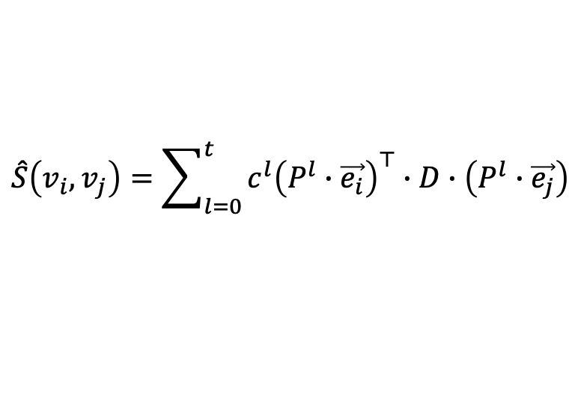
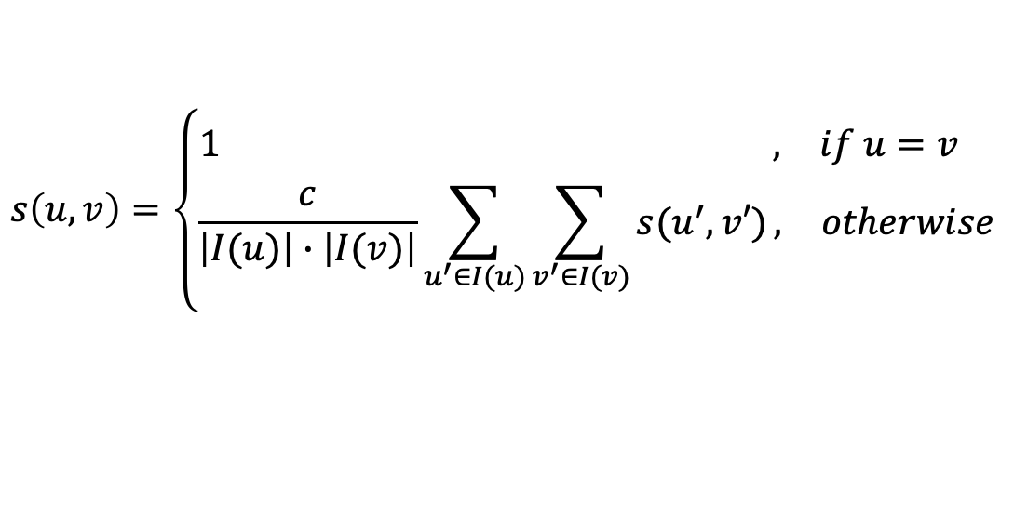
SimRank and Linearization
$$s\left(u,v\right)=\left\{\begin{aligned}\begin{matrix}1 , & if u=v \end{matrix} \\ \begin{matrix}\frac{c}{\left|I(u)\right|∙\left|I(v)\right|}\sum_{u^{′}∈I(u)}{\sum_{v^{′}∈I(v)}{s(u^{′},v′)}}, & otherwise\end{matrix}\end{aligned}\right.$$
iterative
$$\hat{S}\left(v_{i},v_{j}\right)=\sum_{l=0}^{t}{c^{l}{\left(P^{l}∙\vec{e_{i}}\right)}^{⊤}∙D∙\left(P^{l}∙\vec{e_{j}}\right)}$$
linearized
Notes:
Besides, SimRank can be expressed as linear summation shown in the first equation, where P denotes the transition matrix of the given graph and D is a diagonal correction matrix. If we separate the multiplication process and observe the product term enclosed by the red square, the P($v_{i},v_{k}$) to the $l$ power represents the probability that one square root of c walk from node $v_{i}$ arrives at $v_{k}$ in its $l_{th}$ step. D(k,k) is used to avoid double counting and denotes the probability that two square root of c walks starting from node $v_{k}$ do not meet later. Hence, the entire product term enclosed by the red square equals the probability that two square root of c walks from $v_{i}$ and $v_{j}$ last meet at node $v_{k}$ at their $l_{th}$ step. Then the two walks do not meet again. The linearization method and Monte Carlo method are both the interpretation of SimRank and are interchangeable.

Slide 32

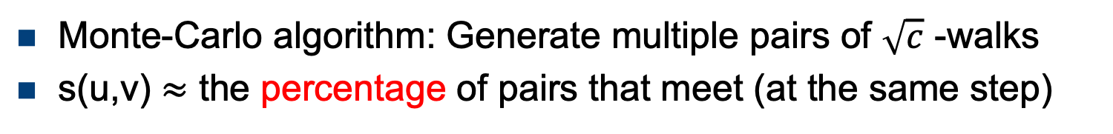
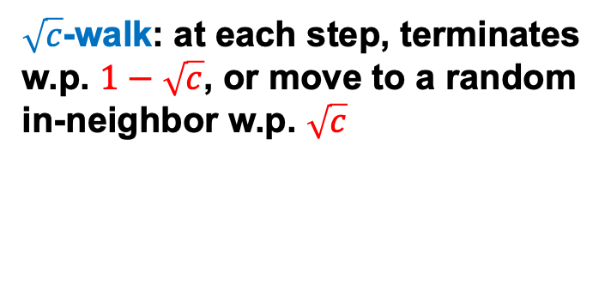
SimRank and Monte-Carlo
10
9
2
12
1
8
3
11
4
$\sqrt{c}$-walk: at each step, terminates w.p. $1−\sqrt{c}$, or move to a random in-neighbor w.p. $\sqrt{c}$
6
5
s(u,v)=Pr{two $\sqrt{c}$-walks from u, v meet at the same step}
7
Monte-Carlo algorithm: Generate multiple pairs of $\sqrt{c}$ -walks
s(u,v) $≈$ the percentage of pairs that meet (at the same step)
Notes:
And the SimRank value between any two nodes u and v on the given graph equals the probability that two square root of c walks generated respectively from the two nodes finally meet at the same step.

Slide 33
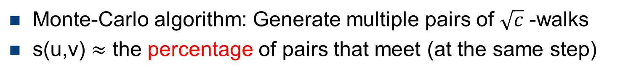
SimRank and Monte-Carlo
10
9
2
12
1
8
3
11
4
$\sqrt{c}$-walk: at each step, terminates w.p. $1−\sqrt{c}$, or move to a random in-neighbor w.p. $\sqrt{c}$
6
5
s(u,v)=Pr{two $\sqrt{c}$-walks from u, v meet at the same step}
7
Monte-Carlo algorithm: Generate multiple pairs of $\sqrt{c}$ -walks
s(u,v) $≈$ the percentage of pairs that meet (at the same step)
Notes:
Repeat generating pairs of square root of c walks from node u and v. And we can regard the percentage of walk pairs which meet at the same step as the estimation of the SimRank results between u and v. This provides us a different interpretation of SimRank from Monte-Carlo aspect.

Slide 34

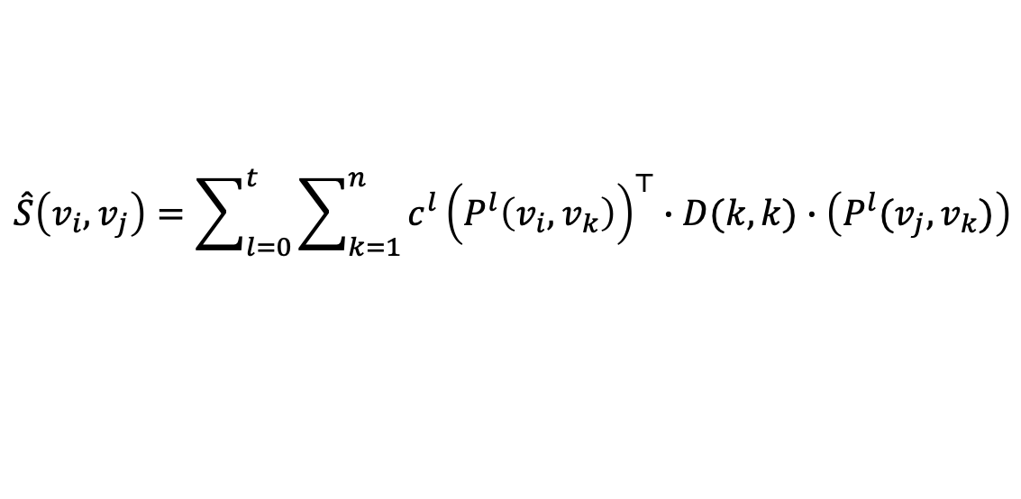
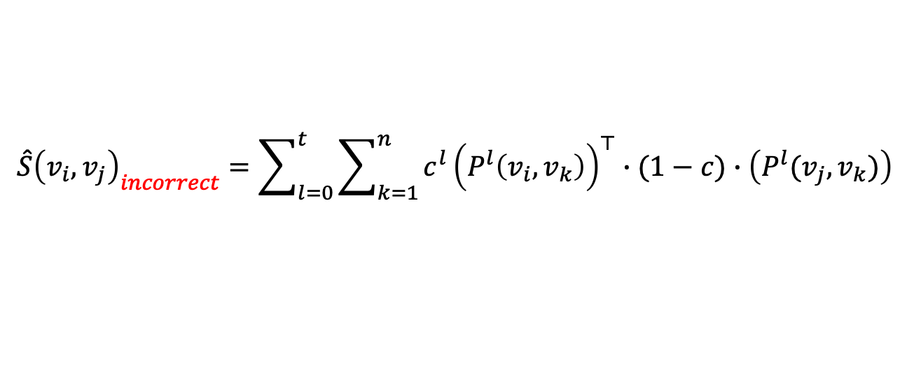

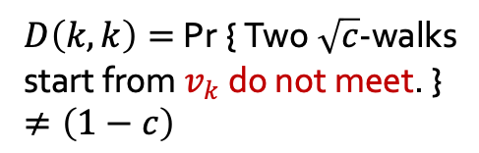

Incorrect SimRank Equation
$$\hat{S}\left(v_{i},v_{j}\right)=\sum_{l=0}^{t}{\sum_{k=1}^{n}{c^{l}{\left(P^{l}\left(v_{i},v_{k}\right)\right)}^{⊤}∙D(k,k)∙\left(P^{l}(v_{j},v_{k})\right)}}$$
$$≠$$
$${\hat{S}\left(v_{i},v_{j}\right)}_{incorrect}=\sum_{l=0}^{t}{\sum_{k=1}^{n}{c^{l}{\left(P^{l}\left(v_{i},v_{k}\right)\right)}^{⊤}∙(1−c)∙\left(P^{l}(v_{j},v_{k})\right)}}$$
SimMat[ICDE13]
ParSim[VLDB15]
…
Do not meet
$D\left(k,k\right)=$ Pr { Two $\sqrt{c}$-walks start from $v_{k}$ do not meet. }
$≠\left(1−c\right)$
7
k
5
8
2
$l_{th}$ step
$l_{th}$ step
6
2
5
3
1
4
j
…
…
…
Notes:
In detail, they use one minus c to substitute each entry of matrix D. Recall that D(k,k) is used to avoid double counting and denotes the probability that two square root of c walks starting from node $v_{k}$ do not meet later. So, this incorrect substitution causes large error.

