Slide 1





Hanzhi Wang¹, Zhewei Wei¹ , Junhao Gan², Ye Yuan³, Xiaoyong Du¹, Ji-Rong Wen¹
Edge-based Local Push for Personalized PageRank
¹: Renmin University of China
²: The University of Melbourne
³: Beijing Institute of Technology
Notes:
Hello everyone, I am Hanzhi Wang from Renmin University of China. It’s my pleasure to present our paper, Edge-based local push for Personalized PageRank. I am sorry I cannot attend the meeting in person. And I would like to present our paper remotely. This work was conducted under the supervision [ˌsuːpərˈvɪʒ(ə)n] of my adviser, Prof Zhewei Wei from Renmin University of China, and Professor Junhao Gan from the University of Melbourne [ˈmelbərn]. We also have cooperators from Beijing Institute of Technology.

Slide 2




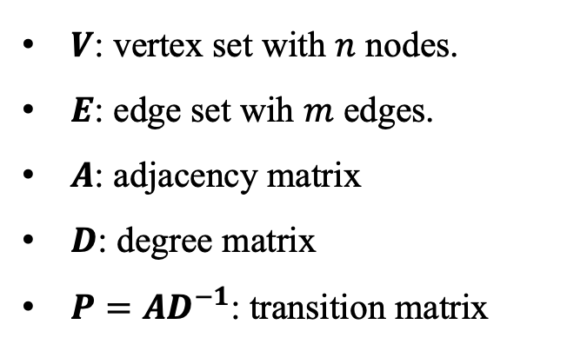

Graph
Graph $G=(V,E)$
Social Network
Transportation Network
$V$: vertex set with $n$ nodes.
$E$: edge set wih $m$ edges.
$A$: adjacency matrix
$D$: degree matrix
$P=AD^{−1}$: transition matrix
Protein Structure
Trade Network
Notes:
Note that we are in the session called “Graphs”. So definitely our work is a study on graphs. We know that graph is a data structure defined as a combination of a vertex set V with n nodes and an edge set E with m edges. Actually, graphs are powerful and ubiquitous because it can model a large number of networks in real life.

Slide 3
Goal
  In this paper, we aim to efficiently approximate the single-source Personalized PageRank on weighted graphs.
Notes:
In this paper, we aim to efficiently approximate the single-source Personalized PageRank on weighted graphs. Note that there are many concepts. I will illustrate them one by one. (click!) First, PageRank.

Slide 4





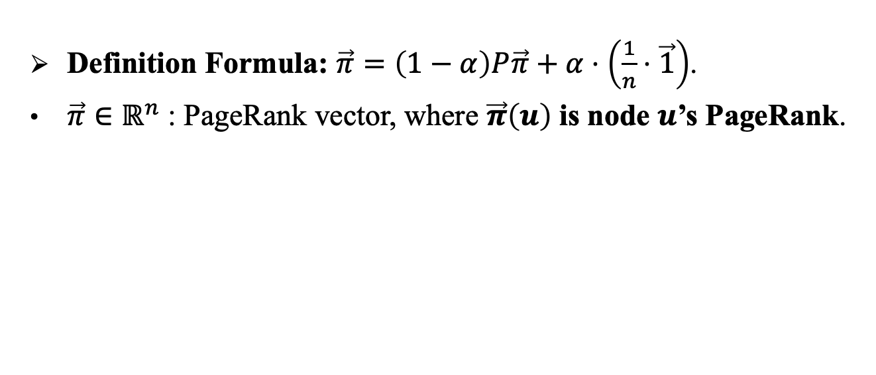


PageRank
  PageRank is a popular measure of node proximity, which is first proposed by Google to rank web pages.
  Basic Idea: more important web pages are likely to receive more links from other web pages.
  Definition Formula: $\vec{π}=\left(1−α\right)P\vec{π}+α⋅\left(\frac{1}{n}⋅\vec{1}\right)$.
  $\vec{π}∈ℝ^{n}$ : PageRank vector, where $\vec{π}\left(u\right)$ is node $u$’s PageRank.
$$u$$
$$s$$
Notes:
We know that PageRank is a famous measure of node proximity, first proposed by Google to rank web pages based on the idea that more important web pages are likely to receive more links from other web pages.

Slide 5
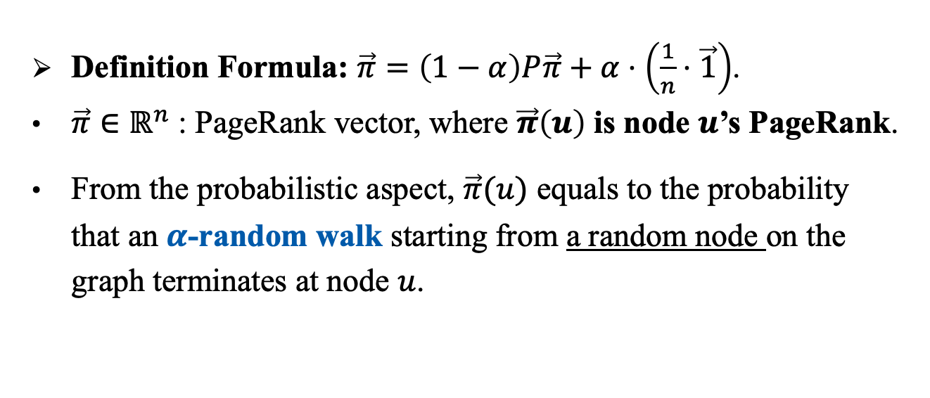


PageRank
  PageRank is a popular measure of node proximity, which is first proposed by Google to rank web pages.
  Basic Idea: more important web pages are likely to receive more links from other web pages.
  Definition Formula: $\vec{π}=\left(1−α\right)P\vec{π}+α⋅\left(\frac{1}{n}⋅\vec{1}\right)$.
  $\vec{π}∈ℝ^{n}$ : PageRank vector, where $\vec{π}\left(u\right)$ is node $u$’s PageRank.
  From the probabilistic aspect, $\vec{π}(u)$ equals to the probability that an $α$-random walk starting from a random node on the graph terminates at node $u$.
$$u$$
$1−α$
$$s$$
$1−α$
Notes:
And the pagerank value of node u can be interpreted as a probability, that is, u’s pagerank equals the probability that an alpha-random walk starting from a random node on the graph terminates at node u. Here, alpha-random walk refers to a specific random walk process that (click) at each step, the walk either terminates at the current node with probability $α$ or moves to a random out-neighbor with probability 1−𝛼.

Slide 6

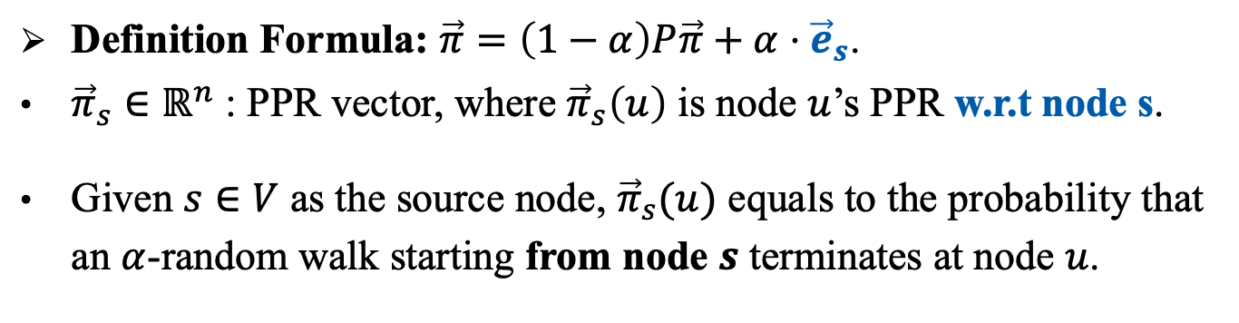



Personalized PageRank (PPR) and SSPPR Queries
$$u$$
  Definition Formula: $\vec{π}=\left(1−α\right)P\vec{π}+α⋅{\vec{e}}_{s}$.
  ${\vec{π}}_{s}∈ℝ^{n}$ : PPR vector, where ${\vec{π}}_{s}\left(u\right)$ is node $u$’s PPR w.r.t node s.
  Given $s∈V$ as the source node, ${\vec{π}}_{s}(u)$ equals to the probability that an $α$-random walk starting from node $s$ terminates at node $u$.
$1−α$
$$s$$
$1−α$
Notes:
The definition of Personalized PageRank stems from that of PageRank. The only difference is, Personalized PageRank measures the node proximity with regard to a given source node s. On the other hand, the Personalized PageRank of u equals to the probability that an $α$-random walk starting from the source node $s$ terminates at node $u$. In this talk, I will use PPR to refer to Personalized PageRank for short, and use pi(u) to denote the PPR value of node u.

Slide 7
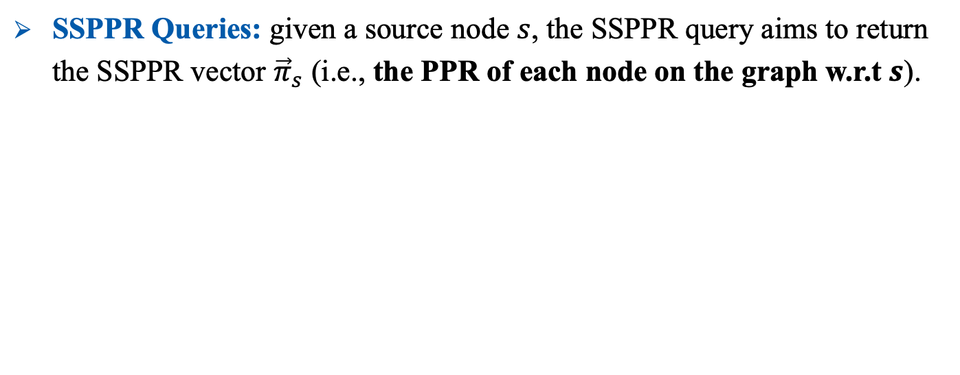

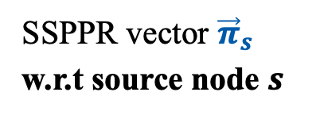
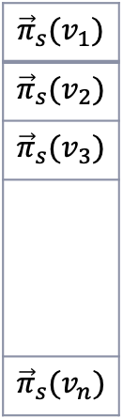
Personalized PageRank (PPR) and SSPPR Queries
$$u$$
  Definition Formula: $\vec{π}=\left(1−α\right)P\vec{π}+α⋅{\vec{e}}_{s}$.
  ${\vec{π}}_{s}∈ℝ^{n}$ : PPR vector, where ${\vec{π}}_{s}\left(u\right)$ is node $u$’s PPR w.r.t node s.
  Given $s∈V$ as the source node, ${\vec{π}}_{s}(u)$ equals to the probability that an $α$-random walk starting from node $s$ terminates at node $u$.
$1−α$
$$s$$
$1−α$
  SSPPR Queries: given a source node $s$, the SSPPR query aims to return the SSPPR vector ${\vec{π}}_{s}$ (i.e., the PPR of each node on the graph w.r.t $s$).
$${\vec{π}}_{s}(v_{1})$$
$${\vec{π}}_{s}(v_{2})$$
$${\vec{π}}_{s}(v_{3})$$
$${\vec{π}}_{s}(v_{n})$$
SSPPR vector ${\vec{π}}_{s}$ w.r.t source node $s$
$$…$$
Notes:
Recall that in this paper, we aim to approximate single-source Personalized PageRank on weighted graphs. Here single-source Personalized PageRank cooresponds to an n-dimentional vector, in which the u-th entry stores the PPR value of u with regrad to the given source node s. And the SSPPR query denotes a query process which aims to approximate the SSPPR vector given node s as the source node.

Slide 8
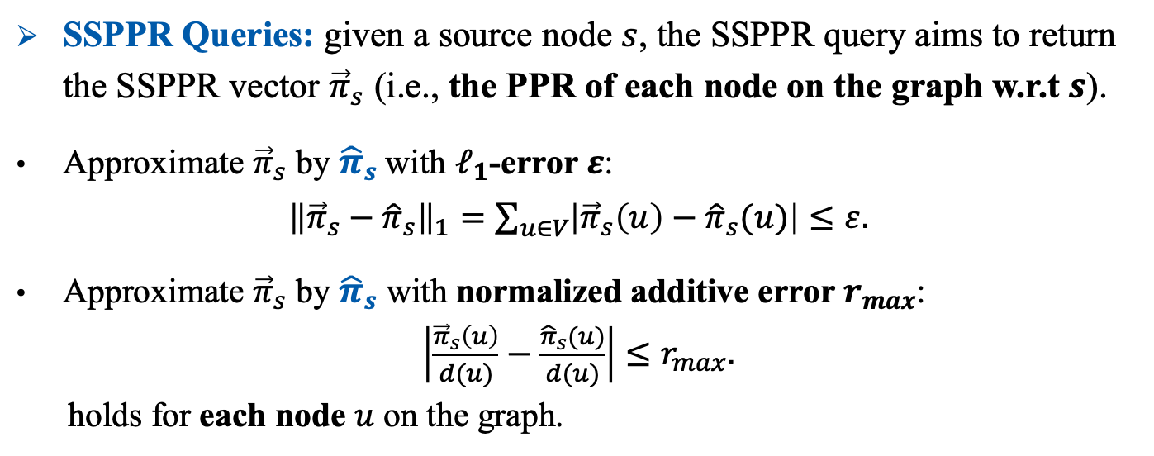
Personalized PageRank (PPR) and SSPPR Queries
$$u$$
  Definition Formula: $\vec{π}=\left(1−α\right)P\vec{π}+α⋅{\vec{e}}_{s}$.
  ${\vec{π}}_{s}∈ℝ^{n}$ : PPR vector, where ${\vec{π}}_{s}\left(u\right)$ is node $u$’s PPR w.r.t node s.
  Given $s∈V$ as the source node, ${\vec{π}}_{s}(u)$ equals to the probability that an $α$-random walk starting from node $s$ terminates at node $u$.
$1−α$
$$s$$
$1−α$
  SSPPR Queries: given a source node $s$, the SSPPR query aims to return the SSPPR vector ${\vec{π}}_{s}$ (i.e., the PPR of each node on the graph w.r.t $s$).
  Approximate ${\vec{π}}_{s}$ by ${\hat{π}}_{s}$with $ℓ_{1}$-error $ε$:
  ${\left\|{\vec{π}}_{s}−{\hat{π}}_{s}\right\|}_{1}=\sum_{u∈V}{\left|{\vec{π}}_{s}\left(u\right)−{\hat{π}}_{s}(u)\right|}≤ε.$
  Approximate ${\vec{π}}_{s}$ by ${\hat{π}}_{s}$ with normalized additive error $r_{max}$:
  $\left|\frac{{\vec{π}}_{s}\left(u\right)}{d(u)}−\frac{{\hat{π}}_{s}(u)}{d(u)}\right|≤r_{max}.$
  holds for each node $u$ on the graph.
$${\vec{π}}_{s}(v_{1})$$
$${\vec{π}}_{s}(v_{2})$$
$${\vec{π}}_{s}(v_{3})$$
$${\vec{π}}_{s}(v_{n})$$
SSPPR vector ${\vec{π}}_{s}$ w.r.t source node $s$
$$…$$
Notes:
Specifically, there are two popular metrics of the approximation error, l1-error and normalized additive error. In this paper, we analyze the theoretical guarantess of our method with both of the two evaluation metrics.

Slide 9
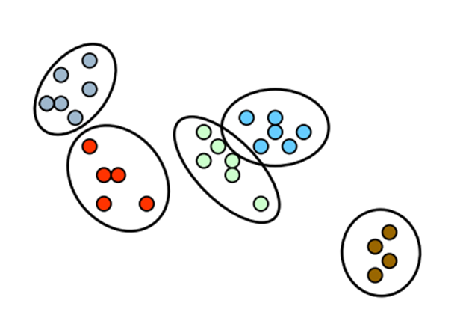


Wide Applications of SSPPR Queries
  Local Clustering [KDD’ 23].
  Point-of-Interest Recommendation [UMAP’17].
  Who-To-Follow Recommendation [WWW’03].
  Graph Representation Learning [KDD’20, NeurIPS’20, ICLR’19, NeurIPS’04].
  …
Notes:
SSPPR queries have been widely applied in various graph mining and learning tasks, such as local clustering, recommendation and representation learning.

Slide 10






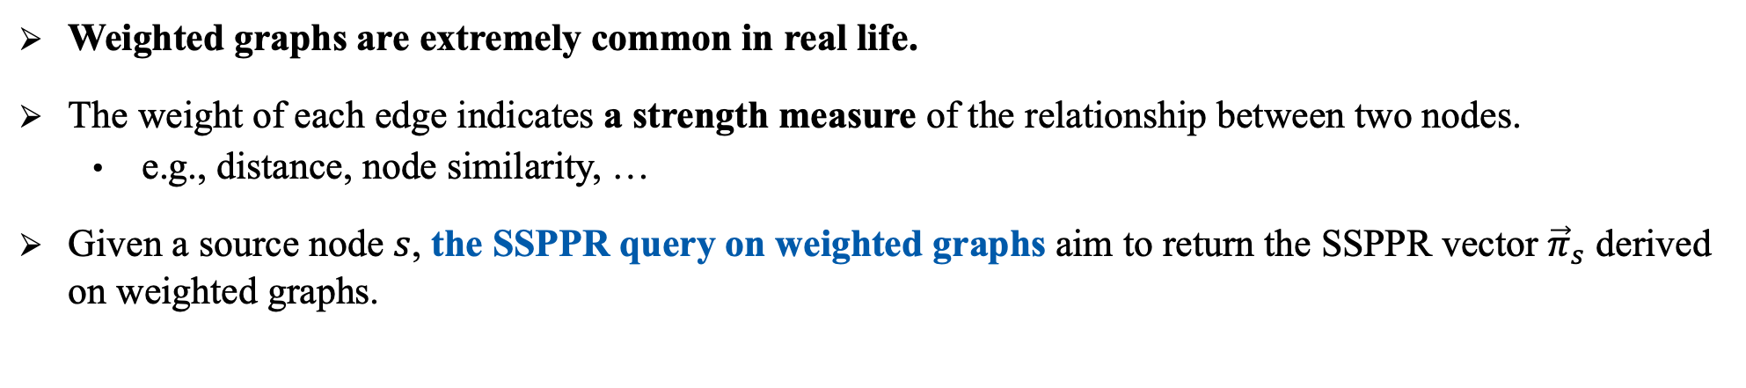
SSPPR Queries on Weighted Graphs
$$u$$
Weighted Graph $G$:
$$A_{uv}$$
$$v$$
$$A_{vs}$$
$$s$$
  Weighted graphs are extremely common in real life.
  The weight of each edge indicates a strength measure of the relationship between two nodes.
    e.g., distance, node similarity, …
  Given a source node $s$, the SSPPR query on weighted graphs aim to return the SSPPR vector ${\vec{π}}_{s}$ derived on weighted graphs.
Notes:
In this paper, we focus on SSPPR queries on weighted graphs because weighted graphs are extremely common in real life, but existing methods for SSPPR queries on weighted graphs can be rather inefficient [ˌɪnɪˈfɪʃ(ə)nt], especially on the graphs with severely [sɪˈvɪrli] unbalanced weight distributions.

Slide 11
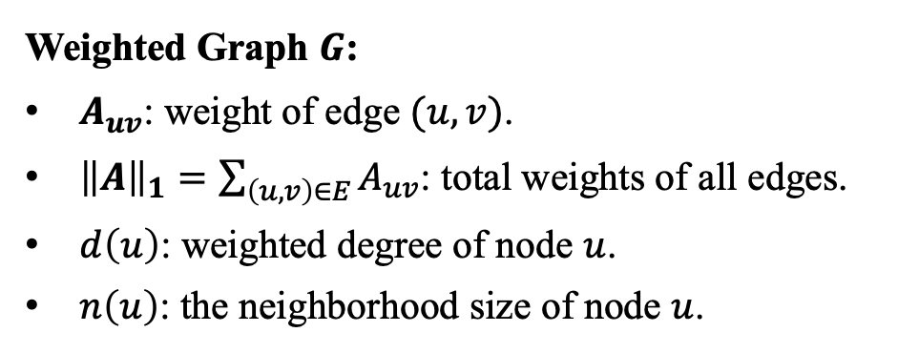
SSPPR Queries on Weighted Graphs
$$u$$
Weighted Graph $G$:
$A_{uv}$: weight of edge $(u,v)$.
${\left\|A\right\|}_{1}=\sum_{\left(u,v\right)∈E}{A_{uv}}$: total weights of all edges.
$d\left(u\right)$: weighted degree of node $u$.
$n\left(u\right)$: the neighborhood size of node $u$.
$$A_{uv}$$
$$v$$
$$A_{vs}$$
$$s$$
  Weighted graphs are extremely common in real life.
  The weight of each edge indicates a strength measure of the relationship between two nodes.
    e.g., distance, node similarity, …
  Given a source node $s$, the SSPPR query on weighted graphs aim to return the SSPPR vector ${\vec{π}}_{s}$ derived on weighted graphs.
Notes:
Before explanning the reasons, I would like to show the notations used on weighted graphs and present the theoretical improvements of our method. We know that each edge on a weighted graph has an edge weight, which measures the relationship’s strength between the two nodes, like distance or node similarity. In our paper, we use Auv to denote the weight of edge (u,v), and the one-norm of A to denote the total weights of all edges on the graph. Note that on weighted graphs, the degree of node u no longer equals the neighborhood size of node u. To distinguish them, we use d(u) to denote the weighted degree of node u, and n(u) to denote the neighborhood size of node u.

Slide 12





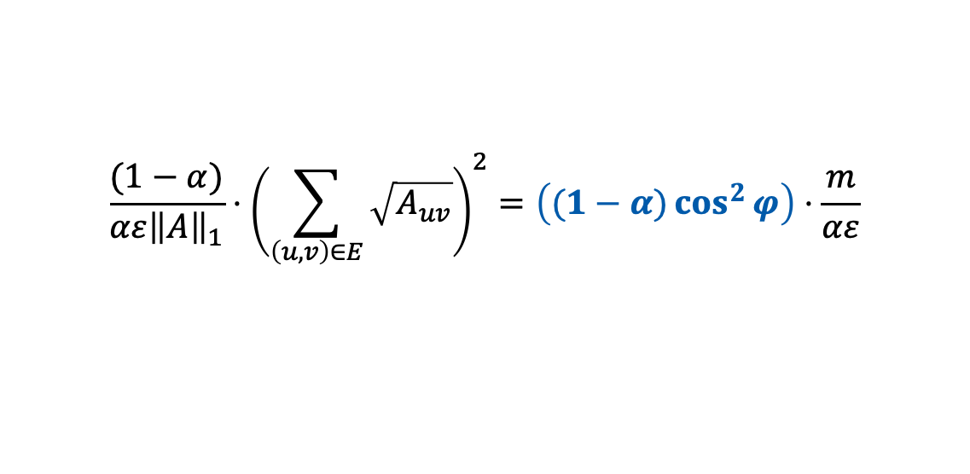




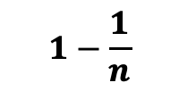

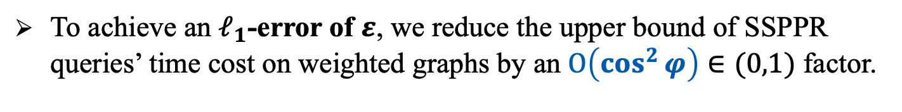
Theoretical Improvements
$$u_{1}$$
  To achieve an $ℓ_{1}$-error of $ε$, we reduce the upper bound of SSPPR queries’ time cost on weighted graphs by an $O\left(\cos^{2}{φ}\right)∈(0,1)$ factor.
$$1−\frac{1}{n}$$
$$\frac{(1−α)}{αε{\left\|A\right\|}_{1}}⋅{\left(\sum_{\left(u,v\right)∈E}{\sqrt{A_{uv}}}\right)}^{2}=\left((1−α)\cos^{2}{φ}\right)⋅\frac{m}{αε}$$
$$\frac{1}{n(n−1)}$$
$$u_{2}$$
$$\frac{1}{n(n−1)}$$
Our Bound
SOTA Bound
$$s$$
$$u_{3}$$
$$\frac{1}{n(n−1)}$$
…
$$u_{n−1}$$
$$\frac{1}{n(n−1)}$$
$$u_{n}$$
Notes:
In our paper, we reduce the upper bound of the time cost of SSPPR queries on weighted graphs, regardless of whether the l1-error or normalized additive error. More specifically, to achieve an $ℓ_{1}$-error of $ε$, our method reduces the time cost by a factor of the square of cosine phi.

Slide 13
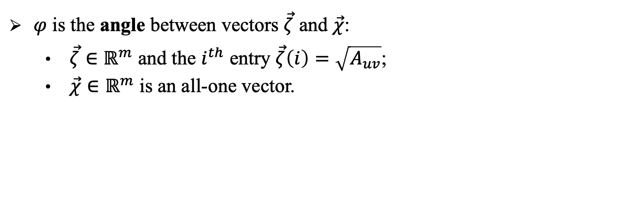
Theoretical Improvements
$$u_{1}$$
  To achieve an $ℓ_{1}$-error of $ε$, we reduce the upper bound of SSPPR queries’ time cost on weighted graphs by an $O\left(\cos^{2}{φ}\right)∈(0,1)$ factor.
$$1−\frac{1}{n}$$
$$\frac{(1−α)}{αε{\left\|A\right\|}_{1}}⋅{\left(\sum_{\left(u,v\right)∈E}{\sqrt{A_{uv}}}\right)}^{2}=\left((1−α)\cos^{2}{φ}\right)⋅\frac{m}{αε}$$
$$\frac{1}{n(n−1)}$$
$$u_{2}$$
$$\frac{1}{n(n−1)}$$
Our Bound
SOTA Bound
$$s$$
$$u_{3}$$
  $φ$ is the angle between vectors $\vec{ζ}$ and $\vec{χ}$:
    $\vec{ζ}∈ℝ^{m}$ and the $i^{th}$ entry $\vec{ζ}\left(i\right)=\sqrt{A_{uv}}$;
    $\vec{χ}∈ℝ^{m}$ is an all-one vector.
$$\frac{1}{n(n−1)}$$
…
$$u_{n−1}$$
$$\frac{1}{n(n−1)}$$
$$u_{n}$$
Notes:
Here phi is an angle, and cosine phi can quantify the unbalancedness of the weighted graph.

Slide 14
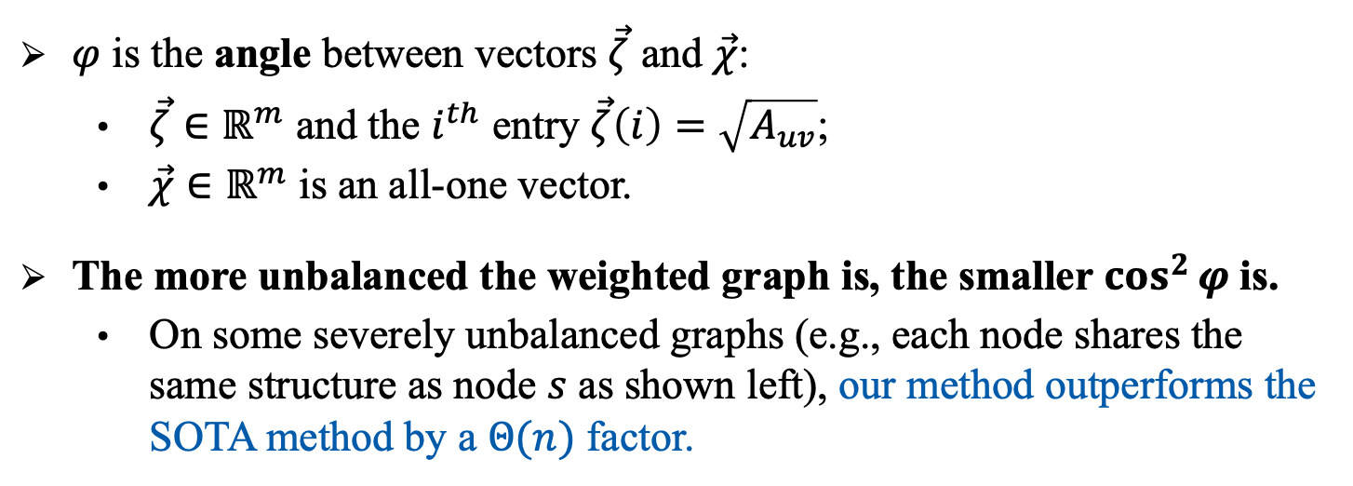
Theoretical Improvements
$$u_{1}$$
  To achieve an $ℓ_{1}$-error of $ε$, we reduce the upper bound of SSPPR queries’ time cost on weighted graphs by an $O\left(\cos^{2}{φ}\right)∈(0,1)$ factor.
$$1−\frac{1}{n}$$
$$\frac{(1−α)}{αε{\left\|A\right\|}_{1}}⋅{\left(\sum_{\left(u,v\right)∈E}{\sqrt{A_{uv}}}\right)}^{2}=\left((1−α)\cos^{2}{φ}\right)⋅\frac{m}{αε}$$
$$\frac{1}{n(n−1)}$$
$$u_{2}$$
$$\frac{1}{n(n−1)}$$
Our Bound
SOTA Bound
$$s$$
$$u_{3}$$
  $φ$ is the angle between vectors $\vec{ζ}$ and $\vec{χ}$:
    $\vec{ζ}∈ℝ^{m}$ and the $i^{th}$ entry $\vec{ζ}\left(i\right)=\sqrt{A_{uv}}$;
    $\vec{χ}∈ℝ^{m}$ is an all-one vector.
  The more unbalanced the weighted graph is, the smaller $\cos^{2}{φ}$is.
    On some severely unbalanced graphs (e.g., each node shares the same structure as node $s$ as shown left), our method outperforms the SOTA method by a $Θ(n)$ factor.
$$\frac{1}{n(n−1)}$$
…
$$u_{n−1}$$
$$\frac{1}{n(n−1)}$$
$$u_{n}$$
Notes:
The more unbalanced the weighted graph is, the smaller cosine phi squared is. In particular, on some severely unbalanced graphs, like each node on the graph shares the same structure as node s as shown left, our method outperforms the SOTA method by an n factor both for the l1-error and normalized additive error.

Slide 15
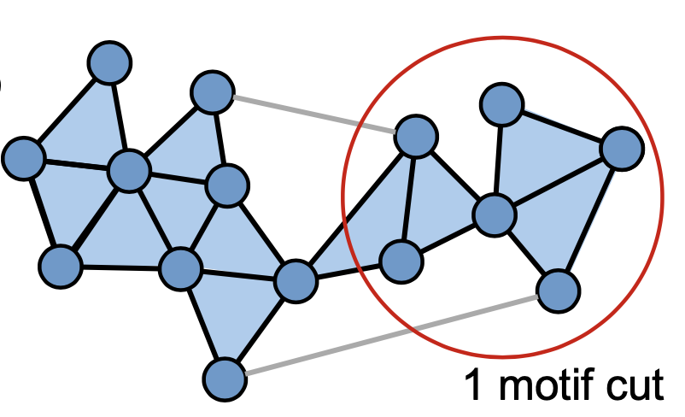
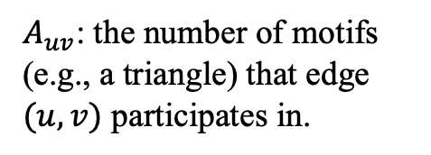
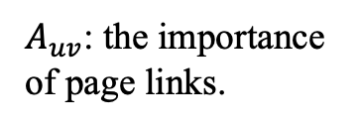
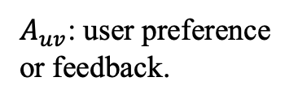
SSPPR Queries on Weighted Graphs
  The personalized ranking results incorporating user preference or feedback embedded in the edge weight are highly valued in social network [KDD’11, KDD’12, KDD’15].
  Taking into account the importance of page links shows increasingly significance for the performance of web page ranking [CNSR’ 04].
  In local clustering, computing SSPPR queries on motif-based weighted graphs can effectively capture the high-order information of network structure[KDD’17].
  …
$A_{uv}$: the number of motifs (e.g., a triangle) that edge $(u,v)$ participates in.
$A_{uv}$: user preference or feedback.
$A_{uv}$: the importance of page links.
Personalized Ranking in Social Network
Web Page Ranking
Local Clustering
Notes:
OK. Let’s go back to SSPPR queries on weighted graphs. We note that various applications are in dire [ˈdaɪər] need of the SSPPR results on weighted graphs. For example, the personalized ranking results incorporating user preference or feedback embedded in the edge weights are highly valued in social network. Also, taking into account the importance of page links shows increasingly significance for the performance of web page ranking. Additionally, in local clustering, computing SSPPR queries on motif-based weighted graphs can effectively capture the high-order information of network structure.

Slide 16


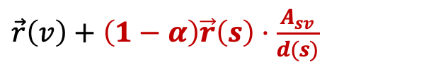


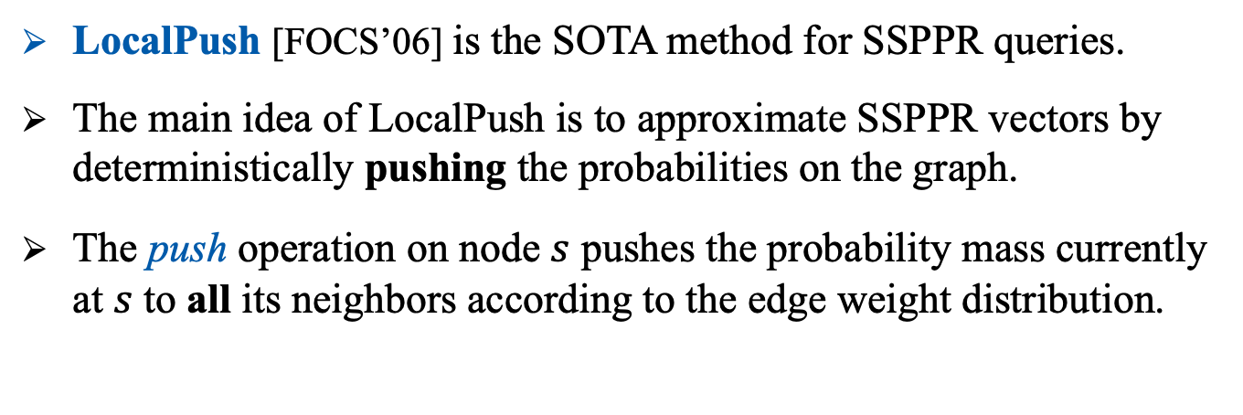

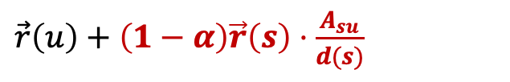







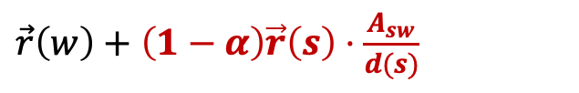




LocalPush for SSPPR Queries on Weighted Graphs
  LocalPush [FOCS’06] is the SOTA method for SSPPR queries.
  The main idea of LocalPush is to approximate SSPPR vectors by deterministically pushing the probabilities on the graph.
  The push operation on node $s$ pushes the probability mass currently at $s$ to all its neighbors according to the edge weight distribution.
$$u$$
$$A_{su}$$
$$s$$
$$A_{sv}$$
$$v$$
$$u$$
$\vec{r}\left(u\right)+\left(1−α\right)\vec{r}\left(s\right)⋅\frac{A_{su}}{d(s)}$
$$A_{su}$$
$$A_{sw}$$
$$A_{sv}$$
$$s$$
$$v$$
$\vec{r}\left(v\right)+\left(1−α\right)\vec{r}\left(s\right)⋅\frac{A_{sv}}{d(s)}$
$$\vec{r}(s)$$
$$w$$
the probability mass at $s$
$$A_{sw}$$
$$w$$
$\vec{r}\left(w\right)+\left(1−α\right)\vec{r}\left(s\right)⋅\frac{A_{sw}}{d(s)}$
Notes:
However, the state-of-the-art method, LocalPush, can be rather ineffective for SSPPR queries on weighted graphs. Let’s have a quick review of the LocalPush method. Its main idea is to approximate SSPPR vectors by deterministically pushing the probabilities on the graph, where the push operation on node $s$ distributes the probability mass currently at $s$ (click) to all its neighbors (click!) according to the edge weight distribution. (click! click! click!).

Slide 17

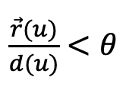
LocalPush for SSPPR Queries on Weighted Graphs
  LocalPush [FOCS’06] is the SOTA method for SSPPR queries.
  The main idea of LocalPush is to approximate SSPPR vectors by deterministically pushing the probabilities on the graph.
  The push operation on node $s$ pushes the probability mass currently at $s$ to all its neighbors according to the edge weight distribution.
$\frac{\vec{r}(u)}{d(u)}<θ$
$$u$$
$$A_{su}$$
$$s$$
$$A_{sv}$$
$$\vec{r}\left(s\right)=1$$
$$v$$
$$u$$
$\vec{r}\left(u\right)+\left(1−α\right)\vec{r}\left(s\right)⋅\frac{A_{su}}{d(s)}$
$$A_{su}$$
$$A_{sw}$$
$$A_{sv}$$
$$s$$
$$v$$
$\vec{r}\left(v\right)+\left(1−α\right)\vec{r}\left(s\right)⋅\frac{A_{sv}}{d(s)}$
$$\vec{r}(s)$$
$$w$$
the probability mass at $s$
$$A_{sw}$$
$$w$$
$\vec{r}\left(w\right)+\left(1−α\right)\vec{r}\left(s\right)⋅\frac{A_{sw}}{d(s)}$
Notes:
Initially, the LocalPush method sets the probability mass at the source node s as 1. (click) Then it repeatedly [rɪˈpiːtɪdli] conducts the push operations on the nodes whose probability mass exceed the push threshold theta (click) (click) . (click!)When the probability mass on each node is less than the threshold, localpush returns the probability that has been pushed to each node u as the approximation of u’s PPR.

Slide 18



Motivations
$${\vec{π}}_{s}(w)$$
$$u_{1}$$
$$1$$
$$w$$
  Notably, the push operation of LocalPush has to touch ALL the neighbors even on the node with severely unbalanced edge weight distribution.
$$1−\frac{1}{n}$$
$$\frac{1}{n(n−1)}$$
$$u_{2}$$
$$\frac{1}{n(n−1)}$$
$$s$$
$$u_{3}$$
$$\frac{1}{n(n−1)}$$
…
$$u_{n−1}$$
$$\frac{1}{n(n−1)}$$
$$u_{n}$$
Notes:
However, the push operation used in the localpush method has a limitation that, it has to touch ALL the neighbors even on the node with severely unbalanced edge weight distribution. For example, on the toy graph as shown left, where the weight distribution of node s is unbalanced, edge (s,u1) merely taking the total weight of s, and all the other edges just share a tiny weight together.

Slide 19


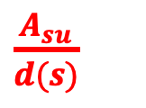





Motivations
$${\vec{π}}_{s}(w)$$
$$u_{1}$$
$$1$$
$$w$$
  Notably, the push operation of LocalPush has to touch ALL the neighbors even on the node with severely unbalanced edge weight distribution.
  On weighted graphs, the push operation of LocalPush may spend excessive time on pushing an tiny probability mass for those “insignificant” edges.
$$1−\frac{1}{n}$$
$$\frac{1}{n(n−1)}$$
$$u_{2}$$
$$\frac{1}{n(n−1)}$$
$$s$$
$$u_{3}$$
$$\frac{1}{n(n−1)}$$
$$u$$
$\frac{A_{su}}{d(s)}$
$\vec{r}\left(u\right)+\left(1−α\right)\vec{r}\left(s\right)⋅$
…
…
$$A_{su}$$
$$s$$
$$A_{sv}$$
$$u_{n−1}$$
$$\vec{r}(s)$$
$$\frac{1}{n(n−1)}$$
$$A_{sw}$$
$$u_{n}$$
the probability mass at $s$
Notes:
When we conduct a push operation on node s, it needs to touch all the n edges incident [ˈɪnsɪdənt] on node s, during which the most of time is spent to push an extremely tiny probability 1 over n for those insignificant edges.

Slide 20


Motivations
$${\vec{π}}_{s}(w)$$
$$u_{1}$$
$$1$$
$$w$$
  Notably, the push operation of LocalPush has to touch ALL the neighbors even on the node with severely unbalanced edge weight distribution.
  On weighted graphs, the push operation of LocalPush may spend excessive time on pushing an tiny probability mass for those “insignificant” edges.
$$1−\frac{1}{n}$$
$$\frac{1}{n(n−1)}$$
$$u_{2}$$
$$\frac{1}{n(n−1)}$$
$$s$$
$$u_{3}$$
$$\frac{1}{n(n−1)}$$
$$u$$
$\frac{A_{su}}{d(s)}$
$\vec{r}\left(u\right)+\left(1−α\right)\vec{r}\left(s\right)⋅$
…
$$A_{su}$$
$$s$$
$$A_{sv}$$
$$u_{n−1}$$
$$\vec{r}(s)$$
$$\frac{1}{n(n−1)}$$
$$A_{sw}$$
$$u_{n}$$
the probability mass at $s$
Notes:
Actually, in this toy example, the optimal push method to approximate SSPPR vector is to (click!) directly distribute the probability mass at node s along edge (s,u1), then to w, and ignore the other edges.

Slide 21
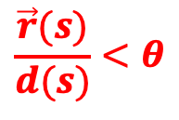
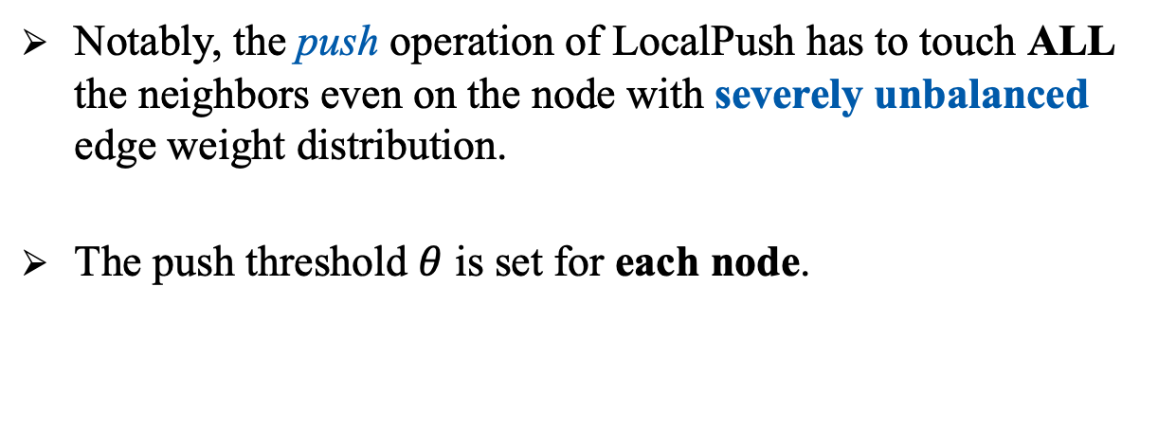
Motivations
$${\vec{π}}_{s}(w)$$
$$u_{1}$$
$$1$$
$$w$$
  Notably, the push operation of LocalPush has to touch ALL the neighbors even on the node with severely unbalanced edge weight distribution.
  The push threshold $θ$ is set for each node.
$$1−\frac{1}{n}$$
$$\frac{1}{n(n−1)}$$
$$u_{2}$$
$$\frac{1}{n(n−1)}$$
$$s$$
$$u_{3}$$
$$\frac{1}{n(n−1)}$$
$$\frac{\vec{r}(s)}{d(s)}<θ$$
…
$$u_{n−1}$$
$$\frac{1}{n(n−1)}$$
$$u_{n}$$
Notes:
One may ask can this be achieved by tuning the push threshold theta? Sadly, the answer is no because the push threshold theta in localpush is set for each node, rather than for each edge. Thus, if we increase the push threshold theta, then no neighbor of s can receive the probability mass, which leads to a large approximation error.

Slide 22
Our Contributions
$$u_{1}$$
$$1$$
$$w$$
  We proposed EdgePush for SSPPR queries on weighted graphs.
$$1−\frac{1}{n}$$
$$\frac{1}{n(n−1)}$$
$$u_{2}$$
$$\frac{1}{n(n−1)}$$
$$s$$
$$u_{3}$$
$$\frac{1}{n(n−1)}$$
…
$$u_{n−1}$$
$$\frac{1}{n(n−1)}$$
$$u_{n}$$
Notes:
To address this problem ,in our paper, we proposed a novel method, EdgePush, for SSPPR queries on weighted graphs.

Slide 23
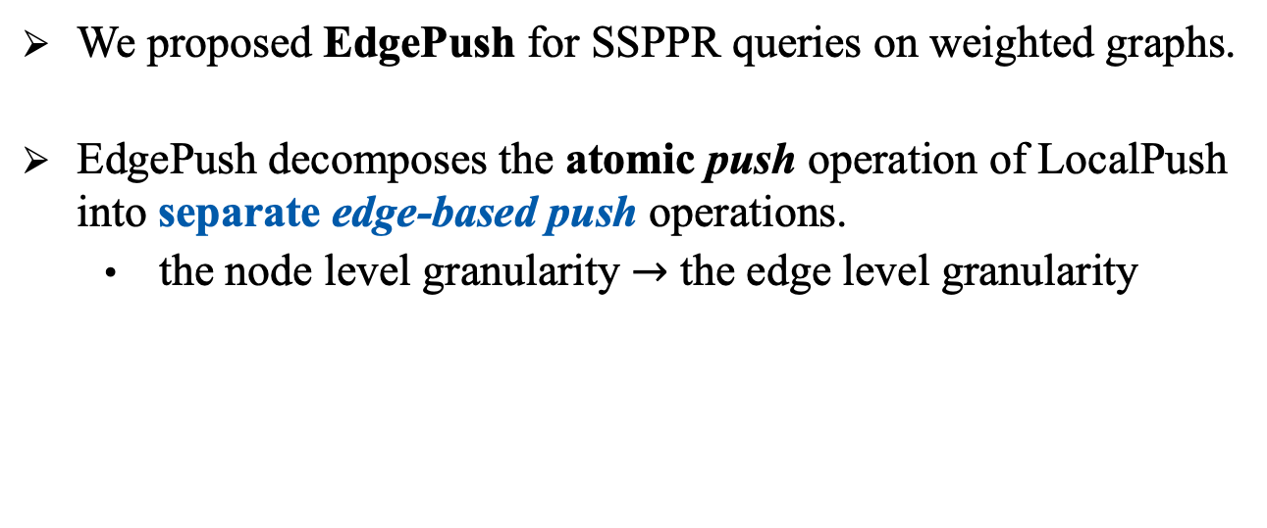
Our Contributions
$$u_{1}$$
$$1$$
$$w$$
  We proposed EdgePush for SSPPR queries on weighted graphs.
  EdgePush decomposes the atomic push operation of LocalPush into separate edge-based push operations.
    the node level granularity $→$ the edge level granularity
$$1−\frac{1}{n}$$
$$\frac{1}{n(n−1)}$$
$$u_{2}$$
$$\frac{1}{n(n−1)}$$
$$s$$
$$u_{3}$$
$$\frac{1}{n(n−1)}$$
…
$$u_{n−1}$$
$$\frac{1}{n(n−1)}$$
$$u_{n}$$
Notes:
In EdgePush, we decompose [ˌdiːkəmˈpoʊz] the atomic [əˈtɑːmɪk] push operation of LocalPush into separate edge-based push operations, which enables [ɪˈneɪb(ə)l] us to flexibly [ˈfleksəbli] select edges to push probability mass based on the edge weights. For example, on the toy graph as shown left, our EdgePush allows to just distribute the probability mass along edge (s,u1) (click), then along edge (u1,w), and ignore other edges.

Slide 24
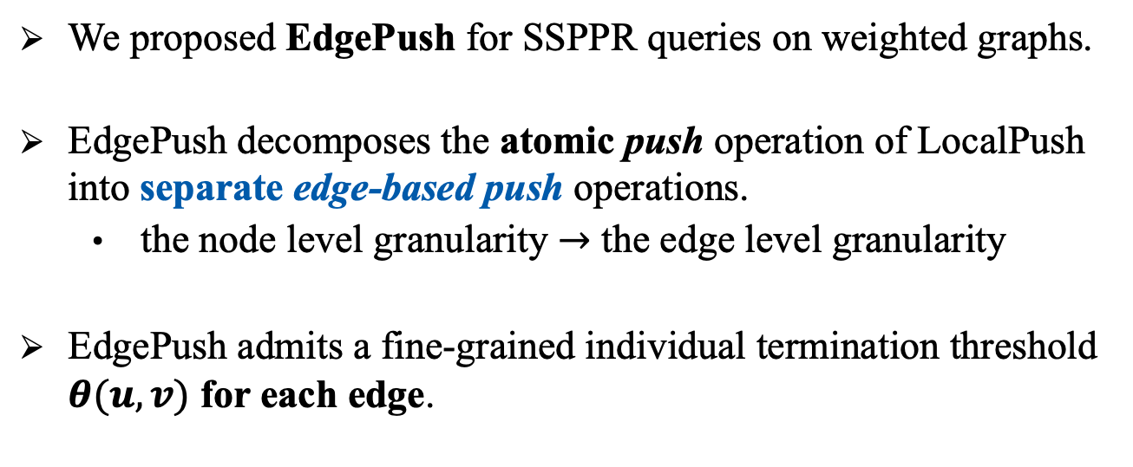
Our Contributions
$$u_{1}$$
$$1$$
$$w$$
  We proposed EdgePush for SSPPR queries on weighted graphs.
  EdgePush decomposes the atomic push operation of LocalPush into separate edge-based push operations.
    the node level granularity $→$ the edge level granularity
  EdgePush admits a fine-grained individual termination threshold $θ(u,v)$ for each edge.
$$1−\frac{1}{n}$$
$$\frac{1}{n(n−1)}$$
$$u_{2}$$
$$\frac{1}{n(n−1)}$$
$$s$$
$$u_{3}$$
$$\frac{1}{n(n−1)}$$
…
$$u_{n−1}$$
$$\frac{1}{n(n−1)}$$
$$u_{n}$$
Notes:
Moreover, our EdgePush admits an fine-grained individual termination threshold theta(u,v) for each edge. With careful threshold choices, EdgePush achieves superior [suːˈpɪriər] query efficiency in terms of the trade offs between the approximation error and the expected [ɪkˈspektɪd] overall running time.

Slide 25



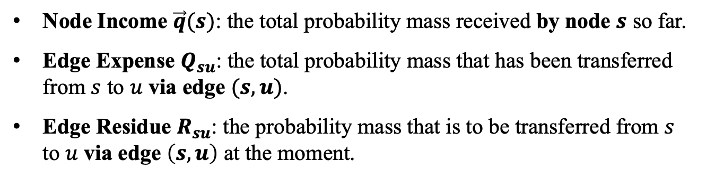









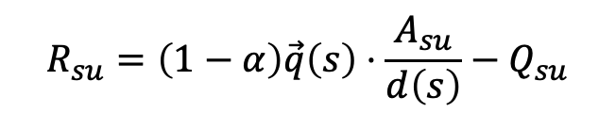


Edge-based Push Operation
$$Q_{su}$$
$$u$$
$$\vec{q}(u)$$
Node Income $\vec{q}(s)$: the total probability mass received by node $s$ so far.
Edge Expense $Q_{su}$: the total probability mass that has been transferred from $s$ to $u$ via edge $(s,u)$.
Edge Residue $R_{su}$: the probability mass that is to be transferred from $s$ to $u$ via edge $\left(s,u\right)$ at the moment.
$$A_{su}$$
$$Q_{sv}$$
$$s$$
$$A_{sv}$$
$$v$$
$$\vec{q}(v)$$
$$\vec{q}(s)$$
$$R_{su}=\left(1−α\right)\vec{q}\left(s\right)⋅\frac{A_{su}}{d\left(s\right)}−Q_{su}$$
$$A_{sw}$$
$$w$$
$$\vec{q}(w)$$
$$Q_{sw}$$
Notes:
Now I will describe our EdgePush method in detail. First, I will define three variables which are conceptually maintained in the EdgePush process. That is: node income, edge expense and edge residue. Consider a node on the graph, for example, node s. The node income of s equals to the total probability mass received by node 𝒔 so far. The expense of edge (s,u) corresponds to the total probability mass that has been transferred from $s$ to $u$. And the residue of edge (s,u) corresponds to the total probability mass that is to be transferred from $s$ to $u$.

Slide 26



Edge-based Push Operation
$$Q_{su}$$
$$u$$
$$\vec{q}(u)$$
Node Income $\vec{q}(s)$: the total probability mass received by node $s$ so far.
Edge Expense $Q_{su}$: the total probability mass that has been transferred from $s$ to $u$ via edge $(s,u)$.
Edge Residue $R_{su}$: the probability mass that is to be transferred from $s$ to $u$ via edge $\left(s,u\right)$ at the moment.
$$A_{su}$$
$$Q_{sv}$$
$$s$$
$$A_{sv}$$
$$v$$
$$\vec{q}(v)$$
$$\vec{q}(s)$$
$$R_{su}=\left(1−α\right)\vec{q}\left(s\right)⋅\frac{A_{su}}{d\left(s\right)}−Q_{su}$$
$$A_{sw}$$
$$w$$
$$\vec{q}(w)$$
the probability mass that
SHOULD BE transferred from $s$ to $u$
$$Q_{sw}$$
the probability mass that is
TO BE transferred from $s$ to $u$
the probability mass that is
HAS BEEN transferred from $s$ to $u$
Notes:
Thus, by denition, we have the following equation that the residue of edge (s,u) equals to (click) the probability mass that node s should transfer to node u according to the edge weight distribution, (click)minus the probability mass that has been transferred from s to u, which is recorded in the expense of edge (s,u). Note that in the EdgePush process, we don’t explicitly [ɪkˈsplɪsɪtli] maintain the edge residue. Instead, we update the node income and edge expense with the edge residue maintained implicitly according to the Equation.

Slide 27



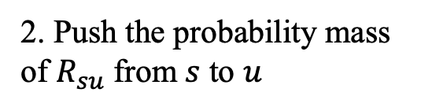
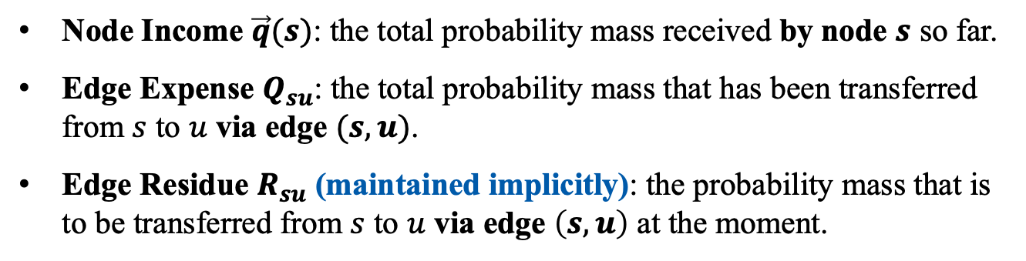


Edge-based Push Operation
1. Calculate $R_{su}$
(1) $\vec{q}\left(u\right)+R_{su}$
2. Push the probability mass of $R_{su}$ from $s$ to $u$
(2) $Q_{su}+R_{su}$
$$Q_{su}$$
$+R_{su}$
$$u$$
$$\vec{q}(u)$$
$+R_{su}$
Node Income $\vec{q}(s)$: the total probability mass received by node $s$ so far.
Edge Expense $Q_{su}$: the total probability mass that has been transferred from $s$ to $u$ via edge $(s,u)$.
Edge Residue $R_{su}$ (maintained implicitly): the probability mass that is to be transferred from $s$ to $u$ via edge $\left(s,u\right)$ at the moment.
$$A_{su}$$
$$Q_{sv}$$
$$s$$
$$A_{sv}$$
$$v$$
$$\vec{q}(v)$$
$$\vec{q}(s)$$
$$R_{su}=\left(1−α\right)\vec{q}\left(s\right)⋅\frac{A_{su}}{d\left(s\right)}−Q_{su}$$
$$A_{sw}$$
$$w$$
$$\vec{q}(w)$$
the probability mass that
SHOULD BE transferred from $s$ to $u$
$$Q_{sw}$$
the probability mass that is
TO BE transferred from $s$ to $u$
the probability mass that is
HAS BEEN transferred from $s$ to $u$
Notes:
In an edge-based push operation on edge (s,u), we calculate Rsu first (click!), and (click!) push the probability mass of Rsu from s to u, which means we need to increase q(u) by Rsu (click), and increase the captical Qsu by Rsu (click).

Slide 28


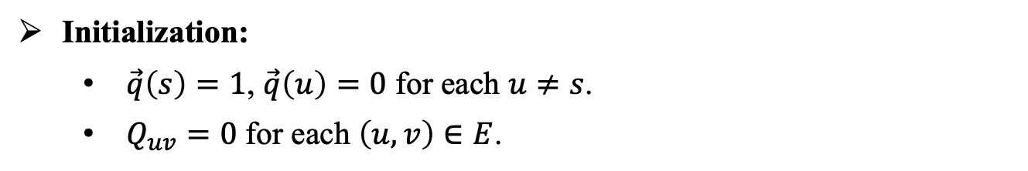




Our EdgePush for SSPPR Queries on Weighted Graphs
Initialization:
  $\vec{q}\left(s\right)=1$, $\vec{q}\left(u\right)=0$ for each $u≠s$.
  $Q_{uv}=0$ for each $\left(u,v\right)∈E$.
$\vec{q}\left(u\right)=0$
$Q_{su}=0$
$$u$$
$$A_{su}$$
$$s$$
$$A_{sv}$$
$$\vec{q}\left(s\right)=1$$
$$v$$
$$A_{sw}$$
$$w$$
Notes:
Now we present the algorithm structure of EdgePush. Initially, we set the income of each node as 0, except the income of source node s as 1. In addition, we also set the edge expense of each edge on the graph as 0.

Slide 29
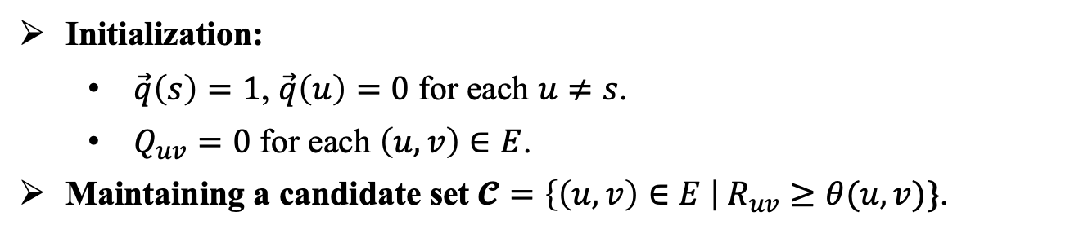
Our EdgePush for SSPPR Queries on Weighted Graphs
Initialization:
  $\vec{q}\left(s\right)=1$, $\vec{q}\left(u\right)=0$ for each $u≠s$.
  $Q_{uv}=0$ for each $\left(u,v\right)∈E$.
Maintaining a candidate set $𝓒=\left\{\left(u,v\right)∈E \right| R_{uv}≥θ(u,v)\}$.
$\vec{q}\left(u\right)=0$
$Q_{su}=0$
$$u$$
$$A_{su}$$
$$s$$
$$A_{sv}$$
$$\vec{q}\left(s\right)=1$$
$$v$$
$$A_{sw}$$
$$w$$
Notes:
During the EdgePush process, we conceptually maintain a candidate set C for storing all the edges whose residue is more than the push threshold. Recall that the reside of edge uv denotes the probability mass that is to be transferred from 𝑢 to 𝑣 at the moment. Thus, the candidate set C maintains all the edges that are to be conducted edge-based push operations.

Slide 30
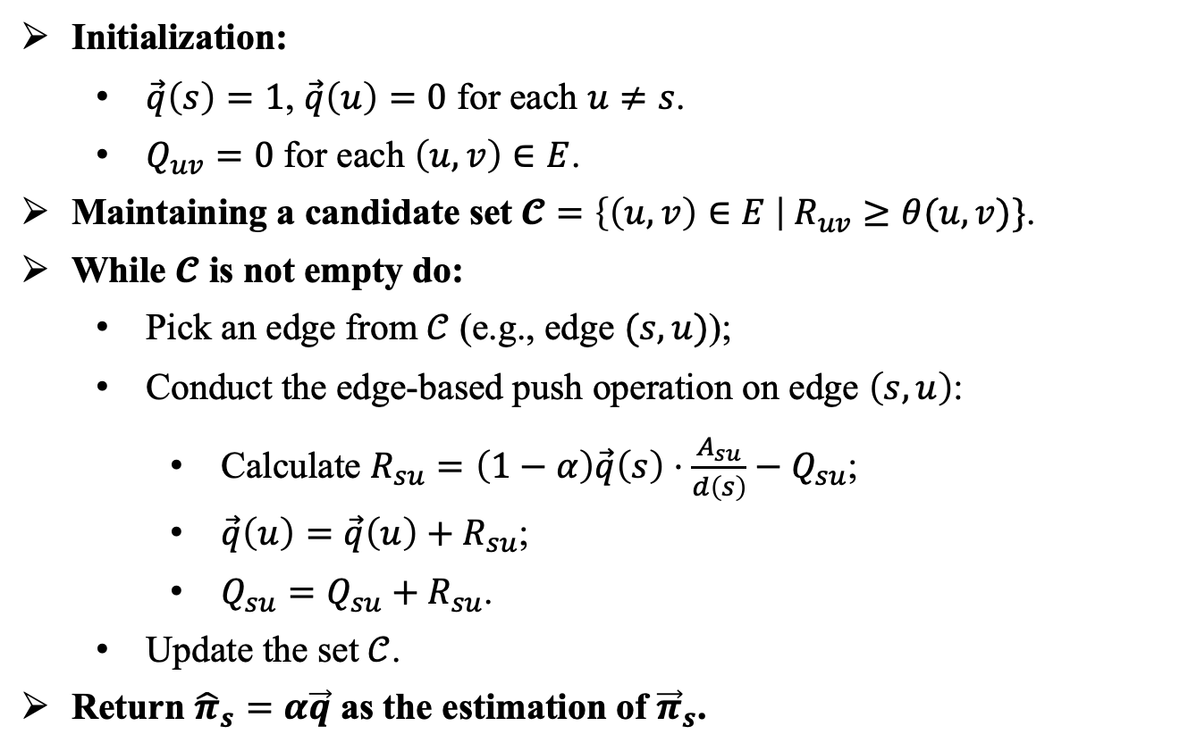
Our EdgePush for SSPPR Queries on Weighted Graphs
Initialization:
  $\vec{q}\left(s\right)=1$, $\vec{q}\left(u\right)=0$ for each $u≠s$.
  $Q_{uv}=0$ for each $\left(u,v\right)∈E$.
Maintaining a candidate set $𝓒=\left\{\left(u,v\right)∈E \right| R_{uv}≥θ(u,v)\}$.
While $𝓒$ is not empty do:
  Pick an edge from $𝒞$ (e.g., edge $(s,u)$);
  Conduct the edge-based push operation on edge $\left(s,u\right)$:
    Calculate $R_{su}=\left(1−α\right)\vec{q}\left(s\right)⋅\frac{A_{su}}{d\left(s\right)}−Q_{su}$;
    $\vec{q}\left(u\right)=\vec{q}\left(u\right)+R_{su}$;
    $Q_{su}=Q_{su}+R_{su}$.
  Update the set $𝒞$.
Return ${\hat{π}}_{s}=α\vec{q}$ as the estimation of ${\vec{π}}_{s}$.
$\vec{q}\left(u\right)=0$
$Q_{su}=0$
$$u$$
$$A_{su}$$
$$s$$
$$A_{sv}$$
$$\vec{q}\left(s\right)=1$$
$$v$$
$$A_{sw}$$
$$w$$
Notes:
We repeatedly pick edges from set C to perform edge-based push operations

Slide 31


Our EdgePush for SSPPR Queries on Weighted Graphs
Initialization:
  $\vec{q}\left(s\right)=1$, $\vec{q}\left(u\right)=0$ for each $u≠s$.
  $Q_{uv}=0$ for each $\left(u,v\right)∈E$.
Maintaining a candidate set $𝓒=\left\{\left(u,v\right)∈E \right| R_{uv}≥θ(u,v)\}$.
While $𝓒$ is not empty do:
  Pick an edge from $𝒞$ (e.g., edge $(s,u)$);
  Conduct the edge-based push operation on edge $\left(s,u\right)$:
    Calculate $R_{su}=\left(1−α\right)\vec{q}\left(s\right)⋅\frac{A_{su}}{d\left(s\right)}−Q_{su}$;
    $\vec{q}\left(u\right)=\vec{q}\left(u\right)+R_{su}$;
    $Q_{su}=Q_{su}+R_{su}$.
  Update the set $𝒞$.
Return ${\hat{π}}_{s}=α\vec{q}$ as the estimation of ${\vec{π}}_{s}$.
$\vec{q}\left(u\right)=0.3$
$Q_{su}=0.3$
$$u$$
$$A_{su}$$
$$s$$
$$A_{sv}$$
$$\vec{q}\left(s\right)=1$$
$$v$$
$$A_{sw}$$
$$w$$
organize the edges with a priority queue
Notes:
until the candidate set C is empty. Fianlly, we return alpha times the node income vector as the estimation of the SSPPR vector with regard to source node s.
However, a difficult problem is that (click!) how to maintain the candidate set C efficiently. More specifically, it is challenging to find a candidate edge to push in O(1) time. In our paper, we proposed a non-trivial method to achieve this bound. (click!) And the basic idea is to organize the edges with a priority queue in a novel way.

Slide 32
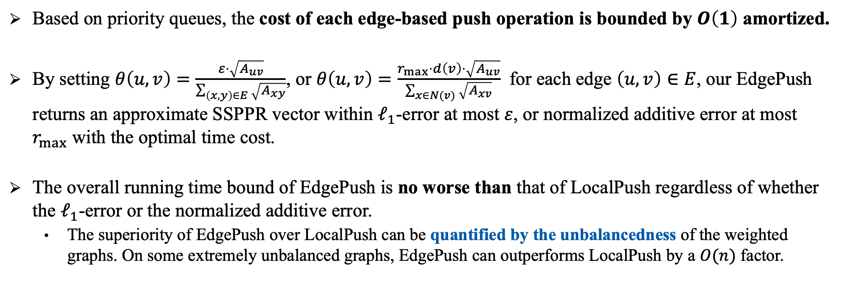
Theoretical Guarantees
  Based on priority queues, the cost of each edge-based push operation is bounded by $O\left(1\right)$ amortized.
  By setting $θ\left(u,v\right)=\frac{ε⋅\sqrt{A_{uv}}}{\sum_{\left(x,y\right)∈E}{\sqrt{A_{xy}}}}$, or $θ\left(u,v\right)=\frac{r_{max}⋅d\left(v\right)⋅\sqrt{A_{uv}}}{\sum_{x∈N(v)}{\sqrt{A_{xv}}}}$ for each edge $\left(u,v\right)∈E$, our EdgePush returns an approximate SSPPR vector within $ℓ_{1}$-error at most $ε$, or normalized additive error at most $r_{max}$ with the optimal time cost.
  The overall running time bound of EdgePush is no worse than that of LocalPush regardless of whether the $ℓ_{1}$-error or the normalized additive error.
    The superiority of EdgePush over LocalPush can be quantified by the unbalancedness of the weighted graphs. On some extremely unbalanced graphs, EdgePush can outperforms LocalPush by a $O(n)$ factor.
Notes:
We can prove that, with the help of the priority queue structure, each edge-based push operation can be completed in O(1) time amortized. We also present the theoretical analysis on the optimal choice of the push threshold for each edge. And we show that the overall running time bound of EdgePush is no worse than that of LocalPush regardless for l1-error or normalized additive error, In particular, on some extremely unbalanced graphs, EdgePush outperforms LocalPush by an $n$ factor.

Slide 33
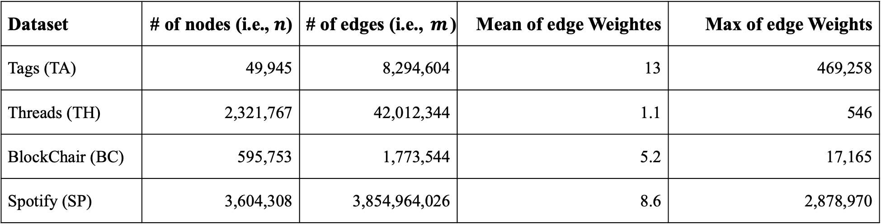
Experiments
  We exaluate the performances of our EdgePush on four real-world weighted graphs.
Dataset | # of nodes (i.e., $n$) | # of edges (i.e., $m$) | Mean of edge Weightes | Max of edge Weights
Tags (TA) | 49,945 | 8,294,604 | 13 | 469,258
Threads (TH) | 2,321,767 | 42,012,344 | 1.1 | 546
BlockChair (BC) | 595,753 | 1,773,544 | 5.2 | 17,165
Spotify (SP) | 3,604,308 | 3,854,964,026 | 8.6 | 2,878,970
Notes:
Next we will present the experimental results of EdgePush. We conduct the experiments on four real-world weighted graphs.

Slide 34
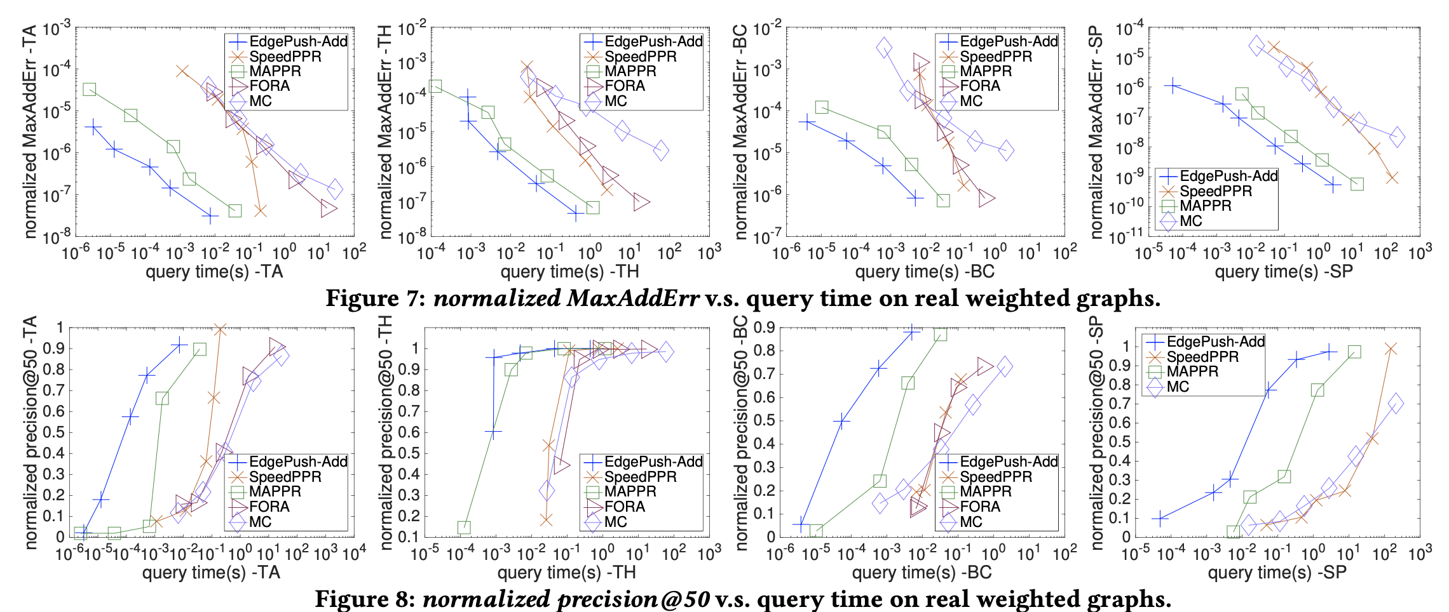
Experiments for SSPPR Queries with Normalized Additive Error
Notes:
We can observe that for SSPPR queries with normalized additive error, edgepush,

Slide 35
Experiments for SSPPR Queries with Normalized Additive Error
Notes:
shown in blue lines, outperforms other baseline methods in terms of query efficiency.

Slide 36
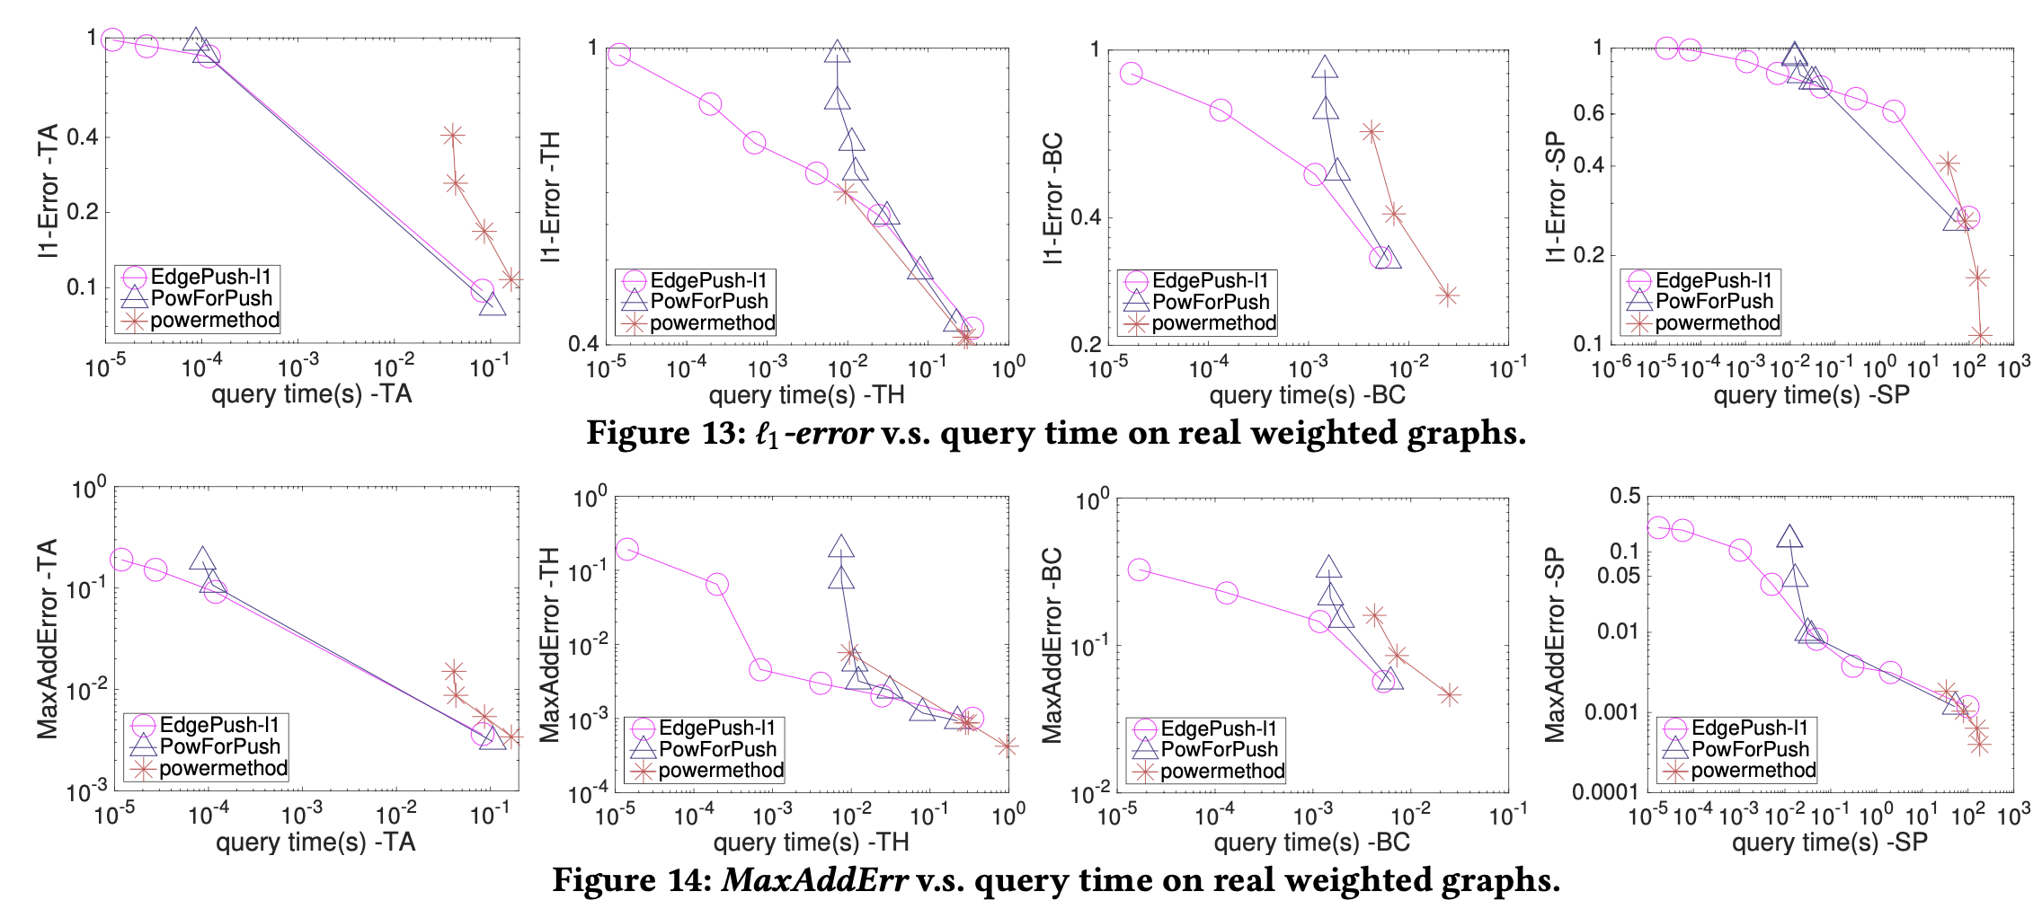
Experiments for SSPPR Queries with $ℓ_{1}$-Error
Notes:
In addition, for SSPPR queries with l1-error, EdgePush

Slide 37
Experiments for SSPPR Queries with $ℓ_{1}$-Error
Notes:
shown in red lines, costs the smallest query time on all datasets under relatively large l1-error, and gradually overlaps with LocalPush when touching most of edges in the graph.

Slide 38
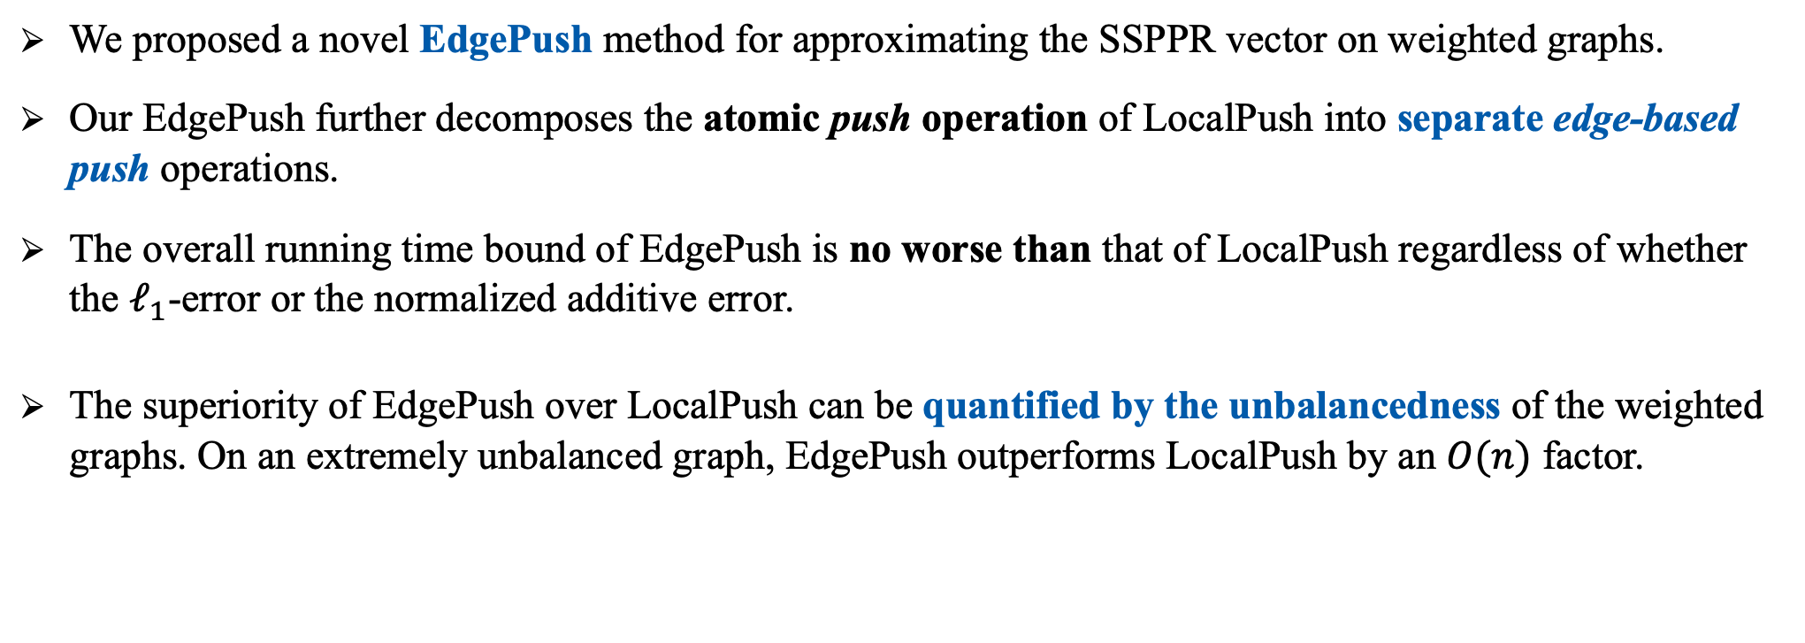
Conclusion
  We proposed a novel EdgePush method for approximating the SSPPR vector on weighted graphs.
  Our EdgePush further decomposes the atomic push operation of LocalPush into separate edge-based push operations.
  The overall running time bound of EdgePush is no worse than that of LocalPush regardless of whether the $ℓ_{1}$-error or the normalized additive error.
  The superiority of EdgePush over LocalPush can be quantified by the unbalancedness of the weighted graphs. On an extremely unbalanced graph, EdgePush outperforms LocalPush by an $O(n)$ factor.
Thanks!
Notes:
In conclusion, we proposed a novel EdgePush method for SSPPR queires on weighted graphs. Our EdgePush further decomposes [ˌdiːkəmˈpoʊzɪz] the atomic push operation of LocalPush into separate edge-based push operations and reduces the upper bound of the time cost for SSPPR queries on weighted graphs. That’s all of my presentation. Thank you!

Slide 39

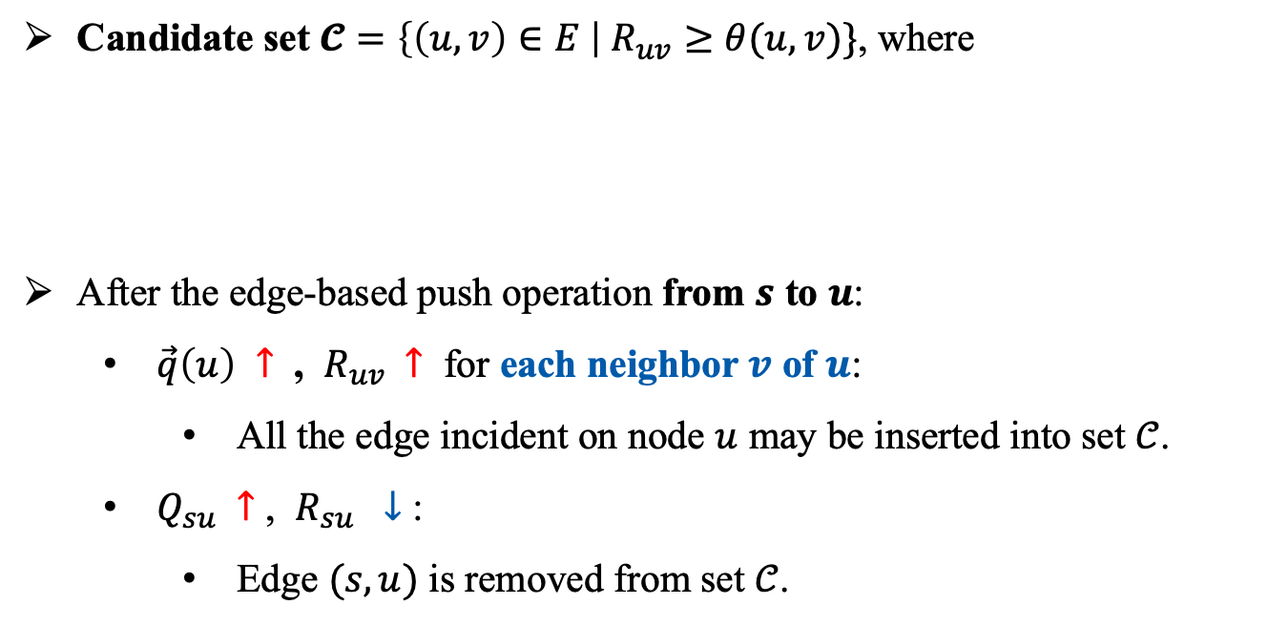



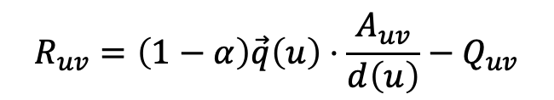

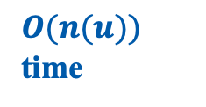
How to Update the Candidate Set $𝓒$ within $O(1)$ Time?
$+R_{su}$
Candidate set $𝓒=\left\{\left(u,v\right)∈E \right| R_{uv}≥θ(u,v)\}$, where
After the edge-based push operation from $s$ to $u$:
  $\vec{q}\left(u\right) ↑$ , $R_{uv}$ $↑$ for each neighbor $v$ of $u$:
    All the edge incident on node $u$ may be inserted into set $𝒞$.
  $Q_{su} ↑$ , $R_{su} ↓$ :
    Edge $(s,u)$ is removed from set $𝒞$.
$\vec{q}\left(u\right)$
$Q_{su}$
$+R_{su}$
$$u$$
$$R_{uv}=\left(1−α\right)\vec{q}\left(u\right)⋅\frac{A_{uv}}{d\left(u\right)}−Q_{uv}$$
$$A_{su}$$
$$s$$
$O(n(u))$ time
$$A_{sv}$$
$$\vec{q}\left(s\right)=1$$
$$v$$
$$A_{sw}$$
$$w$$
$O(1)$ time
Notes:
(click!) Recall that in an edge-based push operation for example on edge (s,u), we increase the income of node u (click!), and the expense of edge (s,u). According to the Equation, increasing q(u) and the capital Qsu leads to the increment of the residue of u’s every adjacency edge, and the decrement of the residue of edge (s,u). If we check the al了edges with updated edge residues one-by-one to maintain the candidate set C. Then we need to cost n(u) time (click), where n(u) denotes the neighborhood size of node u. The edge-based push operation is hardly considered as more efficient than a push operation in LocalPush, because both of them will cost O(n(u)) time.

Slide 40

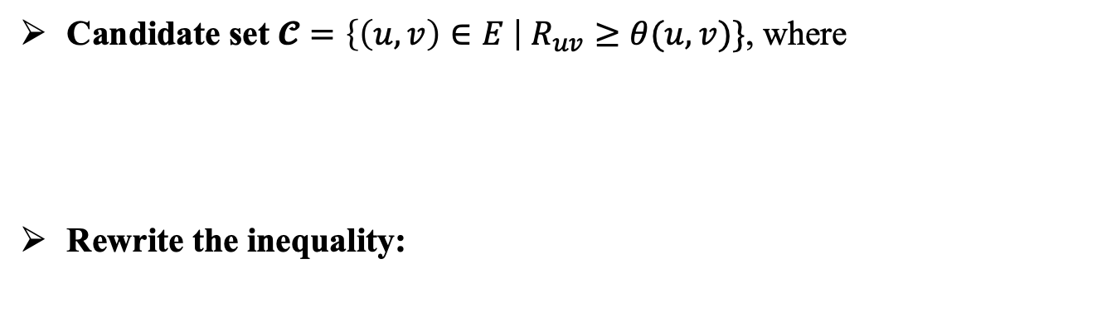


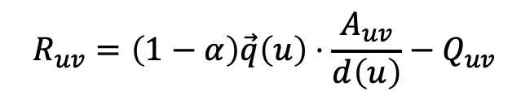

How to Update the Candidate Set $𝓒$ within $O(1)$ Time?
$+R_{su}$
Candidate set $𝓒=\left\{\left(u,v\right)∈E \right| R_{uv}≥θ(u,v)\}$, where
Rewrite the inequality:
$\vec{q}\left(u\right)$
$Q_{su}$
$+R_{su}$
$$u$$
$$R_{uv}=\left(1−α\right)\vec{q}\left(u\right)⋅\frac{A_{uv}}{d\left(u\right)}−Q_{uv}$$
$$A_{su}$$
$$s$$
$$\left(1−α\right)\vec{q}\left(u\right)⋅\frac{A_{uv}}{d\left(u\right)}−Q_{uv}≥θ(u,v)$$
$$A_{sv}$$
$$\vec{q}\left(s\right)=1$$
$$v$$
$$⟹ \left(1−α\right)\vec{q}\left(u\right)⋅\frac{1}{d\left(u\right)} ≥ \frac{1}{A_{uv}}⋅\left(θ\left(u,v\right)+Q_{uv}\right)$$
$$A_{sw}$$
$$w$$
for node $u$
for each edge incident on node $u$
Notes:
Fortunately, we note that the inequality for maintaining candidate set C can be rewritten as below, where the left side focuses on the probability mass maintained by a node, and the right side maintains all the probability mass of the nodes’ adjacency [əˈdʒeɪsənsi] edges.

Slide 41


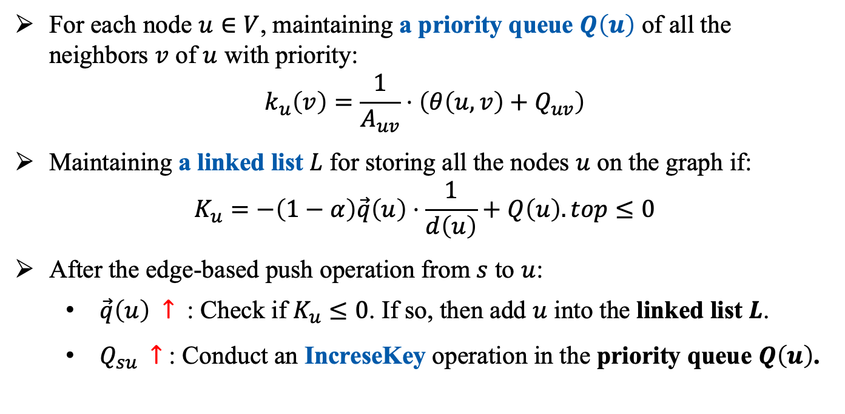

How to Update the Candidate Set $𝓒$ within $O(1)$ Time?
$$\left(1−α\right)\vec{q}\left(u\right)⋅\frac{1}{d\left(u\right)} ≥ \frac{1}{A_{uv}}⋅\left(θ\left(u,v\right)+Q_{uv}\right)$$
$+R_{su}$
$\vec{q}\left(u\right)$
$Q_{su}$
$+R_{su}$
$$u$$
for node $u$
for each edge incident on node $u$
$$A_{su}$$
For each node $u∈V$, maintaining a priority queue $Q\left(u\right)$ of all the neighbors $v$ of $u$ with priority:
$$k_{u}\left(v\right)=\frac{1}{A_{uv}}⋅\left(θ\left(u,v\right)+Q_{uv}\right)$$
Maintaining a linked list $L$ for storing all the nodes $u$ on the graph if:
$$K_{u}=−\left(1−α\right)\vec{q}\left(u\right)⋅\frac{1}{d\left(u\right)}+Q\left(u\right).top≤0$$
After the edge-based push operation from $s$ to $u$:
  $\vec{q}\left(u\right) ↑$ : Check if $K_{u}≤0$. If so, then add $u$ into the linked list $L$.
  $Q_{su} ↑$ : Conduct an IncreseKey operation in the priority queue $Q\left(u\right)$.
$$s$$
$$A_{sv}$$
$$\vec{q}\left(s\right)=1$$
$$v$$
$$A_{sw}$$
$$w$$
Notes:
Inspired by this obvervation, we maintain a priority queue for each node u to store all the neighbors of u. Besides, we define a linked list L for storing all the nodes u on the graph if they has at least one adjacency edge which satisfies the edge push threshold. By this means, after the edge-based operation along edge (s,u), we just need to check whether node u satisfies the push threshold. If so, then add node u into the linked list L. Also, we conduct an IncreasKey operation in the priority queue maintained by node u.

Slide 42
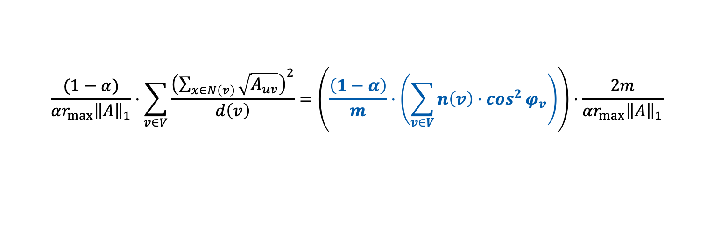
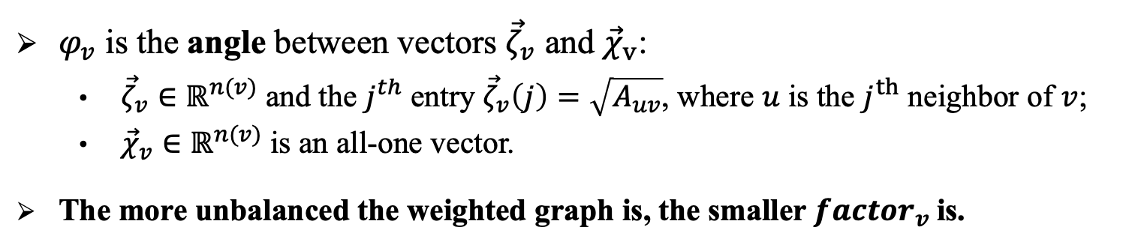

Theoretical Improvements
$$u_{1}$$
  To achieve an normalized additive error of $r_{max}$, we reduce the upper bound of SSPPR queries’ time cost on weighted graphs by a factor of
  $factor_{v}{=}\left(\frac{\left(1−α\right)}{m}⋅\left(\sum_{v∈V}{n\left(v\right)⋅\cos^{2}{φ_{v}}}\right)\right)∈(0,1)$
$$1−\frac{1}{n}$$
$$\frac{1}{n(n−1)}$$
$$u_{2}$$
  $φ_{v}$ is the angle between vectors ${\vec{ζ}}_{v}$ and ${\vec{χ}}_{v}$:
    ${\vec{ζ}}_{v}∈ℝ^{n(v)}$ and the $j^{th}$ entry ${\vec{ζ}}_{v}\left(j\right)=\sqrt{A_{uv}}$, where $u$ is the $j^{th}$ neighbor of $v$;
    ${\vec{χ}}_{v}∈ℝ^{n(v)}$ is an all-one vector.
  The more unbalanced the weighted graph is, the smaller $factor_{v}$is.
$$\frac{1}{n(n−1)}$$
$$s$$
$$u_{3}$$
$$\frac{1}{n(n−1)}$$
…
$$\frac{(1−α)}{{αr}_{max}{\left\|A\right\|}_{1}}⋅\sum_{v∈V}{\frac{{\left(\sum_{x∈N\left(v\right)}{\sqrt{A_{uv}}}\right)}^{2}}{d\left(v\right)}}=\left(\frac{\left(1−α\right)}{m}⋅\left(\sum_{v∈V}{n\left(v\right)⋅\cos^{2}{φ_{v}}}\right)\right)⋅\frac{2m}{αr_{max}{\left\|A\right\|}_{1}}$$
$$u_{n−1}$$
$$\frac{1}{n(n−1)}$$
Our Bound
SOTA Bound
$$u_{n}$$

