Slide 1


随机游走的高效计算
及在图表示学习中的应用
报告人：王涵之
导 师：魏哲巍教授
中国人民大学
Notes:
大家好，我是来自中国人民大学的王涵之，导师是魏哲巍教授。首先很感谢datafun的邀请，非常荣幸可以在这里和大家学习交流。今天我报告的题目是：随机游走的高效计算及在图表示学习中的应用

Slide 2
报告提纲
随机游走的定义与数学性质
随机游走的应用场景
随机游走的高效计算
总结

Slide 3
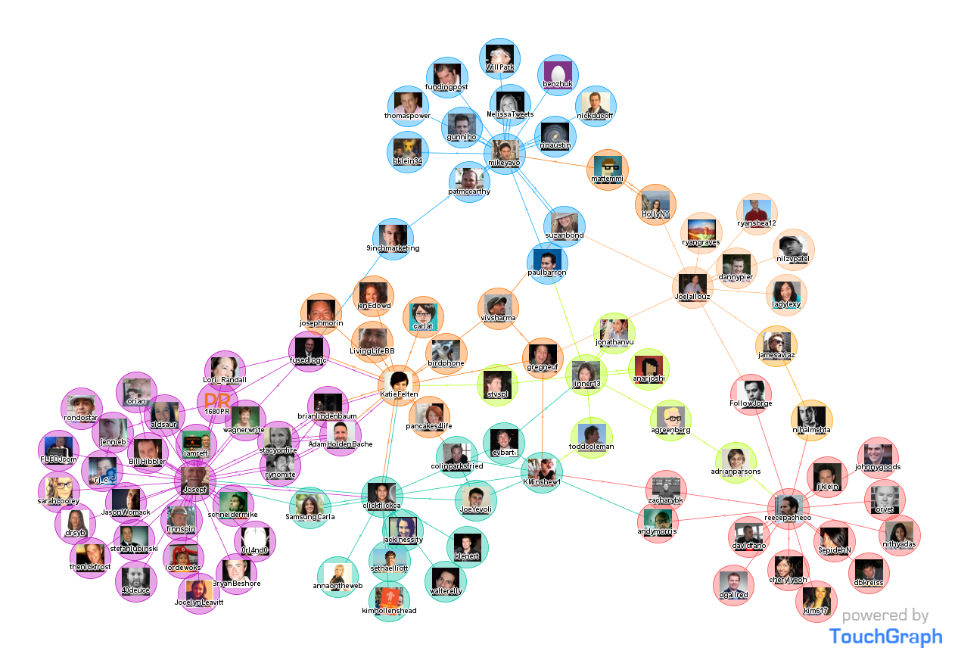
图结构无处不在
社交网络
节点：用户
边 ：好友关系；
转发关系；
点赞关系
…

Slide 4
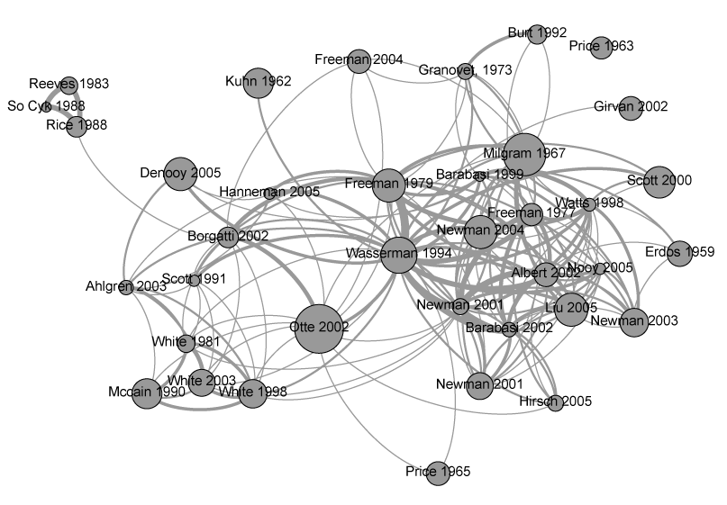
图结构无处不在
论文引用网络
节点：论文
边 ：引用关系

Slide 5
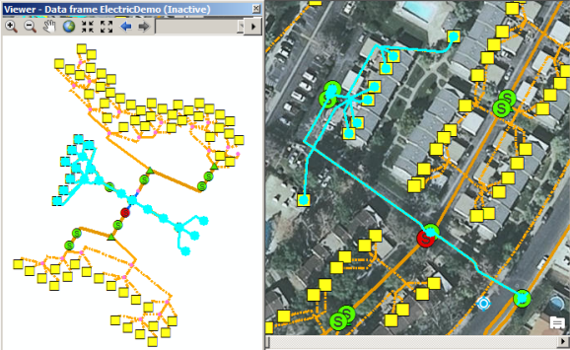
图结构无处不在
地理信息网络
节点：路口/房屋
边 ：道路

Slide 6
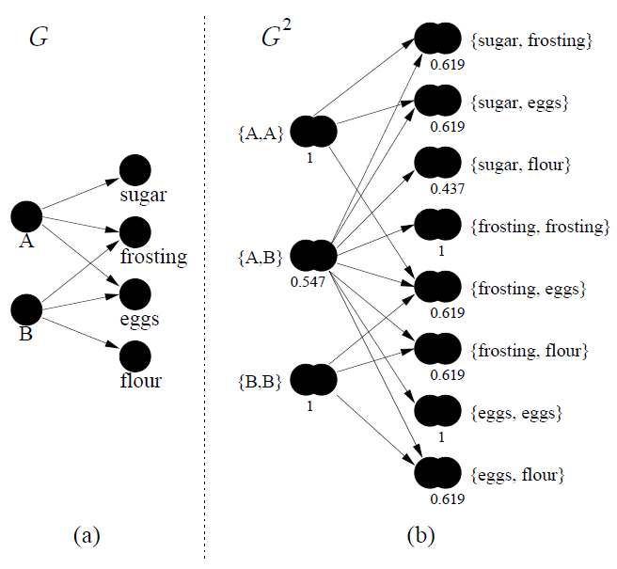
图结构无处不在
商品用户二部图
节点：商品/用户
边 ：购买关系

Slide 7
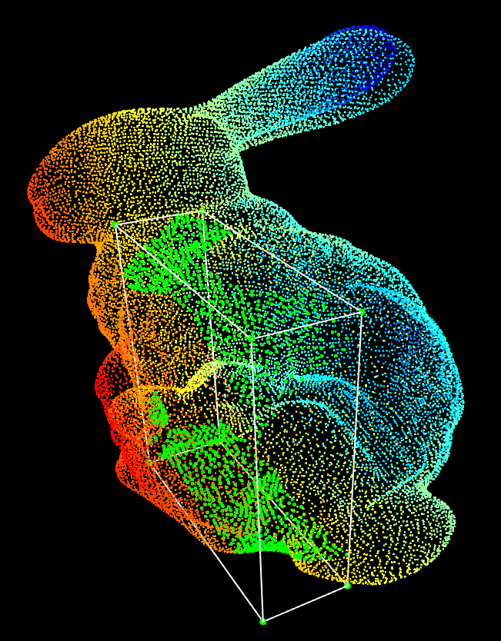
图结构无处不在
点云图
节点：激光点
边 ：坐标关系

Slide 8

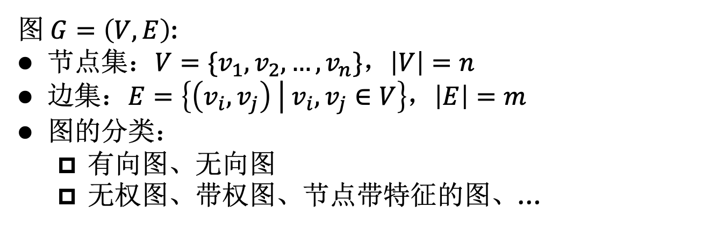
图(Graph)的定义
图 $G=\left(V,E\right)$:
节点集：$V=\{v_{1},v_{2},…,v_{n}\}$，$\left|V\right|=n$
边集：$E=\left\{\left(v_{i},v_{j}\right) \left| v_{i},v_{j}∈V\right.\right\}$，$\left|E\right|=m$
图的分类：
  有向图、无向图
  无权图、带权图、节点带特征的图、…
特征向量
2
2
2
1
3
1
3
1
3
4
4
4
6
6
6
5
5
5
7
7
7
有向图
无向图
节点带特征的图

Slide 9
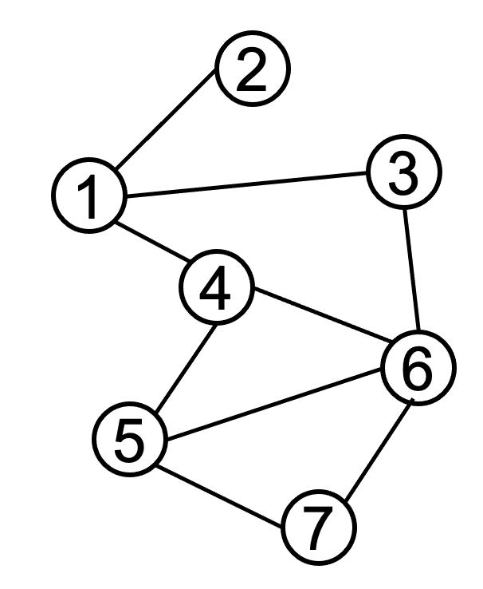
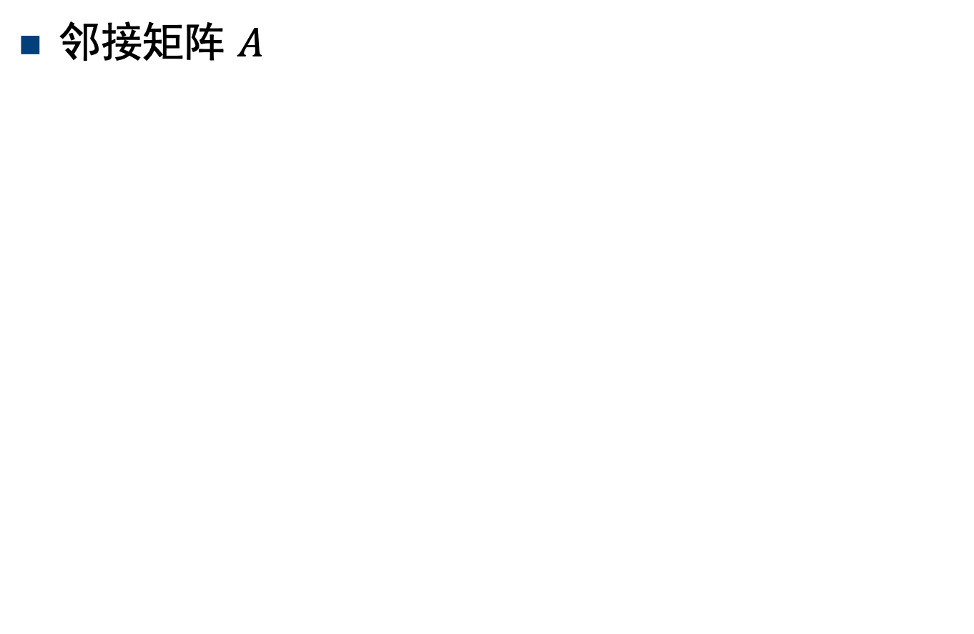

图(graph)的定义
邻接矩阵 $A$
0 | 1 | 1 | 1 | 0 | 0 | 0
1 | 0 | 0 | 0 | 0 | 0 | 0
1 | 0 | 0 | 0 | 0 | 1 | 0
1 | 0 | 0 | 0 | 1 | 1 | 0
0 | 0 | 0 | 1 | 0 | 1 | 1
0 | 0 | 1 | 1 | 1 | 0 | 1
0 | 0 | 0 | 0 | 1 | 1 | 0
$$A=$$

Slide 10


图(graph)的定义
度数矩阵 $D$
3 | 0 | 0 | 0 | 0 | 0 | 0
0 | 1 | 0 | 0 | 0 | 0 | 0
0 | 0 | 2 | 0 | 0 | 0 | 0
0 | 0 | 0 | 3 | 0 | 0 | 0
0 | 0 | 0 | 0 | 3 | 0 | 0
0 | 0 | 0 | 0 | 0 | 4 | 0
0 | 0 | 0 | 0 | 0 | 0 | 2
$$D=$$

Slide 11


图(graph)的定义
转移矩阵 $P=AD^{−1}$
0 | 1 | 1/2 | 1/3 | 0 | 0 | 0
1/3 | 0 | 0 | 0 | 0 | 0 | 0
1/3 | 0 | 0 | 0 | 0 | 1/4 | 0
1/3 | 0 | 0 | 0 | 1/3 | 1/4 | 0
0 | 0 | 0 | 1/3 | 0 | 1/4 | 1/2
0 | 0 | 1/2 | 1/3 | 1/3 | 0 | 1/2
0 | 0 | 0 | 0 | 1/3 | 1/4 | 0
$$P=$$

Slide 12








随机游走
10
9
12
2
1
8
3
11
$$1/4$$
$$1/3$$
$$1/3$$
4
$$1/4$$
每步游走时随机走向当前节点的邻居节点
概率转移矩阵$P=AD^{−1}$
$$1/3$$
6
$$1/4$$
5
$$1/4$$
$$1/4$$
7

Slide 13

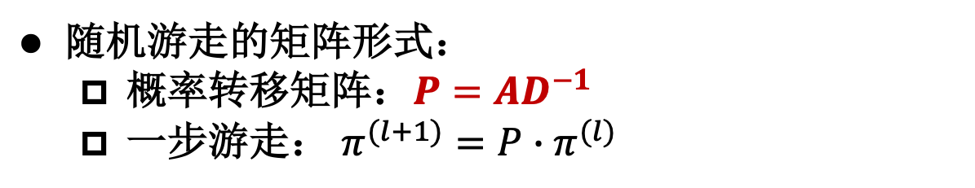




随机游走
随机游走的矩阵形式：
  概率转移矩阵：$P=AD^{−1}$
  一步游走： $π^{(l+1)}=P∙π^{(l)}$
$$π^{(l+1)}$$
$$=$$
$$P$$
$$∙$$
$$π^{(l)}$$
2
0
1/3
1/3
1/3
0
0
0
 | 1 | 1/2 | 1/3
1/3
1/3 |  |  |  |  | 1/4
1/3 |  |  |  | 1/3 | 1/4
 |  |  | 1/3 |  | 1/4 | 1/2
 |  | 1/2 | 1/3 | 1/3 |  | 1/2
 |  |  |  | 1/3 | 1/4
1
0
0
0
0
0
0
1
3
4
6
5
7

Slide 14













随机游走的数学性质
随机游走的稳态分布：
  大部分随机游走有稳态分布$π$，$π=P∙π=AD^{−1}∙π$
  无向图上随机游走的稳态分布: $π(v)=\frac{d_{v}}{2∙\left|E\right|}$
稳态分布与起始节点无关
$$\frac{1}{18}$$
$$π$$
$$=$$
$$P$$
$$∙$$
$$π$$
2
$$\frac{2}{18}$$
1/6
1/18
1/9
1/6
1/6
2/9
1/9
 | 1 | 1/2 | 1/3
1/3
1/3 |  |  |  |  | 1/4
1/3 |  |  |  | 1/3 | 1/4
 |  |  | 1/3 |  | 1/4 | 1/2
 |  | 1/2 | 1/3 | 1/3 |  | 1/2
 |  |  |  | 1/3 | 1/4
1/6
1/18
1/9
1/6
1/6
2/9
1/9
$$\frac{3}{18}$$
1
3
$$\frac{3}{18}$$
4
6
$$\frac{4}{18}$$
$$\frac{3}{18}$$
5
7
$$\frac{2}{18}$$

Slide 15
报告提纲
随机游走的定义与数学性质
随机游走的应用场景
随机游走的高效计算
总结

Slide 16
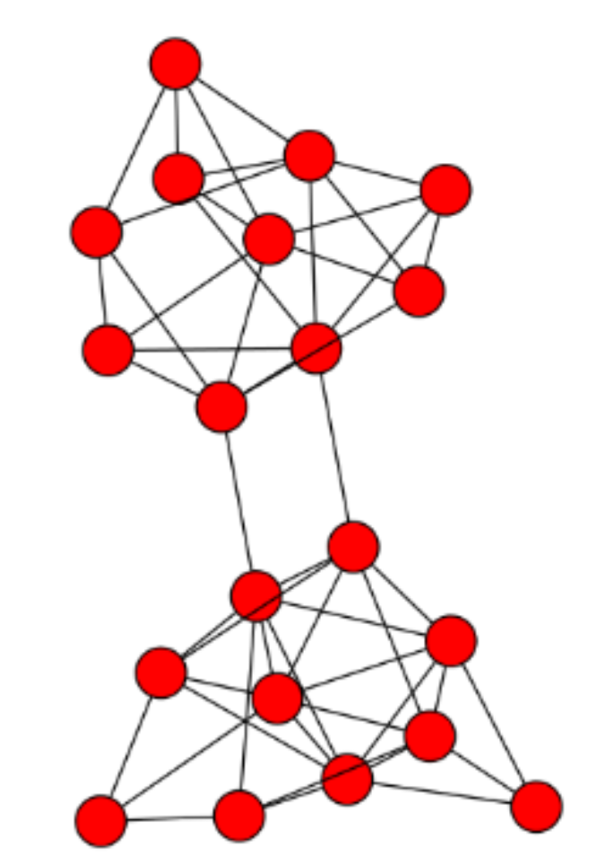

图表示学习
图结构
图学习模型
下游任务结果输出
特征信息

Slide 17
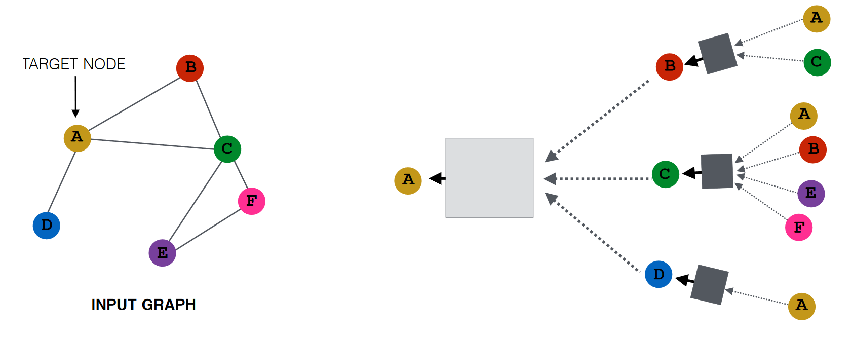

图卷积神经网络(GCN) [Kipf&Welling2017]
在图结构上聚合邻居的特征信息，进行消息传递；
借助神经网络训练消息传递中的权重；
遵循消息传递架构：
$$H^{(ℓ+1)}=σ\left(\tilde{P}H^{(ℓ)}W^{(ℓ)}\right)$$
神经网络
神经网络
神经网络
神经网络
GCN消息传递架构

Slide 18
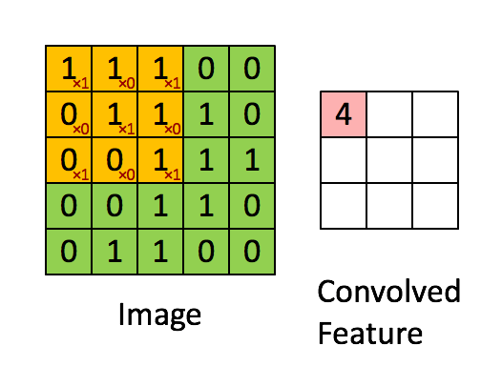


















GCN与CNN
CNN也是一种图卷积神经网络(GCN)：
  聚合周围八个邻居节点和自身的特征信息
$$h_{1}$$
$$h_{2}$$
$$h_{3}$$
$$w_{1}$$
$$w_{0}$$
$$w_{2}$$
$$w_{3}$$
$$h_{8}$$
$$w_{8}$$
$$h_{0}$$
$$w_{4}$$
$$h_{4}$$
$$w_{7}$$
$$w_{5}$$
$$w_{6}$$
$$h_{7}$$
$$h_{6}$$
$$h_{5}$$

Slide 19


GNN与随机游走
$$H^{(ℓ+1)}=σ\left(\tilde{P}H^{(ℓ)}W^{(ℓ)}\right)$$
$$H^{(ℓ+1)}=\tilde{P}…σ\left(\tilde{P}σ\left(\tilde{P}XW^{\left(0\right)}\right)W^{\left(1\right)}\right)…W^{\left(ℓ\right)}$$
$${⇒H}^{(K)}={\tilde{P}}^{K}XW$$
初始特征矩阵X的1列
10
9
0.03
0.1
0.03
0.3
0.2
0
0.1
0.01
0.08
0.03
0
0.12
12
2
1
8
3
11
4
6
5
7
Notes:
Moreover, the generalized graph propagation equation also covers the feature propagation process in Graph Neural Networks. In the work SGC, it proposes that we can decouple the feature propagation process and the prediction process for high scalability. That is, [Click!]given the feature matrix X, [Click!] we can first assign these features to corresponding nodes on the graph,and [Click!]propagate these features following the graph structures.

Slide 20

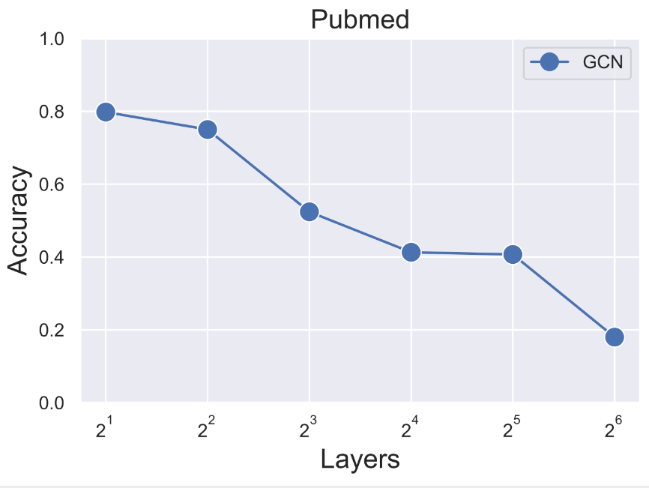
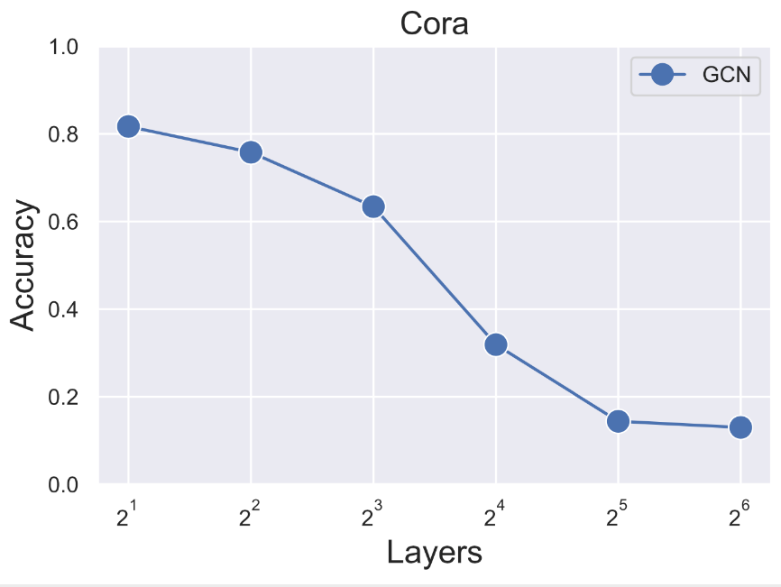
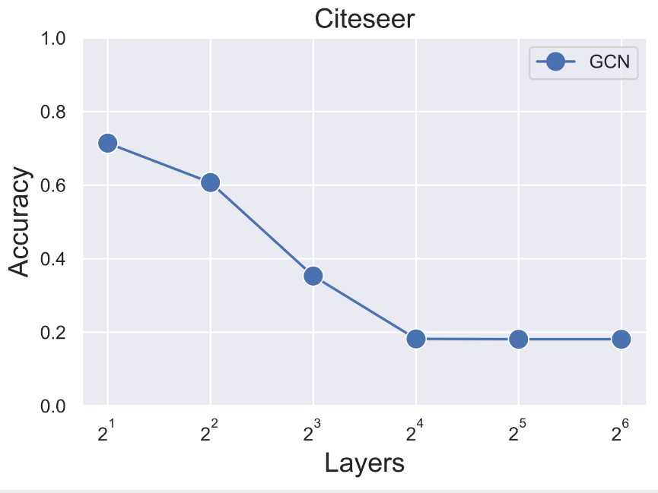
随机游走稳态与图卷积神经网络
GCN问题：无法做深
过平滑！
从特征出发的随机游走收敛到稳态，忘记了初始特征

Slide 21

带重启的随机游走
10
9
12
2
1
8
3
11
4
在每步游走中:
以$α$的概率返回初始状态；
以$(1−α)$的概率随机走向当前节点的任一邻居
6
5
7
稳态分布与起始节点有关

Slide 22
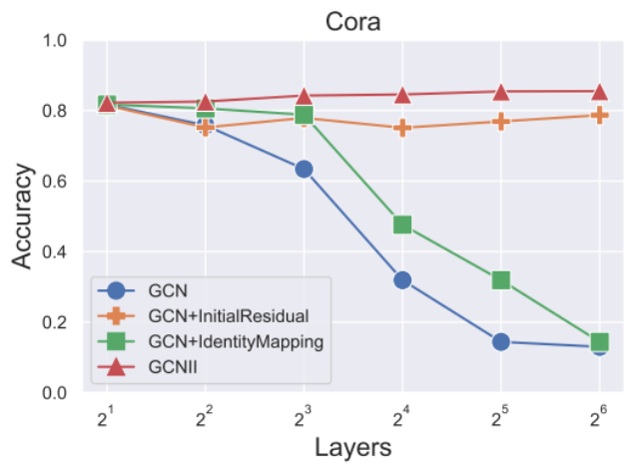
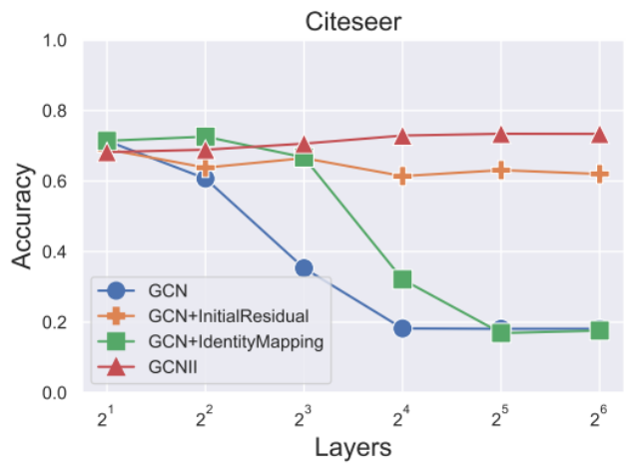
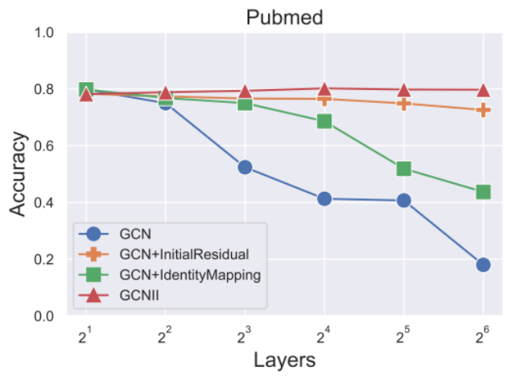
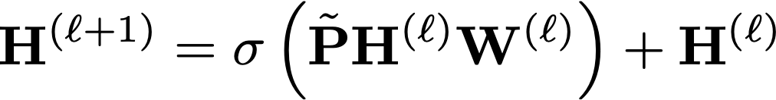
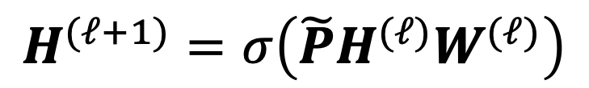
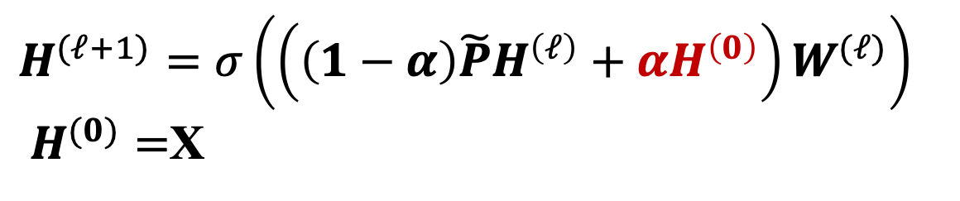
GCN + InitialResidual
GCN：
$$H^{(ℓ+1)}=σ\left(\tilde{P}H^{(ℓ)}W^{(ℓ)}\right)$$
GCN+InitialResidual:
$H^{(ℓ+1)}=σ\left(\left(\left(1−α\right)\tilde{P}H^{\left(ℓ\right)}+αH^{\left(0\right)}\right)W^{(ℓ)}\right)$
$H^{(0)}=$X
Chen M, Wei Z et al. Simple and Deep Graph Convolutional Networks. [ICML 2020]

Slide 23

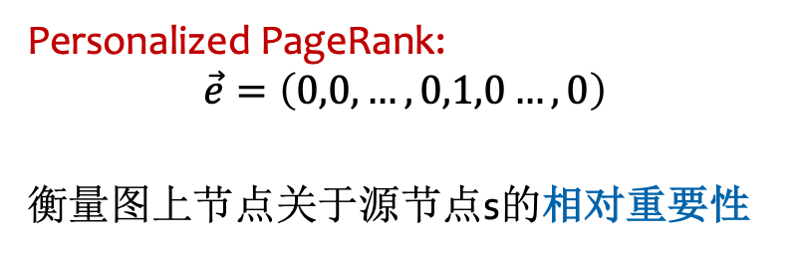

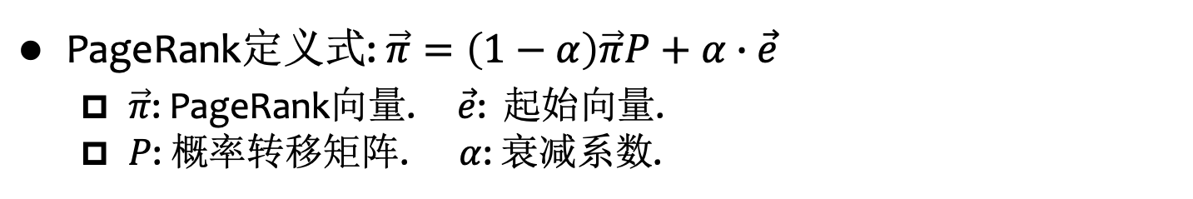
PageRank与PPR
PageRank定义式: $\vec{π}=\left(1−α\right)\vec{π}P+α∙\vec{e}$
  $\vec{π}$: PageRank向量. $\vec{e}$: 起始向量.
  $P$: 概率转移矩阵. $α$: 衰减系数.
PageRank: $\vec{e}=\left(\frac{1}{n},\frac{1}{n},…,\frac{1}{n}\right)$
衡量图上节点的全局重要性.
Personalized PageRank:
$$\vec{e}=\left(0,0, …,0,1,0…,0\right)$$
衡量图上节点关于源节点s的相对重要性
第s项为1
Notes:
Personalized PageRank就是图结构下关于节点邻近度的一种衡量方式。大家可能对Personalized PageRank感到陌生，但是很可能听说过PageRank，它是由谷歌的两位创始人提出的一种衡量web网络上网页重要性的方法。其定义的核心思想为：如果一个网页被很多网页或者重要的网页所引用，则其重要性较高。如果我们将一个web网络抽象为图结构，则基于这一思想，我们可以抽象得到一个迭代形式的定义式。在这一定义式中，pi表示pagerank向量，e为起始向量，P为概率转移矩阵，alpha为衰减系数。在每次迭代中，各节点的新的pagerank值可以由其邻居节点在上一轮的pagerank值融合得到，另外，每次迭代中，还会有alpha的概率变为初始值。由于pagerank希望衡量网络上各网页的全局重要性，即web网络对应的图结构上，各节点的全局重要性，因此pagerank计算时，其初始向量e的各维度均为1/n，表示在一开始图上各节点的全局重要性相同。Personalized PageRank(或者简称PPR)其实是PageRank的一种特殊形式，它希望衡量图上各节点关于给定源节点s的相对重要性，因此PPR的迭代定义式基本与PageRank相同，只有初始向量e设置为一个只有第s项为1，其它项均为0的one hot向量

Slide 24





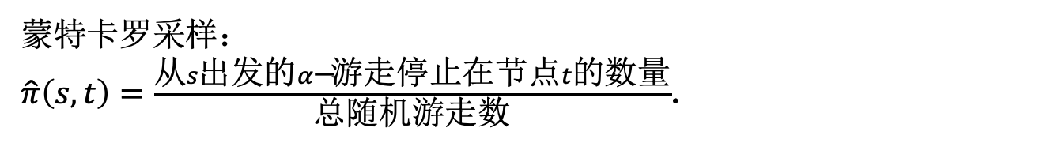









PageRank 与 PPR 的概率含义
10
9
$$α$$
12
2
$$1−α$$
$$1−α$$
$$1−α$$
$$1−α$$
$$α$$
$$1−α$$
8
1
3
11
$$1−α$$
$$α$$
$$1−α$$
$$1−α$$
4
$$1−α$$
$$1−α$$
$$α$$
$$1−α$$
$$1−α$$
6
$α$-衰减随机游走:
5
停止在当前节点, w.p. $α$
走向随机选择的一个出邻居, w.p. $1−α$
7
蒙特卡罗采样：
$\hat{π}\left(s,t\right)=\frac{从s出发的α\text{−}\text{游走}停止在节点t的数量}{总随机游走数}$.

Slide 25
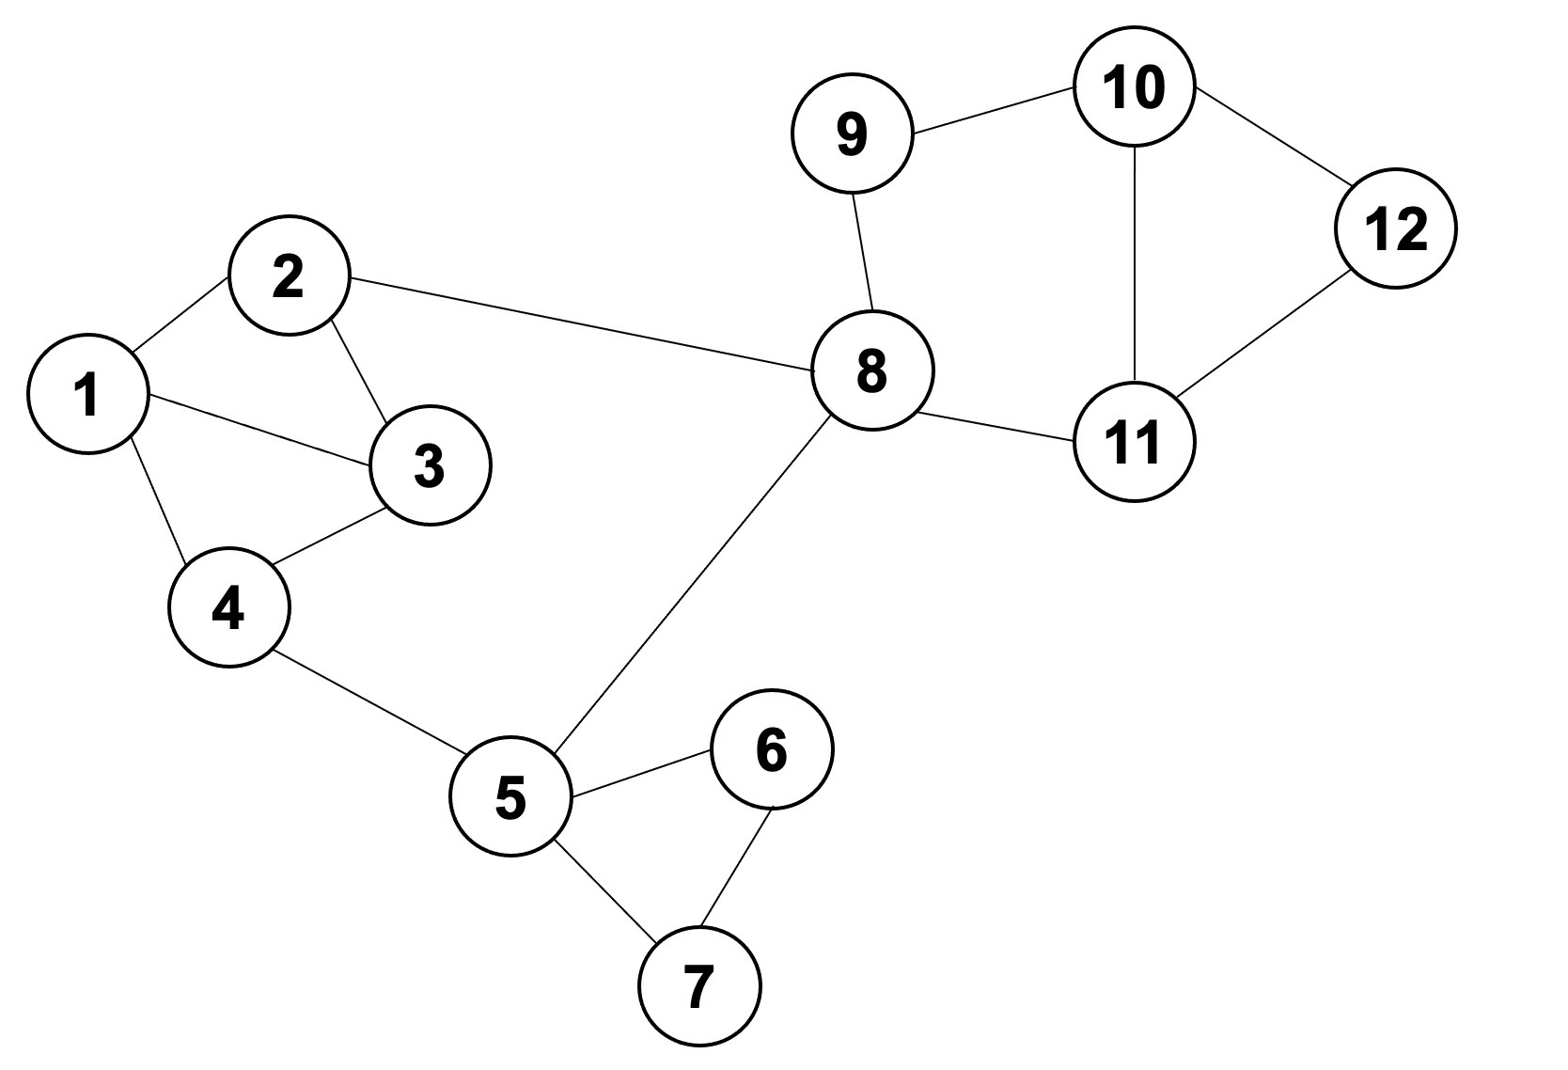
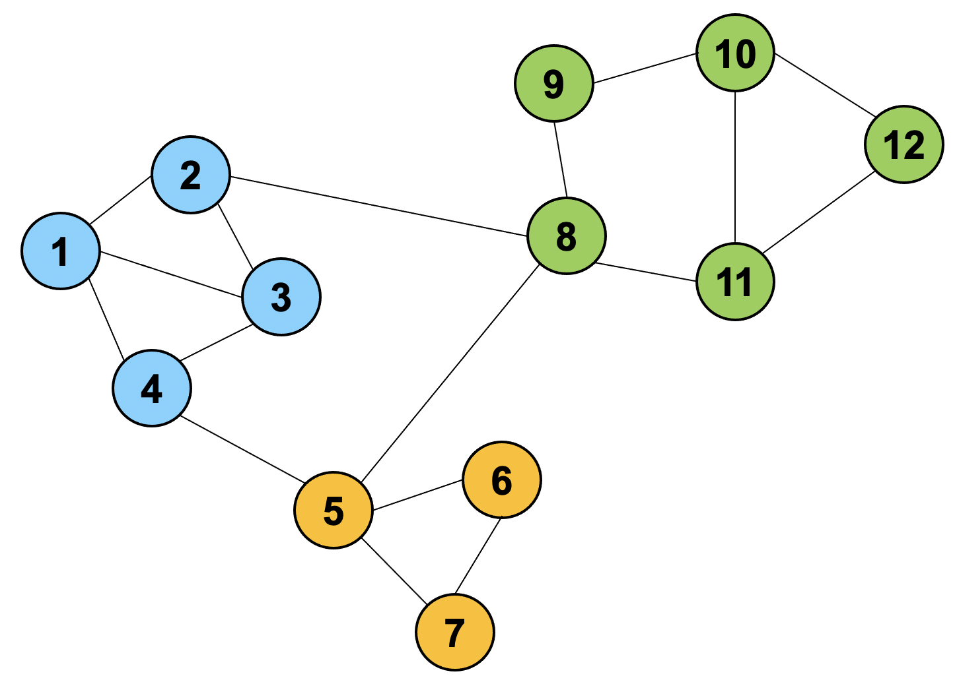
社区发现（Clustering）
社区发现（Clustering）是图挖掘中的重要任务，旨在得到内部关联紧密、与外界关联稀疏的“社区”，也被称作 “图聚类”、“图分割”
Notes:
社区发现是图挖掘中的重要任务，旨在得到内部关联紧密、与外界关联稀疏的“社区”，也被称作“图聚类”、“图分割”；任务目标如示意图所示（点击），不同的颜色代表所得到的不同“社区”。

Slide 26
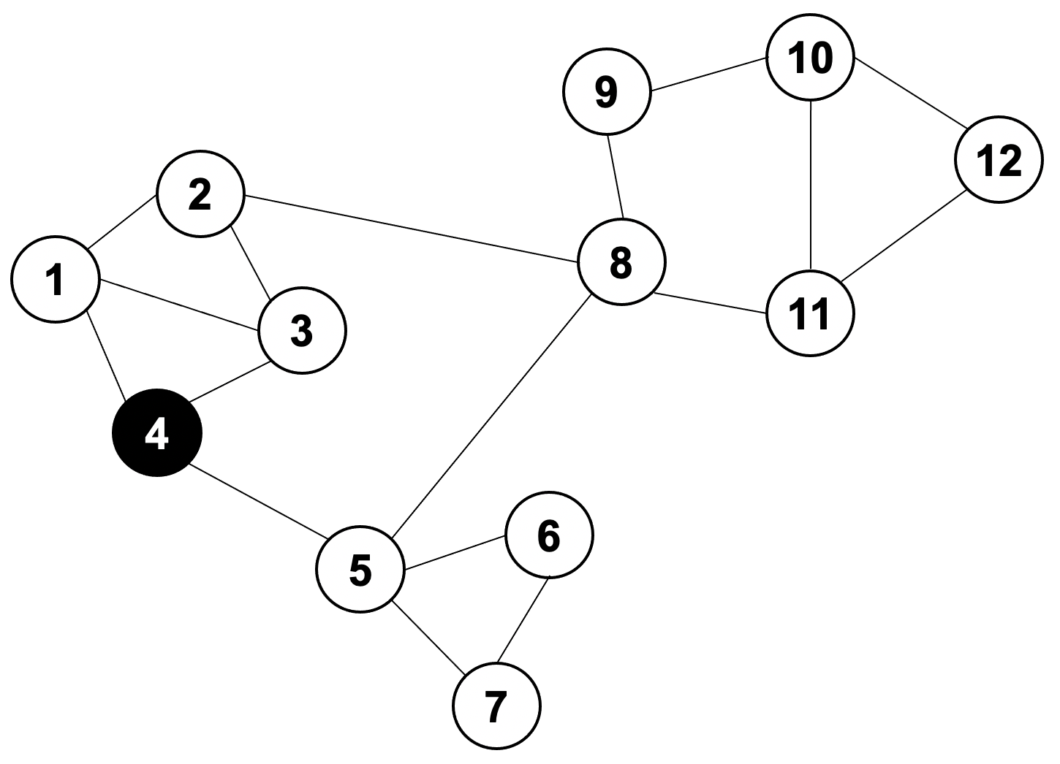
社区发现（Clustering）
社区发现（Clustering）是图挖掘中的重要任务，旨在得到内部关联紧密、与外界关联稀疏的“社区”，也被称作 “图聚类”、“图分割”
种子节点（seed node）
seed node: 4
Cluster: {4,1,3,2}
Notes:
社区发现是图挖掘中的重要任务，旨在得到内部关联紧密、与外界关联稀疏的“社区”，也被称作“图聚类”、“图分割”；任务目标如示意图所示（点击），不同的颜色代表所得到的不同“社区”。

Slide 27
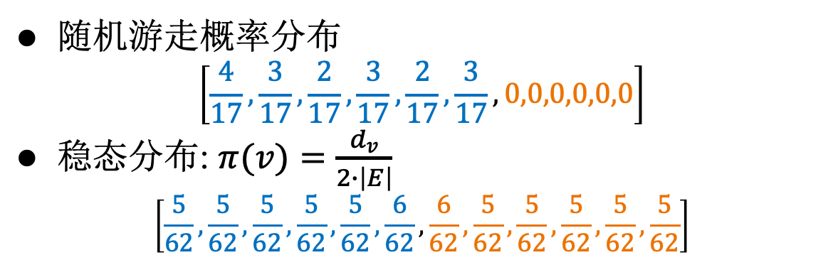
随机游走在社区发现中的应用
随机游走概率分布
$$\left[\frac{4}{17},\frac{3}{17},\frac{2}{17},\frac{3}{17},\frac{2}{17},\frac{3}{17},0,0,0,0,0,0\right]$$
稳态分布: $π(v)=\frac{d_{v}}{2∙\left|E\right|}$
$$\left[\frac{5}{62},\frac{5}{62},\frac{5}{62},\frac{5}{62},\frac{5}{62},\frac{6}{62},\frac{6}{62},\frac{5}{62},\frac{5}{62},\frac{5}{62},\frac{5}{62},\frac{5}{62}\right]$$
2
3
8
9
1
6
7
12
4
5
10
11

Slide 28
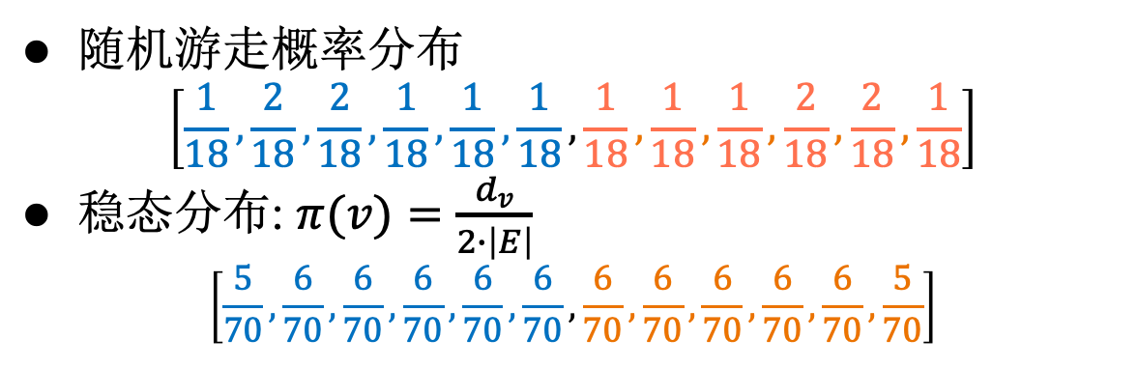
随机游走在社区发现中的应用
随机游走概率分布
$$\left[\frac{1}{18},\frac{2}{18},\frac{2}{18},\frac{1}{18},\frac{1}{18},\frac{1}{18},\frac{1}{18},\frac{1}{18},\frac{1}{18},\frac{2}{18},\frac{2}{18},\frac{1}{18}\right]$$
稳态分布: $π(v)=\frac{d_{v}}{2∙\left|E\right|}$
$$\left[\frac{5}{70},\frac{6}{70},\frac{6}{70},\frac{6}{70},\frac{6}{70},\frac{6}{70},\frac{6}{70},\frac{6}{70},\frac{6}{70},\frac{6}{70},\frac{6}{70},\frac{5}{70}\right]$$
2
3
8
9
1
6
7
12
4
5
10
11

Slide 29
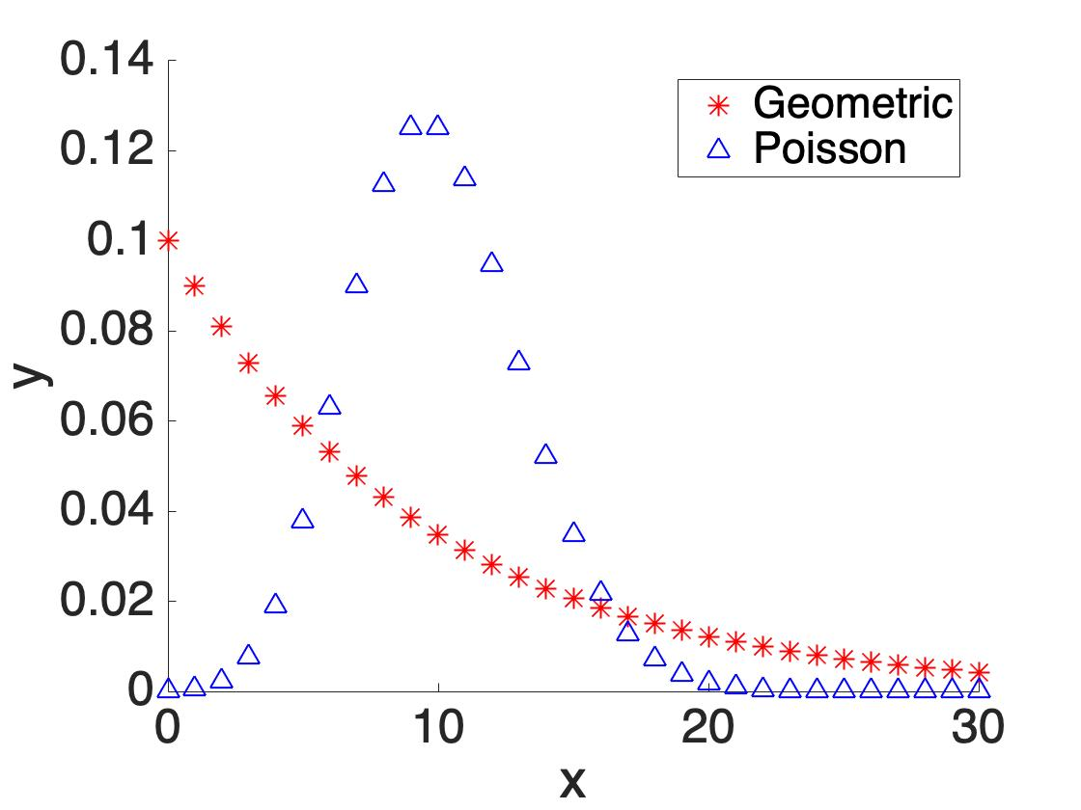
随机游走在社区发现中的应用
相较于PPR，邻近度Heat Kernel PageRank (HKPR) 更适于社区发现，即随机游走的长度服从泊松分布
  PPR：随机游走长度服从二项分布
  HKPR：随机游走长度服从泊松分布
Notes:
社区发现是图挖掘中的重要任务，旨在得到内部关联紧密、与外界关联稀疏的“社区”，也被称作“图聚类”、“图分割”；任务目标如示意图所示（点击），不同的颜色代表所得到的不同“社区”。

Slide 30
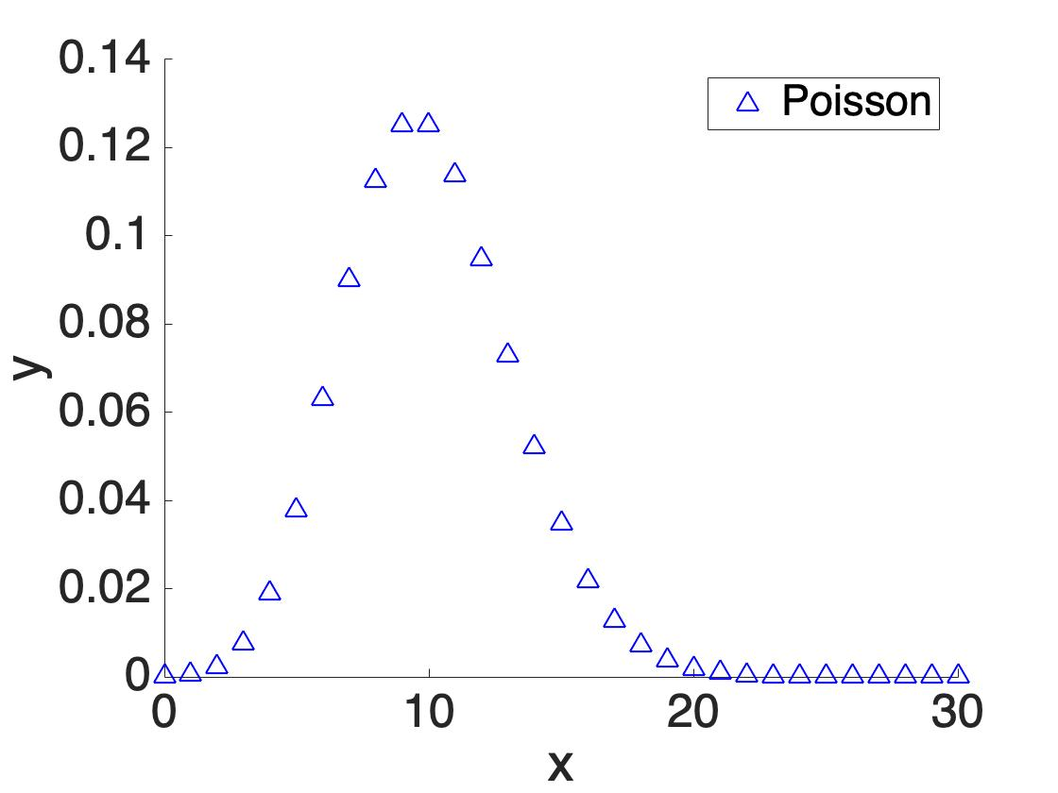
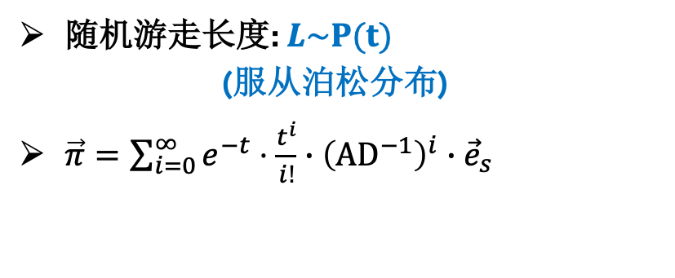
Heat Kernel PageRank (HKPR)
10
9
12
2
1
8
3
11
4
6
L=5
L=13
L=10
5
随机游走长度: $L\sim P(t)$
(服从泊松分布)
$\vec{π}=\sum_{i=0}^{∞}{e^{−t}⋅\frac{t^{i}}{i!}∙{\left({AD}^{−1}\right)}^{i}∙{\vec{e}}_{s}}$
7
Notes:
(Click!) Furthermore, Heat Kernel PageRank is a variant of Personalized PageRank. Heat kernel PageRank uses the teleport probability of a random walk starting from the given source node to compute the node proximity. The length of the random walk in heat kernel PageRank follows the poisson [pwa:sɔn] distribution with parameter t.

Slide 31
报告提纲
随机游走的定义与数学性质
随机游走的应用场景
随机游走的高效计算
总结

Slide 32
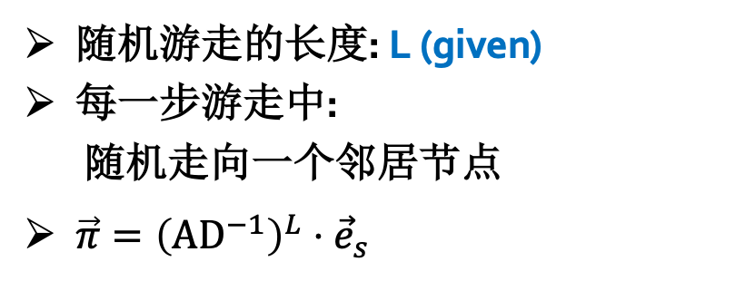


L步随机游走
10
9
12
2
1
8
3
11
$$1/4$$
$$1/3$$
$$1/3$$
4
随机游走的长度: L (given)
每一步游走中:
随机走向一个邻居节点
$\vec{π}={\left(AD^{−1}\right)}^{L}⋅{\vec{e}}_{s}$
$$1/3$$
$$1/4$$
6
$$1/4$$
5
$$1/4$$
$$1/4$$
7
Notes:
(Click!) For L-hop transition proability, it uses the transition probability of a random walk to measure the node proximity. The random walk starts from the source node s. And the length of the walk is given by a fixed number L. In each step, the walk picks a random neighbor node to move.

Slide 33

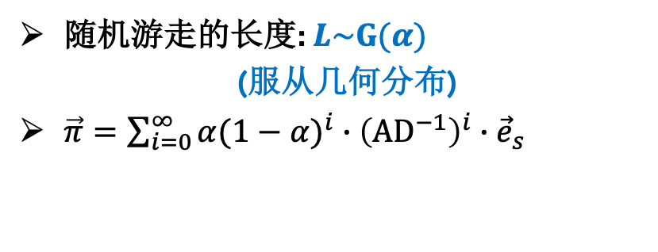


Personalized PageRank (PPR)
10
9
$$α$$
12
2
$$1−α$$
$$1−α$$
$$1−α$$
$$1−α$$
$$α$$
$$1−α$$
8
1
3
11
$$1−α$$
$$α$$
$$1−α$$
$$1−α$$
4
$$1−α$$
$α$-衰减随机游走:
$$1−α$$
停止在当前节点, w.p. $α$
$$α$$
$$1−α$$
$$1−α$$
6
走向随机选择的一个出邻居, w.p. $1−α$
5
随机游走的长度: $L\sim G(α)$
(服从几何分布)
$\vec{π}=\sum_{i=0}^{∞}{{α(1−α)}^{i}∙{\left({AD}^{−1}\right)}^{i}∙{\vec{e}}_{s}}$
7
PPR $π(s,t)$=Pr{从节点s出发的 $α$-衰减随机游走停止在节点}

Slide 34
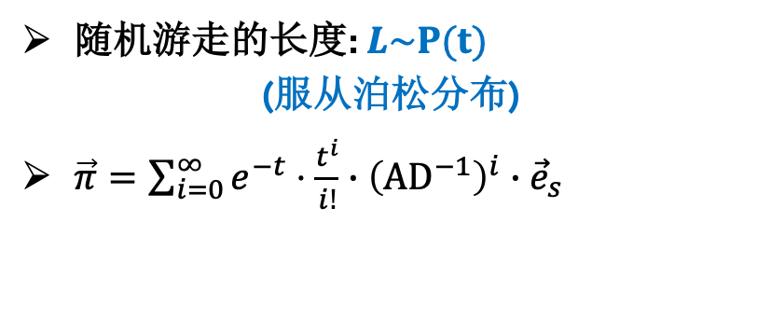
Heat Kernel PageRank (HKPR)
10
9
12
2
1
8
3
11
4
6
L=5
L=13
L=10
5
随机游走的长度: $L\sim P(t)$
(服从泊松分布)
$\vec{π}=\sum_{i=0}^{∞}{e^{−t}⋅\frac{t^{i}}{i!}∙{\left({AD}^{−1}\right)}^{i}∙{\vec{e}}_{s}}$
7
Notes:
(Click!) Furthermore, Heat Kernel PageRank is a variant of Personalized PageRank. Heat kernel PageRank uses the teleport probability of a random walk starting from the given source node to compute the node proximity. The length of the random walk in heat kernel PageRank follows the poisson [pwa:sɔn] distribution with parameter t.

Slide 35
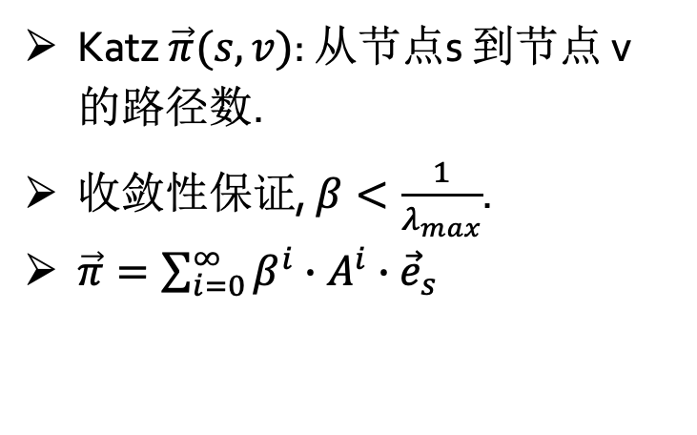
Katz
10
9
12
2
1
8
3
11
4
Katz $\vec{π}(s,v)$: 从节点s 到节点 v 的路径数.
收敛性保证, $β<\frac{1}{λ_{max}}$.
$\vec{π}=\sum_{i=0}^{∞}{β^{i}∙A^{i}∙{\vec{e}}_{s}}$
6
5
7
Notes:
[Click!] Things become a little different in Katz. Katz index is another popular proximity measurement. It uses the number of reachable paths from the source node to other nodes on the graph as node proximities. Katz also adds a parameter beta to guarantee convergence [kənˈvɜːrdʒəns].

Slide 36
是否存在一种通用范式可以概括上述所有的随机游走形式？
是否存在一种通用算法可以高效求解上述所有的随机游走形式？
Notes:
So here comes an interesting question: since we can generalize various node proximity metrics and GNN models into a graph propagation equation. Is there a unified algorithm to compute the generalized propagation equation?

Slide 37



Approximate Graph Propagation
Hanzhi Wang, Mingguo He, Zhewei Wei*, Sibo Wang,
Ye Yuan, Xiaoyong Du, Ji-Rong Wen

Slide 38
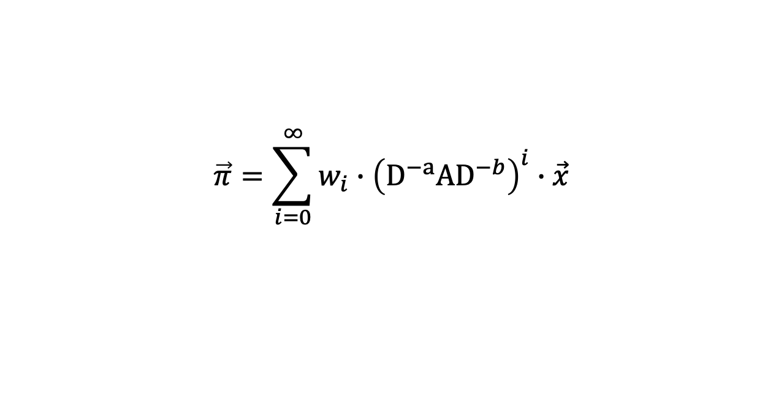
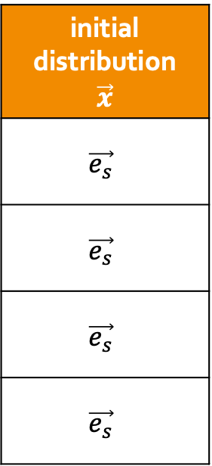
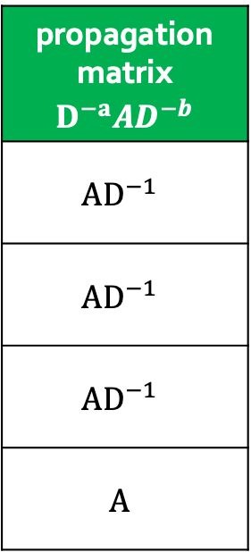
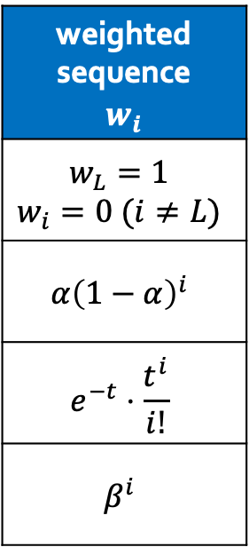
通用图传播范式
$$\vec{π}=\sum_{i=0}^{∞}{w_{i}∙{\left({D^{−a}AD}^{−b}\right)}^{i}∙\vec{x}}$$
weighted sequence $$w_{i}$$
$$w_{L}=1$$ $$w_{i}=0 (i≠L)$$
$$α{\left(1−α\right)}^{i}$$
$$e^{−t}⋅\frac{t^{i}}{i!}$$
$$β^{i}$$
propagation matrix $${D^{−a}AD}^{−b}$$
$${AD}^{−1}$$
$${AD}^{−1}$$
$${AD}^{−1}$$
$$A$$
initial distribution $$\vec{x}$$
$$\vec{e_{s}}$$
$$\vec{e_{s}}$$
$$\vec{e_{s}}$$
$$\vec{e_{s}}$$
transition probability
PPR
HKPR
Katz
Notes:
Reviewing all these node proximity metrics, we can summarize a generalized graph propagation equation. [Click!] The weighted sequence w_i controls the length of the random walk. [CLICK!] The parameters a and b determine the propagation structures, such as forward propagation or backward propagation. [Click!] The vector x represents the initial distribution of the probability mass to be propagated. In these proximity metrics we mentioned before, x is set as the one-hot vector corresponding to the given source node.

Slide 39

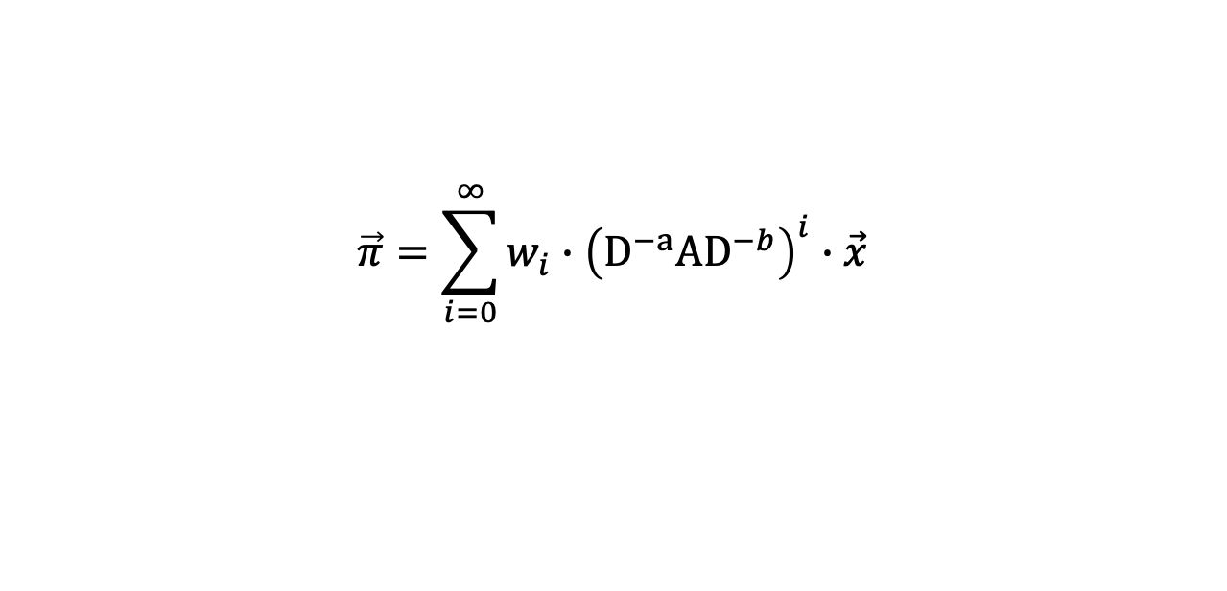
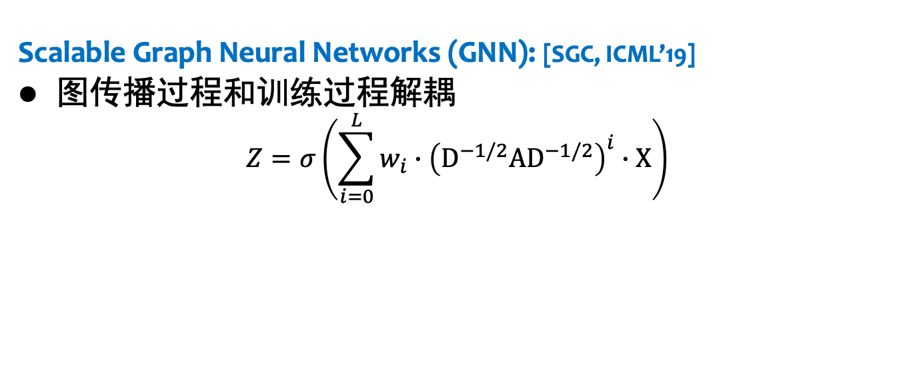
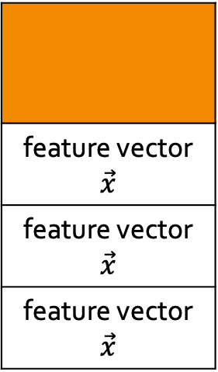
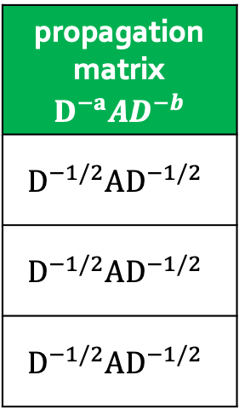
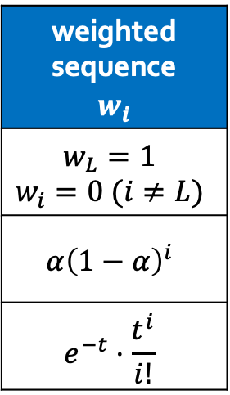
通用图传播范式
Scalable Graph Neural Networks (GNN): [SGC, ICML’19]
图传播过程和训练过程解耦
$$Z=σ\left(\sum_{i=0}^{L}{w_{i}∙{\left({D^{−1/2}AD}^{−1/2}\right)}^{i}∙X}\right)$$
通用图传播范式
$$\vec{π}=\sum_{i=0}^{∞}{w_{i}∙{\left({D^{−a}AD}^{−b}\right)}^{i}∙\vec{x}}$$
transition probability
PPR
HKPR
weighted sequence $$w_{i}$$
$$w_{L}=1$$ $$w_{i}=0 (i≠L)$$
$$α{\left(1−α\right)}^{i}$$
$$e^{−t}⋅\frac{t^{i}}{i!}$$
propagation matrix $${D^{−a}AD}^{−b}$$
$${D^{−1/2}AD}^{−1/2}$$
$${D^{−1/2}AD}^{−1/2}$$
$${D^{−1/2}AD}^{−1/2}$$
feature vector $$\vec{x}$$
feature vector $$\vec{x}$$
feature vector $$\vec{x}$$
propagation
structure
graph signal
$$\vec{x}$$
SGC [ICML’ 19]
APPNP [ICLP’ 19]
GDC [NeurIPS’ 19]
Notes:
Since these GNN models apply the node proximity metrics to propagate features. [Click!]We can summarize these GNN models into the generalized graph propagation equation,[Click!] with the paramters wi, a, b, and vector x. Note that in GNN’s feature propagation, the vector x denotes the columns of the given feature matrix.

Slide 40
GNN模型
Scalable Graph Neural Networks (GNN): [SGC, ICML’19]
图传播过程和训练过程解耦
$$Z=σ\left(\sum_{i=0}^{L}{w_{i}∙{\left({D^{−1/2}AD}^{−1/2}\right)}^{i}∙X}\right)$$
one column of the
feature matrix
10
feature propagation
9
0.03
0.1
0.03
0.3
0.2
0
0.1
0.01
0.08
0.03
0
0.12
12
2
1
8
3
11
4
6
5
7
Notes:
Moreover, the generalized graph propagation equation also covers the feature propagation process in Graph Neural Networks. In the work SGC, it proposes that we can decouple the feature propagation process and the prediction process for high scalability. That is, [Click!]given the feature matrix X, [Click!] we can first assign these features to corresponding nodes on the graph,and [Click!]propagate these features following the graph structures.

Slide 41
GNN模型
Scalable Graph Neural Networks (GNN): [SGC, ICML’19]
图传播过程和训练过程解耦
$$Z=σ\left(\sum_{i=0}^{L}{w_{i}∙{\left({D^{−1/2}AD}^{−1/2}\right)}^{i}∙X}\right)$$
one column of the
feature matrix
10
feature propagation
9
0.03
0.1
0.03
0.3
0.2
0
0.1
0.01
0.08
0.03
0
0.12
12
2
1
8
3
11
4
6
5
7
Notes:
(Click!)(Click!)

Slide 42

GNN模型
Scalable Graph Neural Networks (GNN): [SGC, ICML’19]
图传播过程和训练过程解耦
$$Z=σ\left(\sum_{i=0}^{L}{w_{i}∙{\left({D^{−1/2}AD}^{−1/2}\right)}^{i}∙X}\right)$$
下游预测任务
one column of the
propagation matrix
one column of the
feature matrix
10
feature propagation
9
0.23
0.01
0.1
0.1
0.2
0.01
0.1
0.18
0
0.03
0.1
0.02
0.03
0.1
0.03
0.3
0.2
0
0.1
0.01
0.08
0.03
0
0.12
12
2
1
8
3
11
$$σ$$
4
activation
6
5
7
Notes:
[Click!] Then we feed the final propagation matrix [Click!]to the prediction structures for downstream tasks.

Slide 43
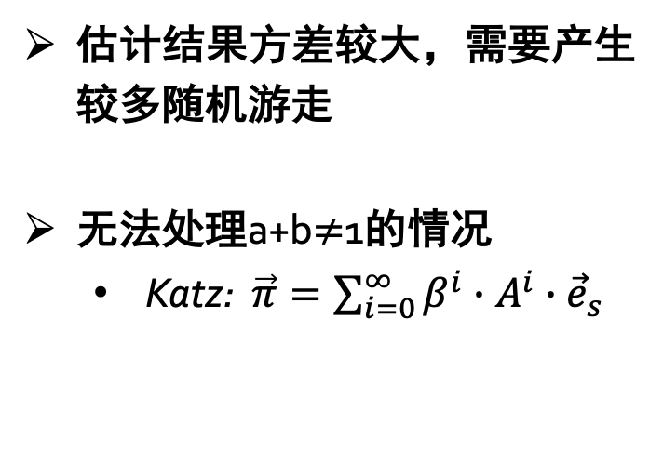
Monte-Carlo 采样
10
9
12
2
1
8
3
11
4
估计结果方差较大，需要产生较多随机游走
无法处理a+b$≠$1的情况
  Katz: $\vec{π}=\sum_{i=0}^{∞}{β^{i}∙A^{i}∙{\vec{e}}_{s}}$
6
5
7
Notes:
To compute the generalized graph propagation equation, a simple algorithm is the Monte-Carlo methods. （Click!）That we can generate multiply random walks to approximate the final probability distribution. While there are two main drawbacks of random walks. The first one is the Monte-Carlo method often needs to generate too many walks and cost lots of time. The second one is the Monte-Carlo method can not deal with the situation that a plus b doesn’t equal 1, such as in the Katz model.

Slide 44







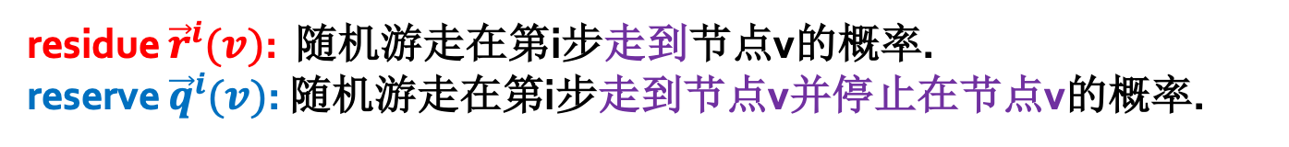



确定性图传播 [FOCS’06, NeurIPS’ 15]
通用图传播范式: $\vec{π}=\sum_{i=0}^{∞}{w_{i}∙{\left({D^{−a}AD}^{−b}\right)}^{i}∙\vec{x}}$ .
residue ${\vec{r}}^{i}(v)$: 随机游走在第i步走到节点v的概率.
reserve ${\vec{q}}^{i}(v)$: 随机游走在第i步走到节点v并停止在节点v的概率.
图传播向量 $\vec{π}$
10
$$\vec{x}$$
9
0.23
0.01
0.1
0.1
0.2
0.01
0.1
0.18
0
0.03
0.1
0.02
0
0
0
1
0
0
0
0
0
0
0
0
${\vec{r}}^{1}\left(1\right)+\frac{Y_{1}}{Y_{0}}⋅\frac{{\vec{r}}^{0}\left(4\right)}{{d_{1}^{a}⋅d}_{4}^{b}}$
12
2
1
8
3
11
${\vec{r}}^{1}\left(3\right)+\frac{Y_{1}}{Y_{0}}⋅\frac{{\vec{r}}^{0}\left(4\right)}{{d_{3}^{a}⋅d}_{4}^{b}}$
4
${\vec{r}}^{0}\left(4\right)=0$
${\vec{r}}^{0}\left(4\right)=1$
${\vec{q}}^{0}\left(4\right)=\frac{w_{0}}{Y_{0}}⋅{\vec{r}}^{0}\left(4\right)$
6
5
repeat
${\vec{r}}^{1}\left(5\right)+\frac{Y_{1}}{Y_{0}}⋅\frac{{\vec{r}}^{0}\left(4\right)}{{d_{5}^{a}⋅d}_{4}^{b}}$
7
$Y_{i}=w_{i}+w_{i+1}+…$
Notes:
On the other hand, how about applying a deterministic propagation to compute the generalized propagation equation? In detail, we can view the vector x as the initial probability distribution and tries to propagate the probability mass step by step. [Click!]In the propagation process, we maintain two values for each node at each propagation level: residue and reserve. Specifcally, the residue records the probability mass transferred to the node at each step. And the reserve records the probability mass transferred to the node and permernantly stayed at the node. For example, in the given graph, [Click!] we suppose the initial probability distribution is an one-hot vector, that the source node 4 has all probability mass. [Click!]In the first propagation step, node 4 leaves some probability mass to its reserve, and transfers the other probability mass to its neighbors. Repeat this process until the increment of probability mass is below the error threshold. Then we can derive the final propagation vector \pi.

Slide 45





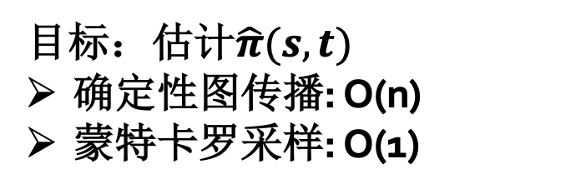
确定性图传播 [FOCS’06, NeurIPS’ 15]
通用图传播范式: $\vec{π}=\sum_{i=0}^{∞}{w_{i}∙{\left({D^{−a}AD}^{−b}\right)}^{i}∙\vec{x}}$ .
$$v_{1}$$
目标：估计$\hat{π}(s,t)$
确定性图传播: O(n)
蒙特卡罗采样: O(1)
$$v_{2}$$
$$v_{3}$$
s
t
…
$$v_{n−1}$$
$$v_{n}$$
Notes:
However, the deterministic propagation method may suffer from unnecessary cost. For example in the given graph, if we want to approximate the propagation results of pi(s,t). The deterministic propagation method has to propagate from s to each of v, then to t. While we find that, in this graph, the optimal solution is to generate only one random walks(Click!), which can definitely walks from s to t and only cost consant time.

Slide 46
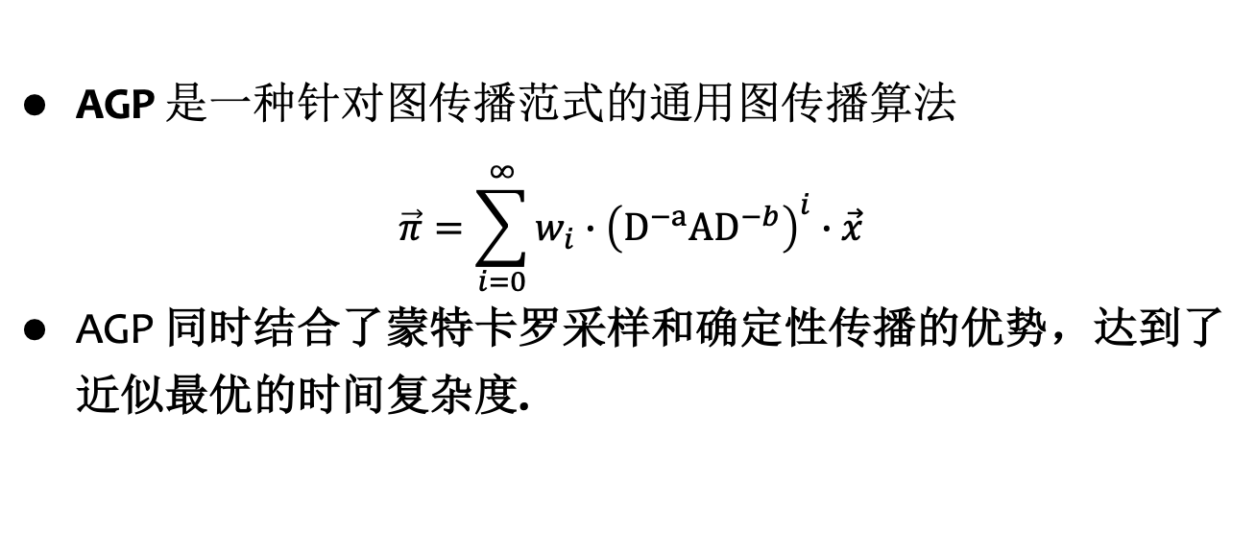
AGP: 面向图传播范式的通用图传播算法
AGP 是一种针对图传播范式的通用图传播算法
$$\vec{π}=\sum_{i=0}^{∞}{w_{i}∙{\left({D^{−a}AD}^{−b}\right)}^{i}∙\vec{x}}$$
AGP 同时结合了蒙特卡罗采样和确定性传播的优势，达到了近似最优的时间复杂度.
多种图节点临近度指标
和GNN模型
一个通用的图传播算法
transition probability | SGC
PPR | APPNP
HKPR | GDC
Katz | …
AGP
近似最优的时间复杂度
Notes:
Hence, We propose an approximate graph propagtion algorithm AGP. In AGP, we combines the strengths of Monte-Carlo methods and the deterministic propagation methods. As a unifed approximate graph propagation algorithm, AGP achieves near optimal tim complexity. [Click!] Compared to prior studies, AGP gets rid of the case-by-case algorithm structure and uses a unfied algorithm to cover various proximity metrics and GNN models in near optimal time complexity. Now we show how AGP works.

Slide 47


AGP: 面向图传播范式的通用图传播算法
通用图传播范式: $\vec{π}=\sum_{i=0}^{∞}{w_{i}∙{\left({D^{−a}AD}^{−b}\right)}^{i}∙\vec{x}}$ .
随机游走在第i步从节点$u$ 走到节点 $v$ 的概率:
$$\frac{Y_{i+1}}{Y_{i}}⋅\frac{{\vec{r}}^{i}\left(u\right)}{{d_{v}^{a}⋅d}_{u}^{b}}$$
度数越大，概率越小
$${d_{v}^{a}⋅d}_{u}^{b}$$
10
9
${\vec{r}}^{1}\left(1\right)+\frac{Y_{1}}{Y_{0}}⋅\frac{{\vec{r}}^{0}\left(4\right)}{{d_{1}^{a}⋅d}_{4}^{b}}$
12
2
1
8
3
11
${\vec{r}}^{1}\left(3\right)+\frac{Y_{1}}{Y_{0}}⋅\frac{{\vec{r}}^{0}\left(4\right)}{{d_{3}^{a}⋅d}_{4}^{b}}$
4
6
5
${\vec{r}}^{1}\left(5\right)+\frac{Y_{1}}{Y_{0}}⋅\frac{{\vec{r}}^{0}\left(4\right)}{{d_{5}^{a}⋅d}_{4}^{b}}$
7
Notes:
(Click!) we notice that the transferred probability mass is in inverse proportion to the node degrees. That is, (Click!)the larger the node degrees are, the smaller the probability mass we transferred. A common sense is we can ignore those propagation with small transferred probability mass to save time.

Slide 48








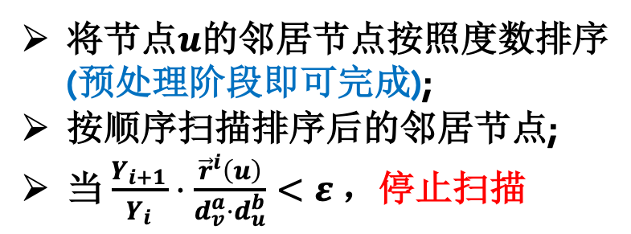




AGP: 面向图传播范式的通用图传播算法
随机游走在第i步从节点$u$ 走到节点 $v$ 的概率:
$$\frac{Y_{i+1}}{Y_{i}}⋅\frac{{\vec{r}}^{i}\left(u\right)}{{d_{v}^{a}⋅d}_{u}^{b}}$$
度数越大，概率越小
将节点$u$的邻居节点按照度数排序 (预处理阶段即可完成);
按顺序扫描排序后的邻居节点;
当 $\frac{Y_{i+1}}{Y_{i}}⋅\frac{{\vec{r}}^{i}\left(u\right)}{{d_{v}^{a}⋅d}_{u}^{b}}<ε$ ，停止扫描
$+\frac{Y_{i+1}}{Y_{i}}⋅\frac{{\vec{r}}^{i}\left(u\right)}{2^{a}⋅5^{b}}$
$$v_{1}$$
$+\frac{Y_{i+1}}{Y_{i}}⋅\frac{{\vec{r}}^{i}\left(u\right)}{3^{a}⋅5^{b}}$
$$v_{2}$$
$$u$$
$$v_{3}$$
$+\frac{Y_{i+1}}{Y_{i}}⋅\frac{{\vec{r}}^{i}\left(u\right)}{4^{a}⋅5^{b}}$
是否可以直接忽略剩余节点呢?
$$v_{4}$$
$+\frac{Y_{i+1}}{Y_{i}}⋅\frac{{\vec{r}}^{i}\left(u\right)}{5^{a}⋅5^{b}}$
$$v_{5}$$
$+\frac{Y_{i+1}}{Y_{i}}⋅\frac{{\vec{r}}^{i}\left(u\right)}{6^{a}⋅5^{b}}$
Notes:
Hence, based on this intuition, (Click!) we can sort each node’s adjacent list in the ascending order of the neighbor nodes’ degrees. This sorting process can be finished when reading the graph. In the query phase, (Click!)we can scan the ordered adjacent list. (Click!)Once we find a probability mass to be transferred is below the error threshold. Then we straightly break the propagation from node u to save time. (Click!) However, this simple idea may confront with some bad cases and suffers from large approximation error.

Slide 49









AGP: 面向图传播范式的通用图传播算法
将节点$u$的邻居节点按照度数排序 (预处理阶段即可完成);
按顺序扫描排序后的邻居节点;
当 $\frac{Y_{i+1}}{Y_{i}}⋅\frac{{\vec{r}}^{i}\left(u\right)}{{d_{v}^{a}⋅d}_{u}^{b}}<ε$ ，停止扫描
$$v_{1}$$
$$v_{2}$$
$$u$$
$$v_{3}$$
$$q$$
…
$$v_{n−1}$$
度数相同的节点，概率增长也相同： $\frac{Y_{i+1}}{Y_{i}}⋅\frac{{\vec{r}}^{i}\left(u\right)}{{d_{v}^{a}⋅d}_{u}^{b}}$
$$v_{n}$$
Notes:
As shown in the given example where node v1 to vn has the same degrees, when we propagate probability mass from node u to any node v, the proability mass to be transferred from u to v is also the same. Note that u’s degree is n and is large. Hence, the probability mass transferred to node v is small.

Slide 50








AGP: 面向图传播范式的通用图传播算法
将节点$u$的邻居节点按照度数排序 (预处理阶段即可完成);
按顺序扫描排序后的邻居节点;
当 $\frac{Y_{i+1}}{Y_{i}}⋅\frac{{\vec{r}}^{i}\left(u\right)}{{d_{v}^{a}⋅d}_{u}^{b}}<ε$ ，停止扫描
1. Ignore all edges:
$$v_{1}$$
wrong approximation
$$\hat{π}\left(q\right)=0$$
$$v_{2}$$
$$u$$
$$v_{3}$$
$$q$$
…
$$v_{n−1}$$
$$v_{n}$$
Notes:
According to our previous idea, if the probability increment is smaller than the error threshold, we can ignore all the adjacent nodes with the same or the larger degrees. However, in this example, if we ignore all the adjacent nodes v, we will propagate nothing from u to v, then to q. (Click!) Hence, the approximation of pi(u,q) is zero. While, we find that even though the probability mass transferred to each v is small, but there are n edges to propagate mass, leading to an unavoidable value of pi(u,q).

Slide 51





AGP: 面向图传播范式的通用图传播算法
将节点$u$的邻居节点按照度数排序 (预处理阶段即可完成);
按顺序扫描排序后的邻居节点;
当 $\frac{Y_{i+1}}{Y_{i}}⋅\frac{{\vec{r}}^{i}\left(u\right)}{{d_{v}^{a}⋅d}_{u}^{b}}<ε$ ，停止扫描
1. Ignore all edges:
$$v_{1}$$
wrong approximation
$$\hat{π}\left(q\right)=0$$
$$v_{2}$$
2. Push through each edges:
$$u$$
$$v_{3}$$
$$q$$
large cost O(n)
…
$$v_{n−1}$$
$$v_{n}$$
Notes:
So in order to return the qualified approximation results, we cannot ignore all these edges. (Click!) And this can lead to large time cost because we need to do the propagation from node u to each v.

Slide 52







AGP: 面向图传播范式的通用图传播算法
将节点$u$的邻居节点按照度数排序 (预处理阶段即可完成);
按顺序扫描排序后的邻居节点;
当 $\frac{Y_{i+1}}{Y_{i}}⋅\frac{{\vec{r}}^{i}\left(u\right)}{{d_{v}^{a}⋅d}_{u}^{b}}<ε$ ，采样部分节点进行概率传播
对于节点 $v_{k}$ ，
以概率 $\frac{1}{ε}⋅\frac{Y_{i+1}}{Y_{i}}⋅\frac{{\vec{r}}^{i}\left(u\right)}{{d_{v}^{a}⋅d}_{u}^{b}}$ 进行采样.
对于采样到的节点，
${\vec{r}}^{i+1}\left(v\right)+ε$保证无偏性
$$v_{1}$$
$$v_{2}$$
$$u$$
$$v_{3}$$
$$q$$
…
$$v_{n−1}$$
$$v_{n}$$
Notes:
In order to figure out this problems, in AGP,(Click!) we propses to sample some nodes to propagate probability mass. By this means, we will not cost much time, and (Click!) we can modify the sampling probability to guarantee unbiasedness of the approximation. However, (Click!) there comes another difficiulty: how can we sample the neighbors without checking each of them one by one.

Slide 53












AGP: 面向图传播范式的通用图传播算法
将节点$u$的邻居节点按照度数排序 (预处理阶段即可完成);
按顺序扫描排序后的邻居节点;
对于概率增长值较大的节点，确定性传播
对于剩余节点，采样部分节点进行概率传播
$+\frac{Y_{i+1}}{Y_{i}}⋅\frac{{\vec{r}}^{i}\left(u\right)}{2^{a}⋅5^{b}}$
$$v_{1}$$
确定性图传播
$+\frac{Y_{i+1}}{Y_{i}}⋅\frac{{\vec{r}}^{i}\left(u\right)}{3^{a}⋅5^{b}}$
$$v_{2}$$
$$u$$
$$v_{3}$$
$+\frac{Y_{i+1}}{Y_{i}}⋅\frac{{\vec{r}}^{i}\left(u\right)}{4^{a}⋅5^{b}}$
采样部分节点进行图传播
无偏采样
采样时间需仅关于输出规模
Subset Sampling
$$v_{4}$$
$+\frac{Y_{i+1}}{Y_{i}}⋅\frac{{\vec{r}}^{i}\left(u\right)}{5^{a}⋅5^{b}}$
$$v_{5}$$
$+\frac{Y_{i+1}}{Y_{i}}⋅\frac{{\vec{r}}^{i}\left(u\right)}{6^{a}⋅5^{b}}$
Notes:
To summarize, (Click!)AGP only deterministically propagate the large probability mass. For other edges, (Click!)AGP applies the subset sampling technique to sample some nodes to propagate probability. In this way, AGP saves much time without obvious error increment.

Slide 54
Experiments
基于 HKPR 的社区发现
Datasets:
Datasets | Type | # of nodes n | # of edges m
Youtube | undirected | 1,138,499 | 5,980,886
Orkut | undirected | 3,072,441 | 234,369,798
Twitter | directed | 41,652,230 | 1,468,364,884
Friendster | undirected | 68,349,466 | 3,623,698,684
Dataset source: http://snap.stanford.edu/data/index.html. http://law.di.unimi.it/datasets.php.
Notes:
In the experiment part, we conduct two kinds of experiments: local clustering with HKPR proximity metrics, and node classification with GNN models. In the local clustering experiments, we use four large datasets and choose maxError and conductance to evaluate the performace of AGP.

Slide 55


Experiments: 基于HKPR的社区发现
MaxError v.s. query time
Notes:
We first plot the trade-offs between maxError and query time. We use the red line with circle to denote the results of AGP. We compare AGP with four baseline methods. Among them, TEA+ is the state-of-the-art of local clustering as far as we know. We observe that AGP outperforms other competitors in terms of query efficiency.

Slide 56

Experiments: 基于HKPR的社区发现
Conductance v.s. query time (the smaller, the better)
Notes:
Besides, we also compare the conductance of each clustering methods. Conductance is a metric to evaluet the clustering’ quality. The smaller conductance means the better performance. We note that AGP can always achieve the smallest conductance on all datasets.

Slide 57
Experiments
基于GNN的节点分类
Datasets:
Datasets | # of nodes n | # of edges m | Feature dimension | Classes | Label %
Reddit | 232,965 | 114,615,892 | 602 | 41 | 0.0035
Yelp | 716,847 | 6,977,410 | 300 | 100 | 0.7500
Amazon | 2,449,029 | 61,859,140 | 100 | 47 | 0.7000
Papers100M | 111,059,956 | 1,615,685,872 | 128 | 172 | 0.0109
目前最大的 GNN 数据集
Dataset source: http://snap.stanford.edu/data/index.html. http://law.di.unimi.it/datasets.php.
Notes:
In the experiments of node classification with GNN Models, we select four datasets. (Click!)Among them, papers100M is the largest available GNN dataset with 1 billion edges.

Slide 58


Experiments: 基于GNN的节点分类
Accuracy (%) v.s. graph propagation time
原始GNN模型
借助AGP优化后的GNN模型
Notes:
We consider three GNN models: SGC, APPNP and GDC. (Click!)We augment the three models with AGP to abtain three variants SGC-AGP, APPNP-AGP and GDC-AGP. (Click!) We observe that the AGP-variant models adhieve 10 times speedup in the propagation timw without sacrificing the classification accuracy.

Slide 59
报告提纲
随机游走的定义与数学性质
随机游走的应用场景
随机游走的高效计算
总结

Slide 60
总结
随机游走的概率计算是一个经典的理论问题，目
前还没有完全得到解决
  分布式计算、单对查询、SimRank、其他转移矩阵等
随着图学习的兴起，随机游走的作用越来越重要，需借助其理论性质帮助我们理解和改进图学习模型
  稳态、不对称性、收敛速度…
  图学习框架的可扩展性

Slide 61



图与推荐
公众号
AlgorithmicRUC
知乎专栏

